Slide 1

That Wasn’t Easy: A Faculty-Led LMS Transition
Allegra Davis Hanna
English Faculty
Department Chair
Faculty Development Campus Chair
Technology Work Team Lead
LMS Project Faculty Lead
Sometimes people accidentally call me “Canvas”

Slide 2

LMS Change Process
Pre-RFP
Who is the LMS for?
What do they need?
What are we getting?
Who gets to decide?
How will we train everyone?
How do we tell everyone?
RFP
End User Implementation

Slide 3
Six Faculty-Led Steps
Training Plan
Training Array
Communication Needs Assessments
LMS Criteria and Needs Assessment
RFP: Internal + Demo
Evaluation + Selection

Slide 4
Step 1: LMS Criteria and Needs Assessment
Created the LMS Focus Team
Deliverable:
  Functional Criteria Document
    Represent all campuses
    Inclusive and comprehensive
    All modalities and programs
    Categorized and ranked
Notes:
Faculty Senate request faculty be involved in LMS discussions
Strategic panel: Integrated Instructional Learning Environments is asked to lead the process
IILE Technology Work Team create the LMS Focus Team

Slide 5
LMS Focus Team
Faculty, IT, Admin and Staff
3-Month Team
Every Campus
Programs and Disciplines
Learning Commons
Functional Components

Slide 6
Functional Criteria: Most Vital
Ease of Use
Lesson Building
Mobile Functionality
  Effective, easy-to-read text input (text entry or pasted text stays formatted and ADA compliant)
  Universal common course cartridge support (courses can be added to or from other LMSes)
  Ability to see whole course in an outline view (all modules, items, assignments, in order)
  Clear and easy navigation within and between lessons. Students can get from one item to the next easily, moving through a lesson intuitively. Lesson items are grouped within lesson
  ADA features (text entry, images, videos, design elements – faculty are guided to build course elements compliant with ADA)
  Rubrics (custom, can be copied between courses, can be shared with other users)
  Can add inline links, media, LTI
  Clear, simple, easy-to-use, built-in system for organizing lesson content
  Variety of assessment types, including tests, quizzes, discussion boards (threaded and unthreaded), surveys, essays
  All users can access lessons, full gradebook, quizzes on all devices in a functional manner (easy to read, navigate, and complete assignments)
  Mobile app (or mobile responsive browser application) allows access for faculty to gradebook, student information, in-LMS messaging, alerts, quizzes, assignments, etc.
  Student mobile app includes a calendar, notifications (including announcements for all courses), and access to email / messaging
  Ability to grade and interact with the gradebook on all devices
Notes:
The full criteria document, that you have a review copy of, includes 17 categories, and over 200 items. The next few slides will give a broad overview of those categories and some of the criteria in each.
Ease of Use, Lesson Building, and Mobile Functionality were determined to be the most vital.
The first category, and easily the most requested by faculty and staff, is ease of use. We need a system that is easy to learn, and easy to use on a daily basis.
The second category is lesson building. These are tools that allow faculty to create learning objects and assessments that serve students. This includes ADA features, rubrics, clear, simple, lesson organization systems that are built-in an native to the LMS, and a variety of assessment types.
The third vital category is mobile functionality. Mobile functionality is increasingly important, as more and more of us use tablets and phones to access the LMS. Many students don’t have reliable internet connections, other than on their phones, and everyone uses a phone as a back-up when computers or internet connections fail. Instructors need to be able to quickly access items using mobile devices, and students should have full functionality on all devices.

Slide 7
Functional Criteria: Core Instructional Tools
Integration
Announcements
  MyMathLab
  Turnitin.com
  Portfolio tool
  Colleague
  Google
  Remote proctoring
  Pearson
  Video platform
  Instructors can post announcements that include audio, video, images, links, files, attachments
  Faculty can choose to make an announcement to one or multiple class sections
Gradebook
Calendar Tools
  Grades can be weighted, unweighted, categorized
  Customize what grade columns are shown / hidden
  Grade by annotation, rubric, audio, video, comment, number grade
  Send customizable emails from within gradebook (for instance to non-submitters)
  Change date anywhere on an item and it changes everywhere
  Dates update to student and faculty calendars and to-do lists
  Option to see and update all dates at the same time (course outline view)
Groups
Attendance
  Student group resources for interactive assignments – instructors can create groups, groups can discuss, share files, communicate
  Take attendance in LMS
  Attendance information accessible by Financial Aid, advisors
Notes:
These are other categories that represent our core, in-class, instructional needs in an LMS.
For each of these 6 categories, I’m including only a sampling of the criteria. Some categories have 15-20 criteria listed. In addition to ease of use, lesson building, and mobile functionality, we consider “in-class instructional” categories to include integration with third-party systems, like MyMathLab, Turnitin, colleague, Google, Pearson, and remote proctoring services.
In addition, if the LMS does not come with an add-on video platform, we want to make sure it would work with most leading vendors for that type of tool – video platoforming would allow us to create video assignments, online tutoring, and allow student video submissions for assignments.
Gradebook functions include how to set-up grading, how to grade student work, and how to share information. Faculty would like options when it comes to providing grading feedback, and want their LMS to enable grading by annotation, rubric, audio, video, typed comment, written comment, and number grading. Some classes require students to work in groups, and we need our LMS to be able to facilitate that. Announcement tools are essential communication tools, and we need more options for how to create and send those announcements, including the ability to send one announcement to multiple sections. Faculty need more advanced calendar tools, including the use of to-do lists, and would like to ensure that they only have to change dates for an item or assignment once, and have it be changed everywhere in the course.
Being able to take attendance in the LMS is one of the most frequently asked for items.

Slide 8
Step 2: RFP (Internal and Demos)

Slide 9
Informed Decision Making
LMS Evaluation
Advisory Panels
Academic Affairs
IT and IT Security
Faculty and Faculty Associationn
Instructional Designers
Notes:
Allegra
The 7-member evaluation team made informed decisions, with input from across the college. The scenarios, criteria lists, and evaluation scorecards were created using the functional criteria documents Dr. Blankenbaker just reviewed. All faculty and staff had the opportunity to contribute to those documents, and criteria were created with multiple advisory panels and divisions in mind.
The evaluation team was joined by William Jeskey from IT Security during the longer demonstrations. He was able to verify that all vendors would be secure within the IT framework and infrastructure.
Because of your support, College-wide invitations were sent for LMS Showcases, with 120-150 attendees at each. Surveys were provided to solicit attendee feedback based on the Showcase demonstrations.
7-member LMS RFP Evaluation Team, plus Phung Nguyen from Procurement and William Jeskey from IT Security

Slide 10



LMS Showcase Demonstrations
August 19, 2020
August 20, 2020
August 21, 2020
Faculty
110
69
104
49
39
36
Administrator
Staff
9
8
2
Not Identified
4
4
-
172
120
142
TOTAL
Notes:
Allegra

Slide 11
Step 3: EVALUATION AND SELECTION

Slide 12
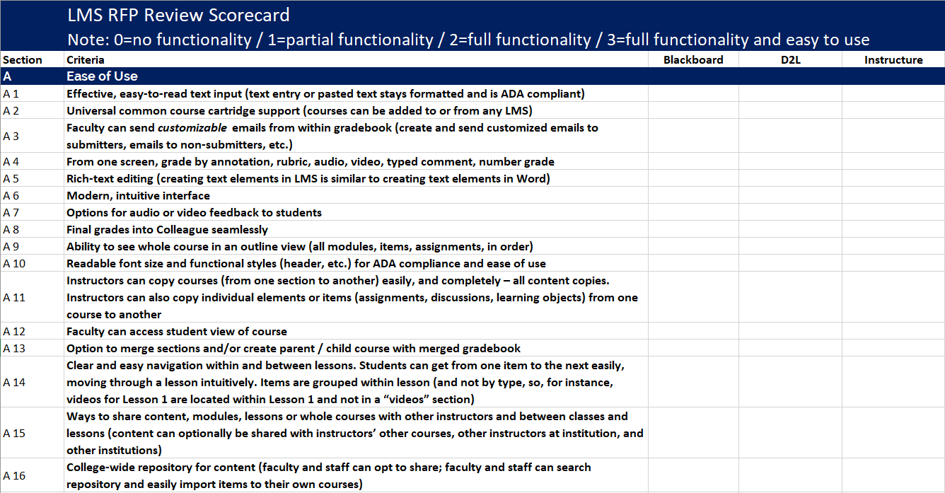
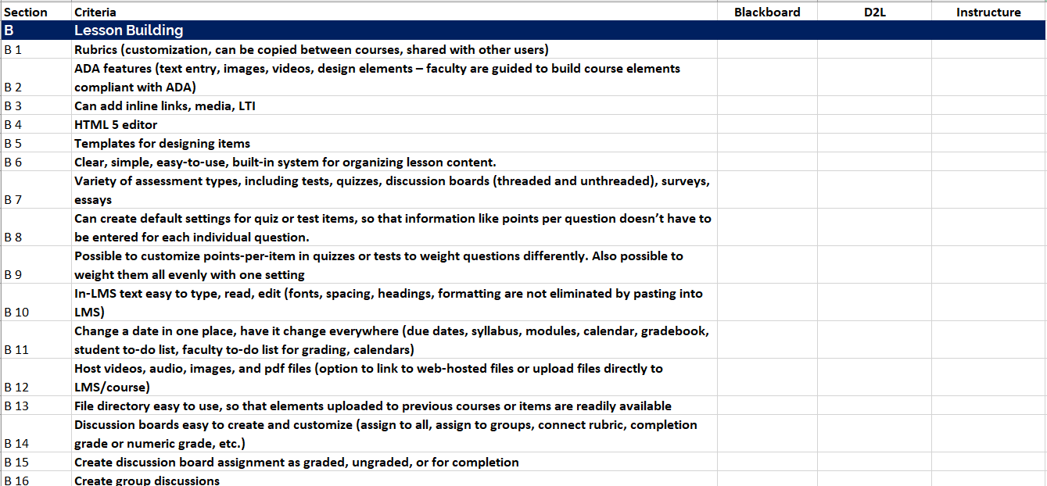
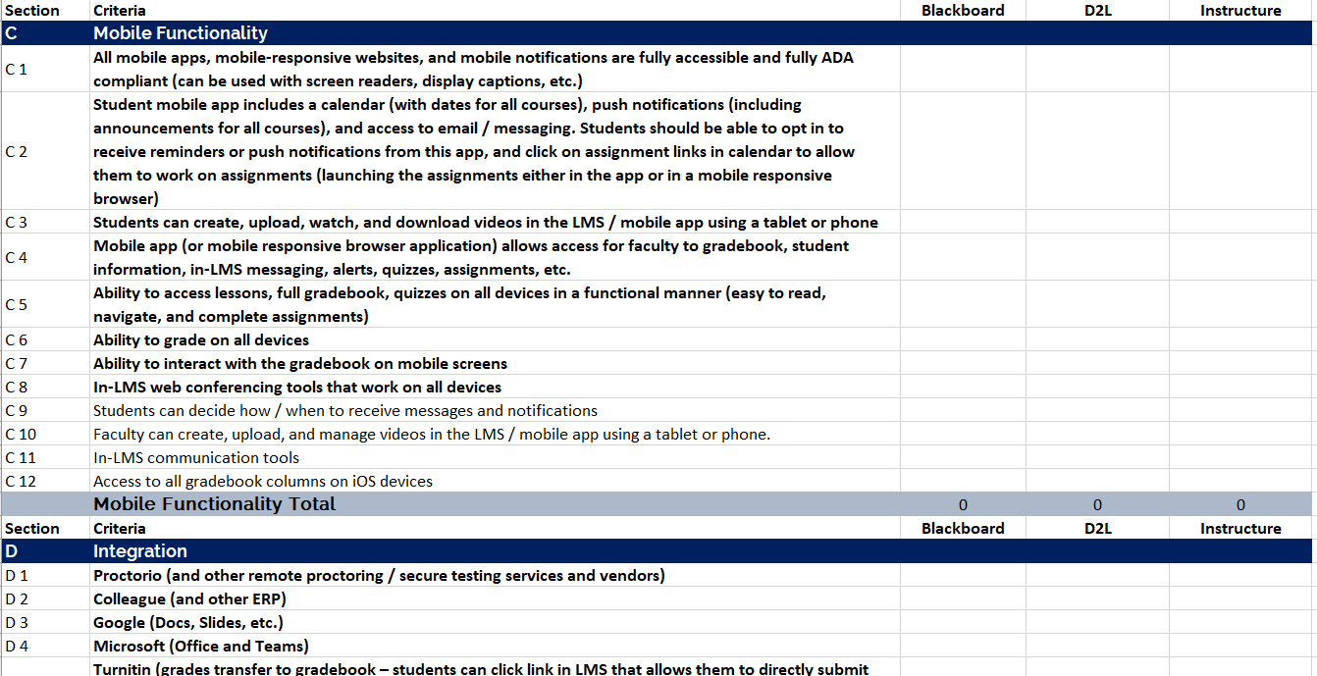
LMS Evaluation
Notes:
Allegra
The functional criteria and non-negotiable criteria documents were used to create scorecard for evaluation team members’ own notetaking during day-long vendor presentations. Each participant asked questions, required vendors to demonstrate usability and functionality, and scored the LMS solutions.
RFP Written Responses read by team
Evaluation team attended 4-hour, in-depth demonstrations for each responding vendor
LMS vendors went through required scenarios and answered questions from team members

Slide 13
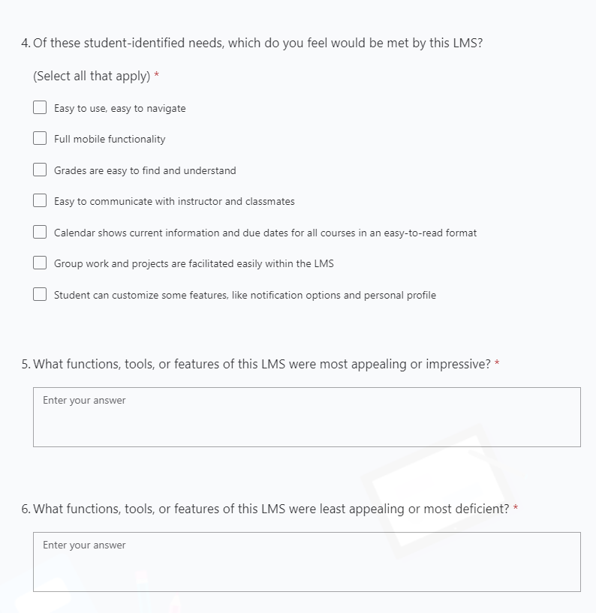
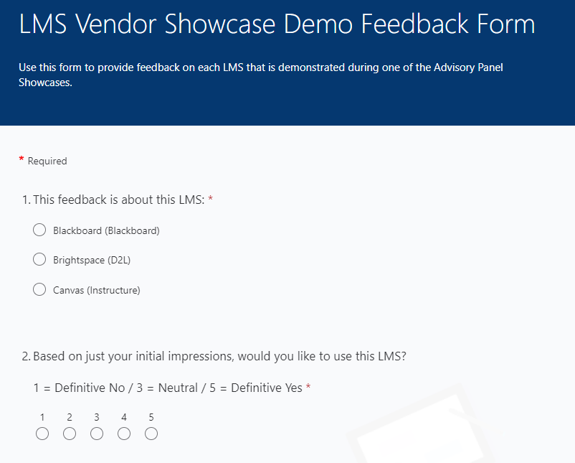
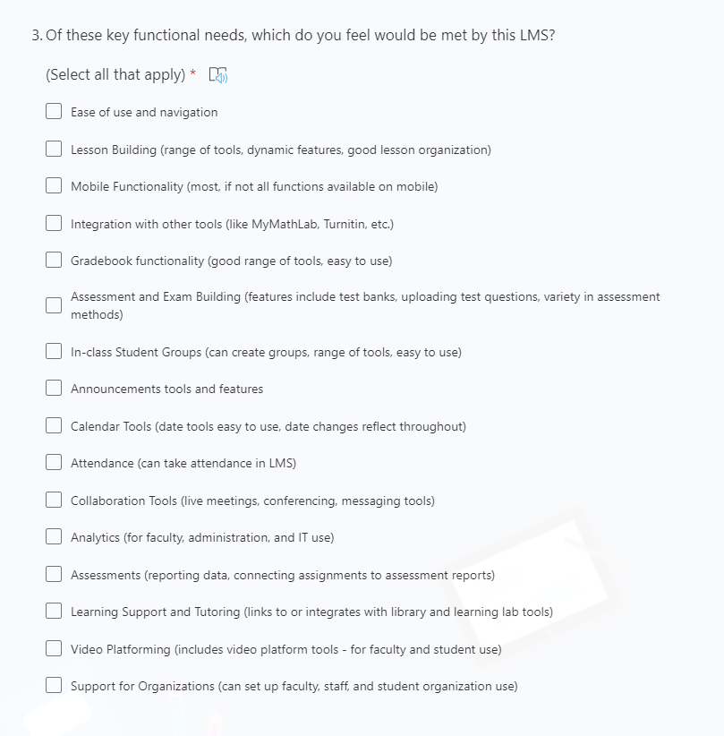
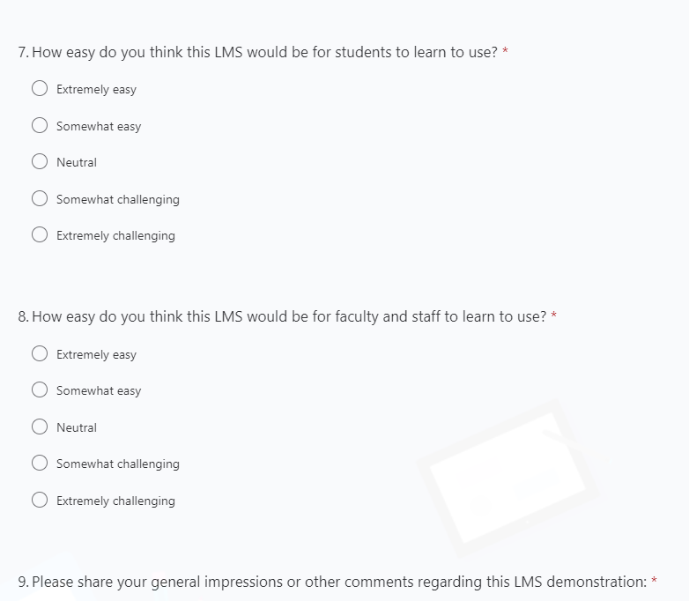
Survey
Notes:
Allegra
All evaluation team members had access to the survey feedback, and had access to the chat comments and questions from the conversations during the Showcase Demonstrations. This qualitative feedback provided input on what functionalities were priorities for attendees.
If asked, total respondents: 107

Slide 14
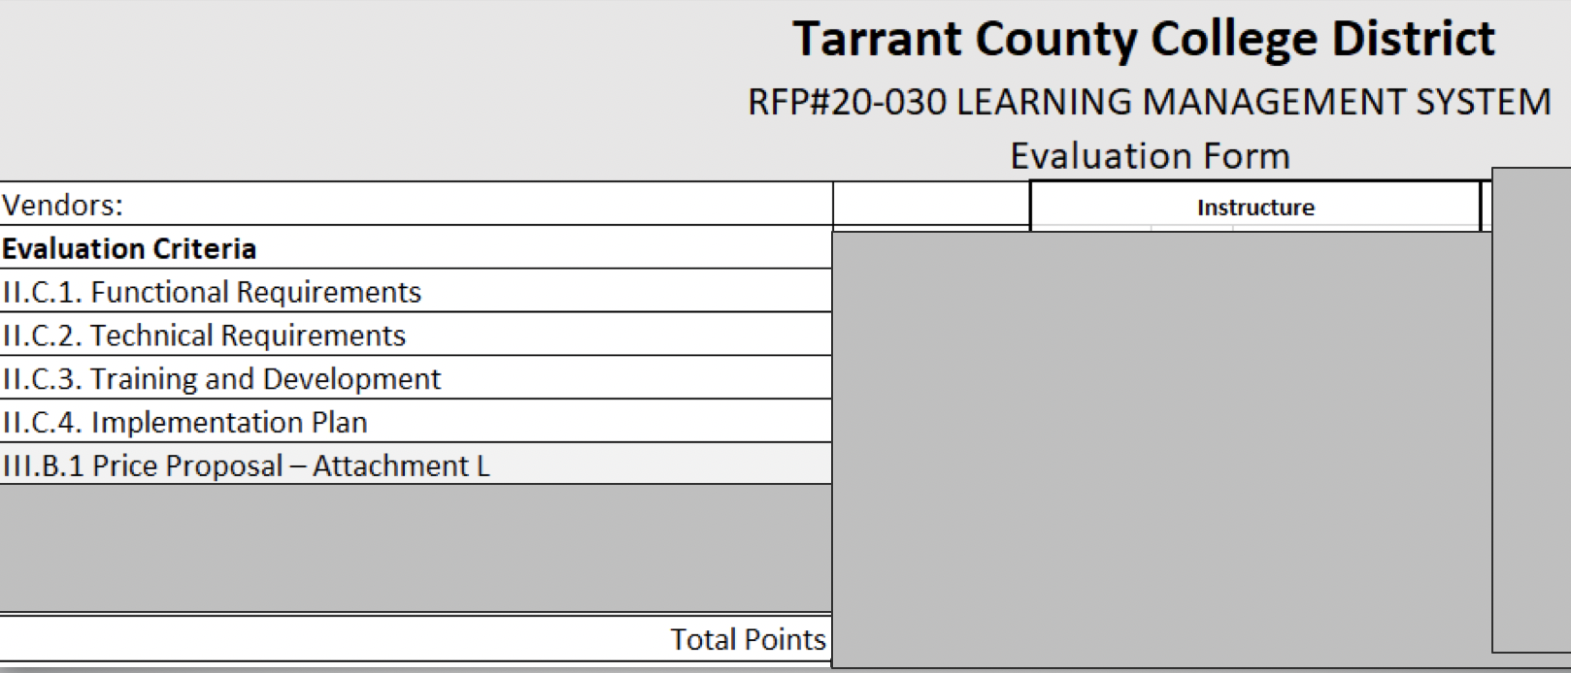
LMS Evaluation
Notes:
Allegra
Scores were submitted to procurement using the official evaluation form, which weighted functional and technical requirements as 55% of the score. The team also ranks the vendors’ plans for training and implementation. Procurement provided tabulation and added scores for pricing and MWBE, using standard process.

Slide 15
Implementation Begins

Slide 16
Next Steps: Now Through November 2020
Procurement Process
Purchase Order
Legal Review
October Board Meeting
Contract Begins
IT Processes Begin
Notes:
Dr. Blankenbaker
This fall, procurement and legal will work on contracting, and the plan is for this to be presented at the October board meeting for final board approval. Only after contracts are final can IT begin their work, since we cannot share data with the LMS vendor until after those contracts are signed and agreed to.
I will be back in November to share the cutover and implementation plan to seek your input on professional development training.

Slide 17
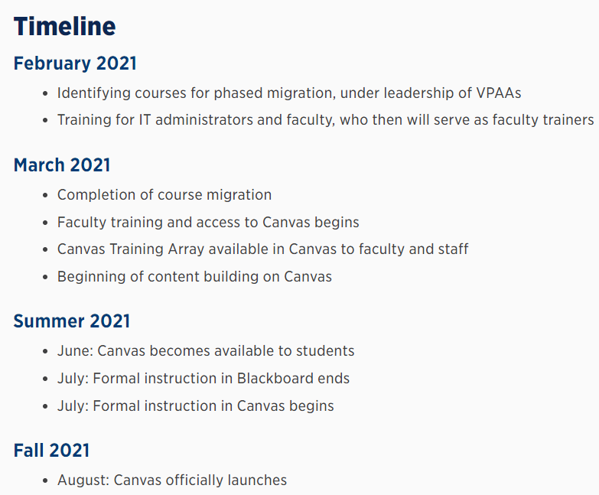
Updates on insideTCC
Notes:
<Caroline Hamilton>
Through insideTCC our TCC community can gain real time information on where we are and where we are going with the Canvas Implementation. The current placement is under the Center for Teaching and Learning umbrella. We have considered that this may not deliver parallel visibility to the ERP project currently underway. I believe there is a desire to increase the visibility to promote easier access for our constituents.

Slide 18
Current TCC Canvas Strategic and Implementation Teams
Strategic Team
Core Team
Communications Team
Training Team
Technical Implementation Team
COO, CTO, 2 Campus Presidents, Director of Academic Tech, Program Manager (plus me!)
IT LMS Team, Project Managers
Director of Academic Tech, Me, IT LMS lead, Communications Lead, Program and Project Managers
Faculty member from each campus, from IDs, CTL
District Communications Team (Plus Director and Academic Tech and me!)
Notes:
<Caroline Hamilton>
We just need a single sentence regarding responsibilities, expected length of time in which team will be active, who is on the team-what Instructure team member works with the team
Strategic Team
Provides overarching thematic guidance through implementation
Members: Susan Alanis, Bob Pacheco, Dr. Caroline Hamilton, Dr. Zarina Blankenbaker, Dr. Carlos Morales, and Victoria Yen
Core Team
Addresses tactical activities and delivers communication to senior leadership and the TCC community
Members: Dr. Caroline Hamilton (Lead), Allegra Davis, Suzanne Groves, Victoria Yen, Jessica Rogers, and Shonda Powell
Communications Team
Develops communication plan and delivers clear and timely communication to TCC community
Members: Suzanne Groves (Lead), Samantha Windschitl, Stephen Fornal, and David Wissore
Training Team
Organizes professional development activities to create a cycle of sustainable training practices.
Members: Allegra Davis (Lead), Sean Foushee, Brian Tatum, Candice Torres, Marlon Mote, April Trafton, Ryan Ferguson, Katherine Smith, David Denny, Stephen Fornal, and CTL members James Gills II, Pradeepika Samaranayake, Shannon Stoker
Technical Implementation Team
Responsible for implementing day-to-day technical tasks per the Implementation Plan as well as for configuring, deploying and testing the Canvas modules.
Members: Jessica Rogers (Lead), Maria Johnson, Shonda Powell, Robert Bauer, Kerry Neal, Robert Gainer, Chase Jowell

Slide 19
Step 4: TRAINING PLAN

Slide 20
Training Model
TtT 3-Day Online Training
10 Faculty Trainers
Trainers Designed Curriculum
Training Required for All Faculty

Slide 21
Live, Online Training: Faculty Trainers
3,500 employees use the LMS (faculty, learning commons staff, administration, SI)
Foundational training (Level 1):
  30 seats per session
  3-hour sessions
  Up to 120 sessions
  360 training hours + 60 prep hours=420 hours
Advanced faculty training (Level 2):
  30 seats per session
  2-hour sessions
  Up to 50 sessions
  100 training hours + 25 prep hours=125 hours
By Session
170 total sessions (Level 1 + Level 2)
10 faculty trainers
Each lead 15-20 total sessions from March – July
By Stipend Hour
545 total hours
Each faculty would have up to 60 stipend hours
Notes:
<Allegra Davis>
Foundational training sessions are for any TCC employee who would be LMS users (faculty and learning support staff).
Advanced faculty sessions are more in-depth sessions with examples and recommendations.
These sessions will all be led by the Canvas-trained TCC faculty trainers who will be stipended for the hours they spend preparing for and delivering live training sessions.
Following the Full-Time Credit Faculty Stipend Pay Schedule process, the stipend form (the same form used for summer advisory panel stipends) will be submitted to the training administrator, and then to campus deans for final approval and processing.

Slide 22
Step 5: TRAINING ARRAY

Slide 23
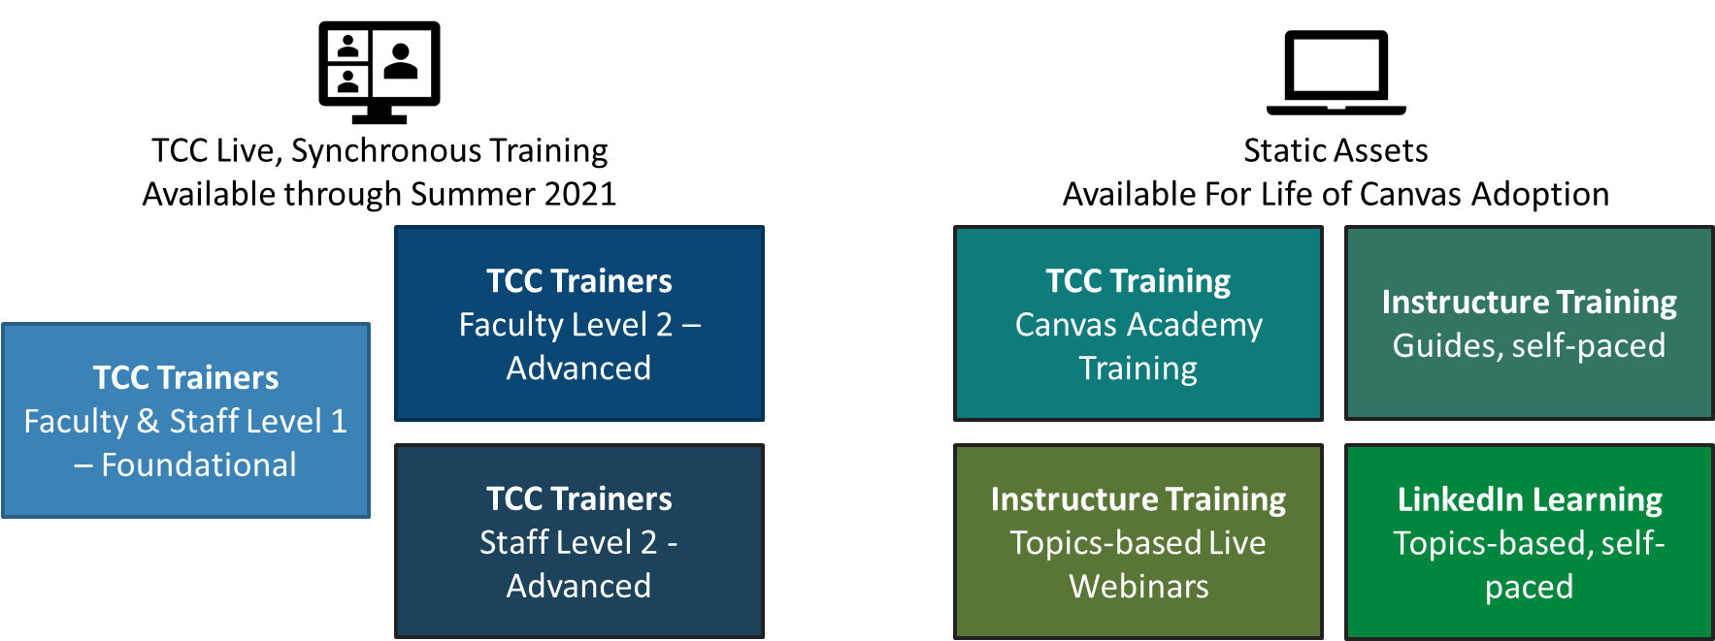
Canvas Training Array Overview
Notes:
<Allegra Davis>
Constructed by the IILE Canvas Training Focus Team, this Training Array is built as a course in Canvas. All TCC users will have this course in their Canvas dashboard. It will include
Template for Canvas Homepage
Template for Square One Student Course Orientation module
Sample Module
Information on Live, Online Training sessions
Guides, Videos, and Resources from Canvas (Community, videos, etc.)
TCC Canvas Academy Training (CAT)
Additional resources (for example, LinkedIn Learning)

Slide 24
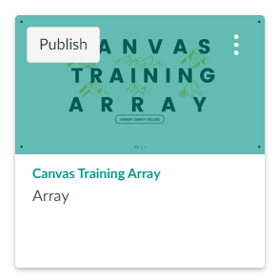
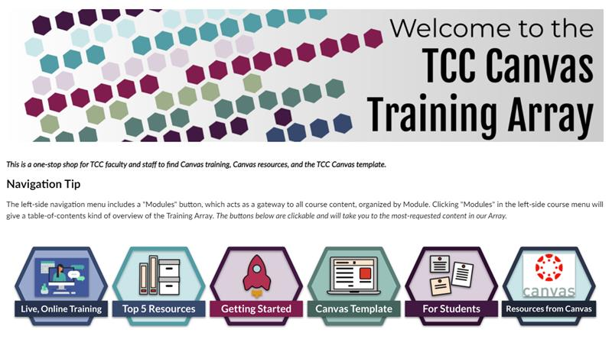
TCC Training Array in Canvas
Notes:
<Allegra Davis>
All faculty and LMS-using staff will have access to this TCC training array when Canvas becomes available.

Slide 25
WHY IT’S WORKING

Slide 26
WE WERE INTENTIONAL (and lucky)
Add-Ons
Size
Experience
- Change management and training support included on the contract
- VPS and ePortfolio tool involved Academic Affairs
- 6K courses converted (which is fewer than the number of sections offered in a semester)
- 2 LMS team members working on Canvas
- Contractors to handle Blackboard and Help Desk
- Contract additional ID support
- ID Team
- eLearning campus
- College poised to initiate strategic projects
- Listen to (and sometimes ignore) people who were here last time we changed our LMS

Slide 27
WE KEPT THREE THINGS IN MIND
TEACHING
INFORMATION
SHARING
PARTNERSHIPS
- Faculty in leadership role on every team
– Functional criteria document at the center of all decision making
- Faculty and student needs in training assessed
- Presentations to Chancellor, campus leaders, faculty associations, Academic Council
- Canvas Countdown site for months before the launch
- Open channels with all campuses through each team
- IT
- CTL
- Connect Campus
- Campus Presidents
- Learning Commons
- Faculty Association
- Assessment
- Procurement

Slide 28
PROJECT MANAGEMENT
RESPONSIBLE
Identifying who does the work (individuals or teams)
ACCOUNTABLE
Identifying who delegates and reviews – one per task
R
A
Asked for input, invited to discussions and ad hoc meetings
CONSULTED
Kept updated on big changes
INFORMED
I
C

Slide 29
DANGER ZONES

Slide 30

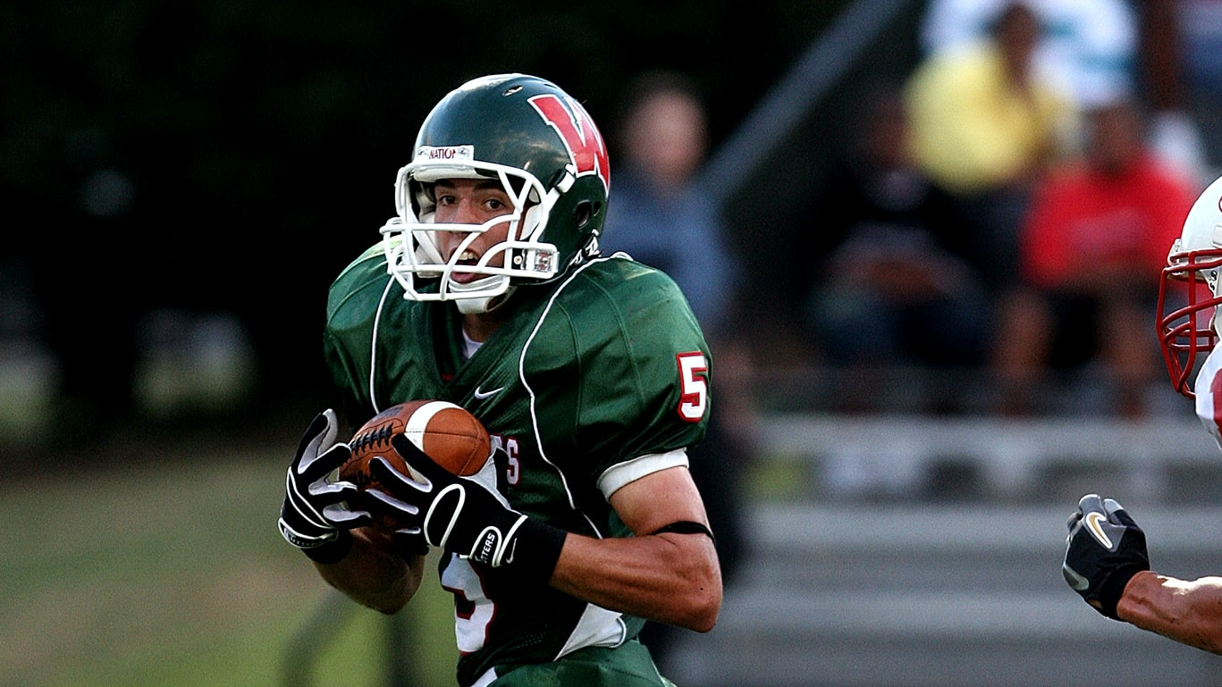
Lots of people want to coach, advise, cheer, and boo…
Who is carrying the ball?

Slide 31
HAZARDOUS
(NO MATTER WHAT YOU DO)
Communication
Change
Management
All the Chefs
- Never enough
– Never soon enough
- No matter what, people will “not know what’s going on!!!!!!!”
- 10/80/10
- Too fast
- Too slow
- Anxiety and hand-holding
- Lots of people are the experts
- Lots of people “should have been involved sooner”
- Lots of people have lots of reasons they need access sooner

Slide 32
Advice for working with Them:
Always give them something to do
Always give them someone to ask
Involve them
(in big or small ways)

Slide 33
QUESTIONS

Slide 34
allegrahanna.com

