Slide 1

Hit Record: Audio and Video Lectures, Lessons, and Assignments
Presented by:
Dr. Cristina Martinez Sullivan, Dr. Brian Cervantez, and Allegra Davis Hanna
Tarrant County College

Slide 2
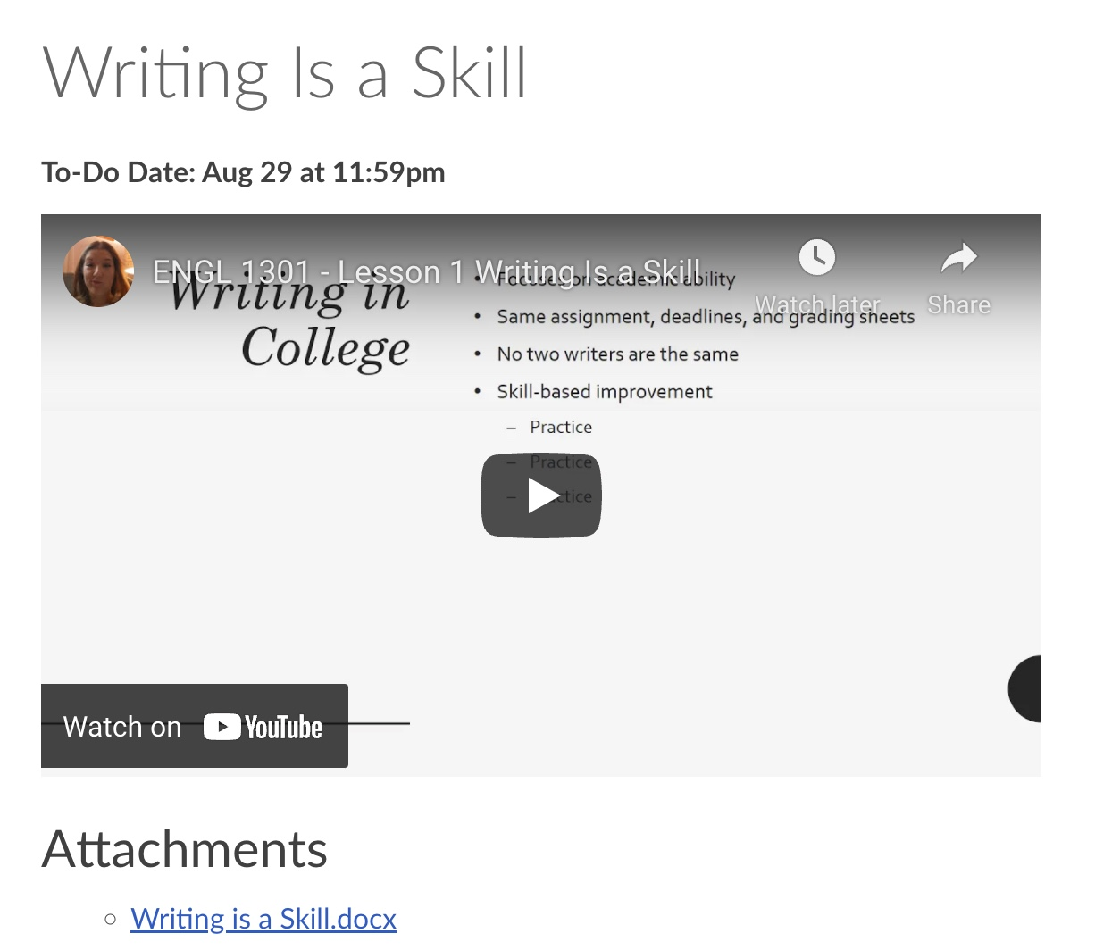

Variety and Equity
Multiple means to access information addresses:
- Learner preference
- Reading fatigue
- Student isolation / distance
- Student’s feeling that they are “teaching themselves”

Slide 3

What to make
Instruction
  Lesson Intros
  Mini-lectures
  Announcements
Create Presence
  Instructor Welcome
  Course Walkthrough
Unique Experiences
  Interviews
  Tours
  Expert Advice
  Demonstrations

Slide 4
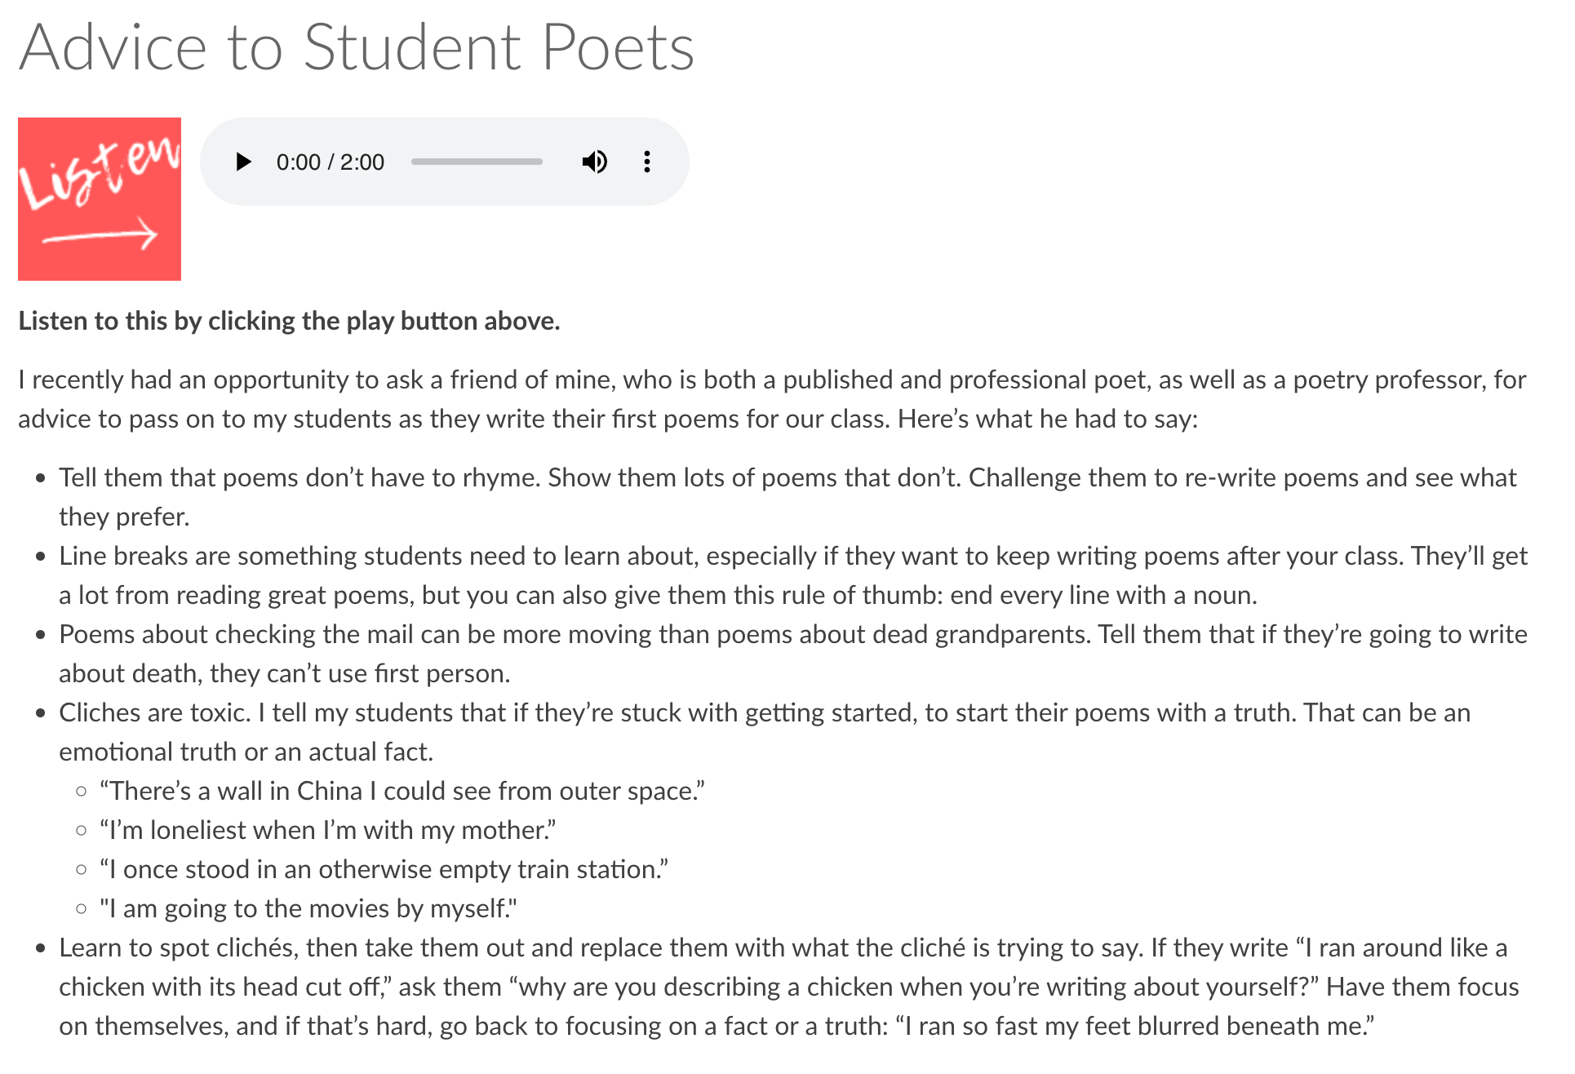
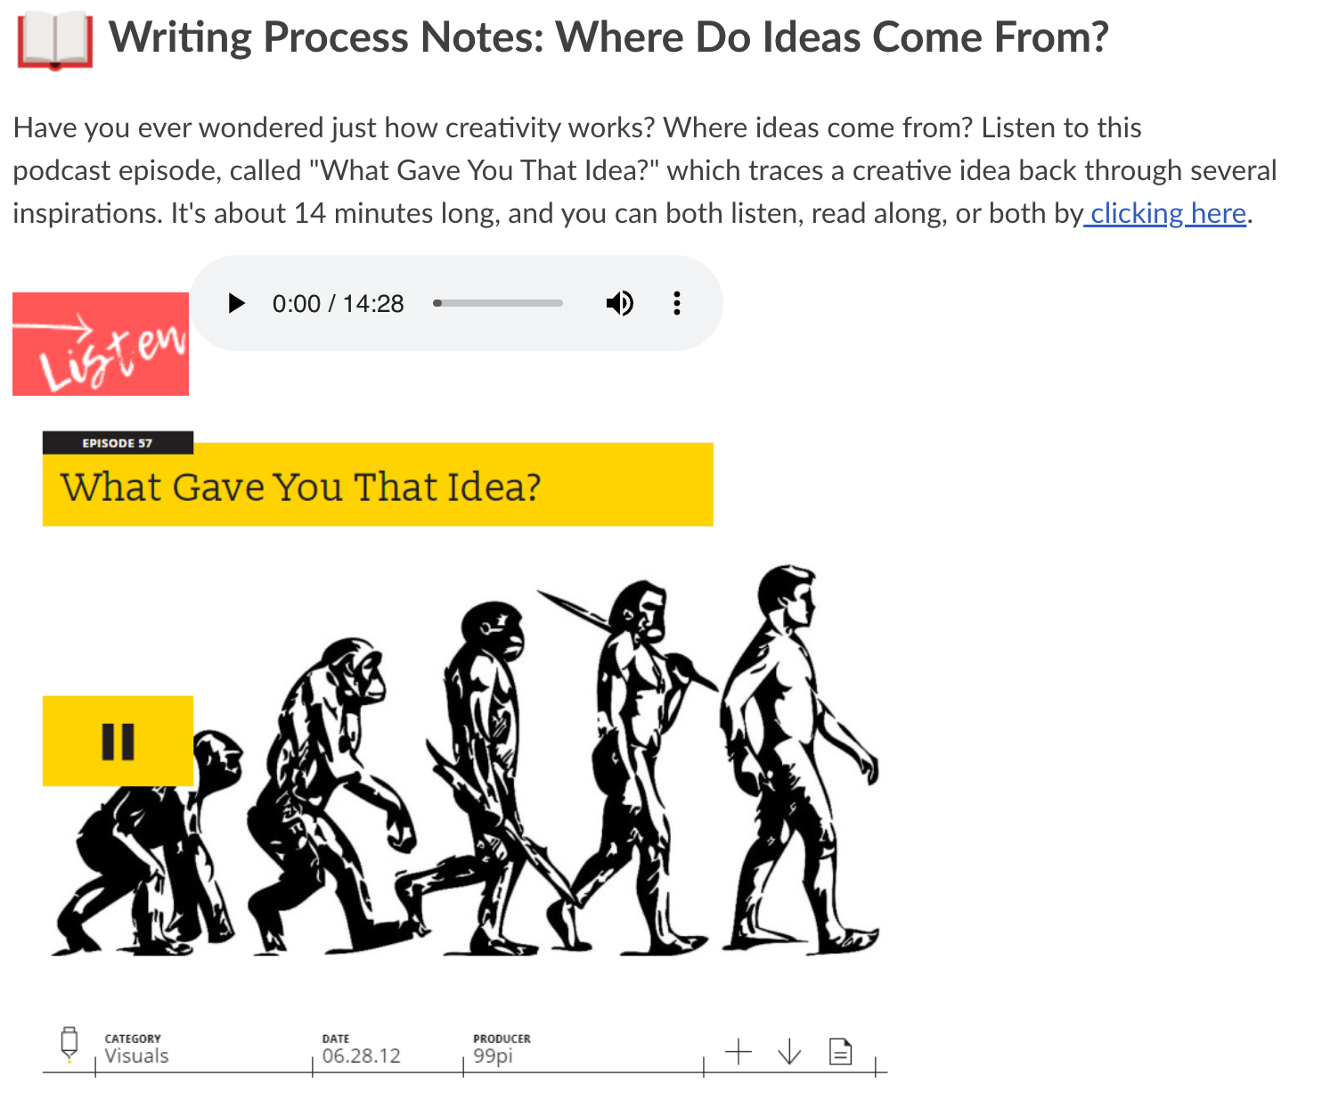
Audio content

Slide 5
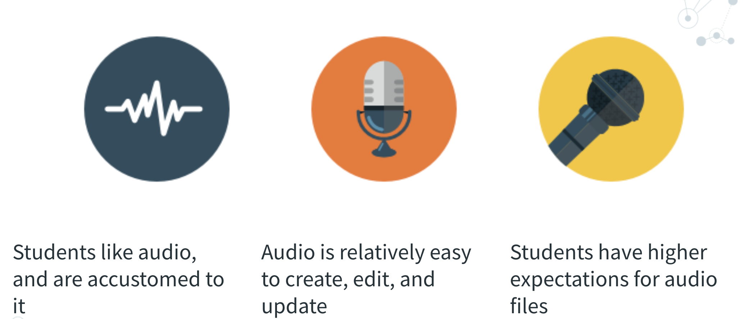
Engaging Audio Content

Slide 6

Audio and video assignments

Slide 7
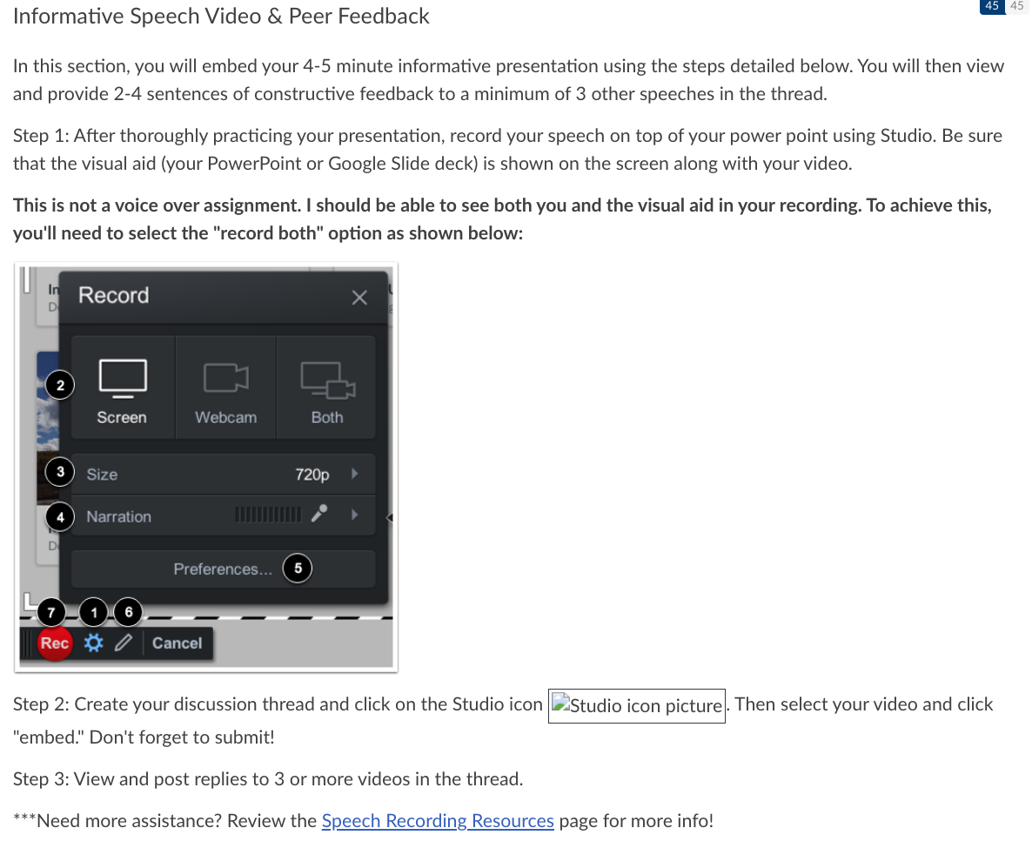
Audio and video assignments
- Public speaking and communication students uploading speeches and presentations
- Students can record using laptops or cell phones
- Video discussions, group projects, alternative essays
- Skip proctors with “math explainer” videos

Slide 8

Student voice through audio and video assignments
Practice and Revision
Self-reflection
Peer review
Refining Voice

Slide 9
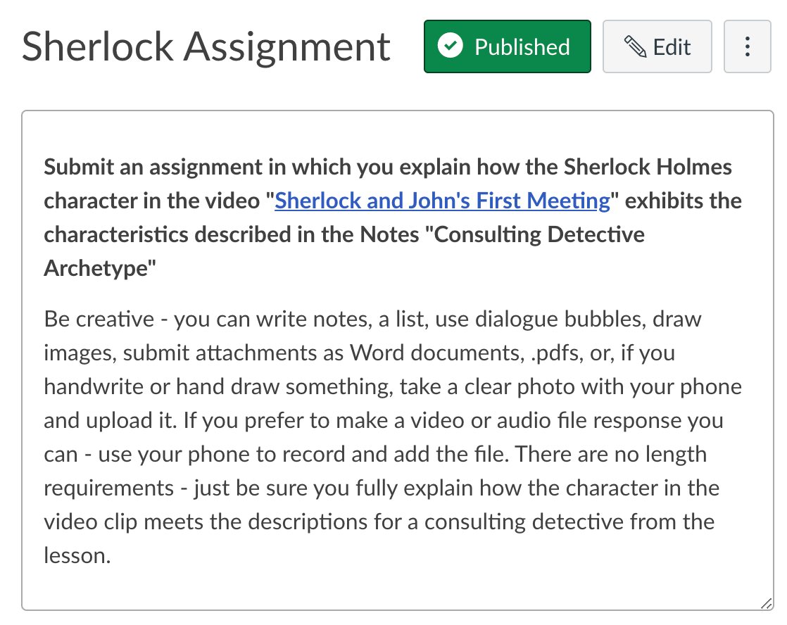
Student choice assignments
Focus on lesson and assignment objectives
Give students option on form of submission
Provide help or clear instructions

Slide 10

Podcast projects and other ways to show mastery
Students find podcast episodes related to topics covered in the class and do a review or analysis assignment
Students create mini-podcasts individually or in groups and submit via LMS or VPS
Podcast project as an “alternative essay” for a major assignment
Pro tip: Teach students about transcripts and accessibility

Slide 11
Fix grading
- You don’t need proctoring for video and audio submissions
- You have less reading and more variety
- Rubrics and assessment are based on standards specific to the lesson objectives, instead of formatting and grammar

Slide 12

Advice, technology, and helping faculty

Slide 13
What Makes a Good video?
- Simple and conversational
- Short and focused
- Clear audio
- Slides and visual aids
- Preparing a script
Better videos and easy transcripts!

Slide 14
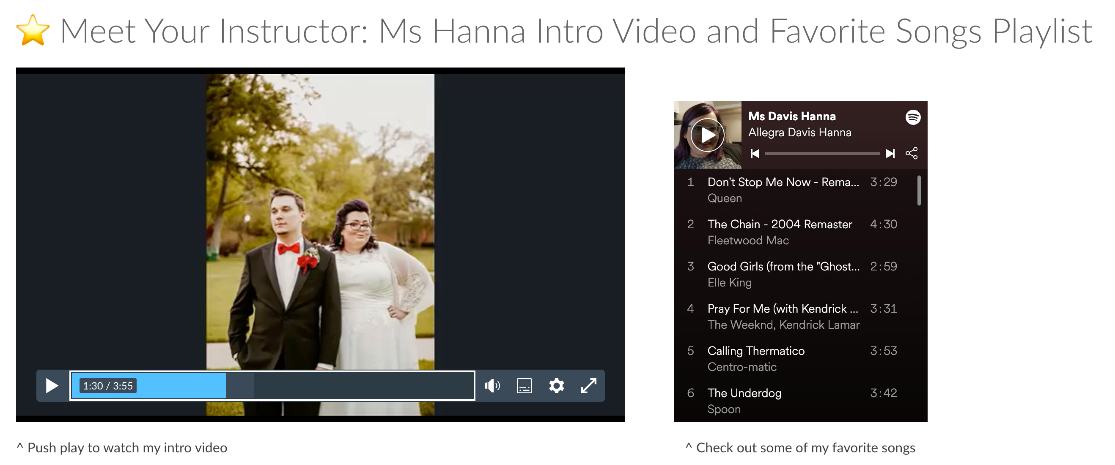
Be extra

Slide 15
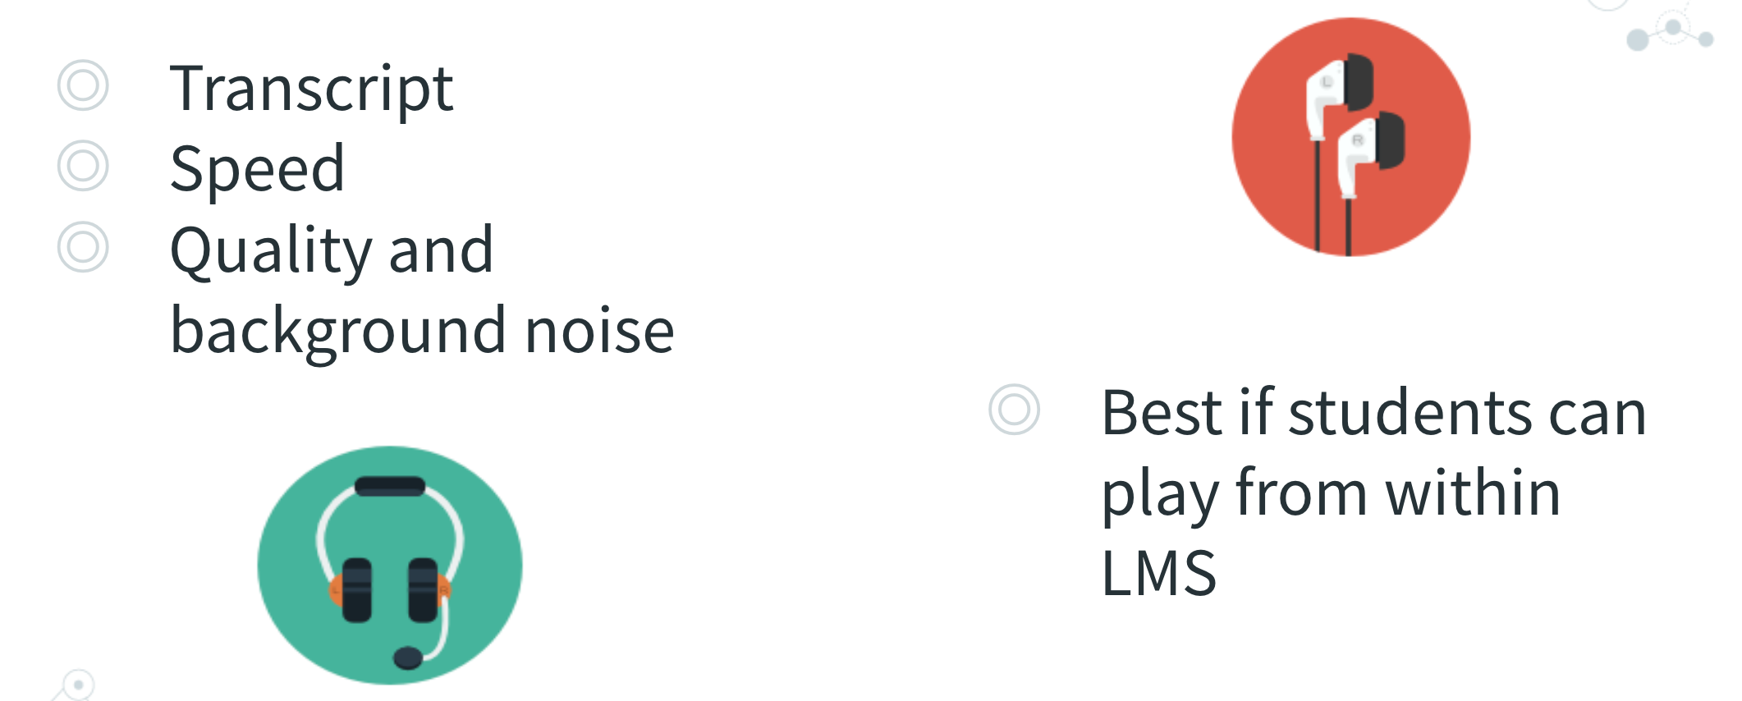
Accessibility in audio and video

Slide 16
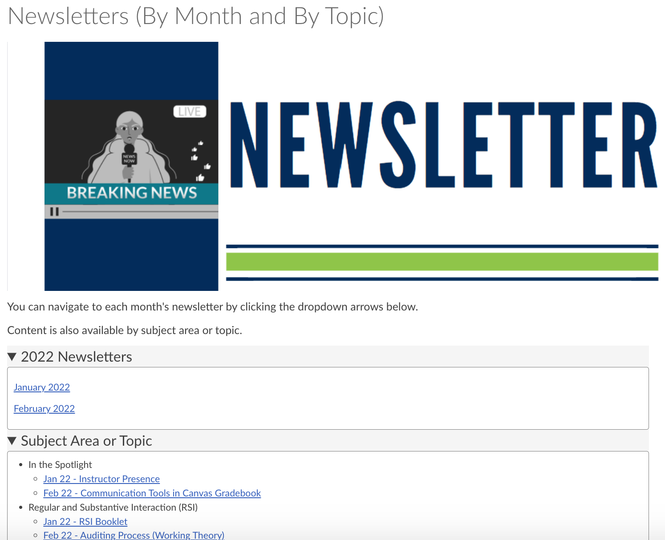
Leveraging IDs to help faculty
Trainings
Newsletter
PDC
Office hours
Team email address
Cross training

Slide 17



Resources for audio and video
Snagit
Canva
Vimeo
Youtube
Canvas Community
Hardware

Slide 18

Presentation materials
allegrahanna.com

