Slide 1



Student Choice Assignments
Community College Summit | OLC Innovate
April 2022
allegrahanna.com

Slide 2

About our Campus
Spring 2022 headcount: 15,584
Spring 2020 headcount: 12,372
Fully online campus with:
  21 FT faculty dedicated to online teaching
  FT faculty from F2F teaching up to 2 online sections
  6 Department Chairs
  6 Instructional Designers
  1 Dean & 3 Assistant Deans
Required OIC
Robust PD offerings for online faculty

Slide 3
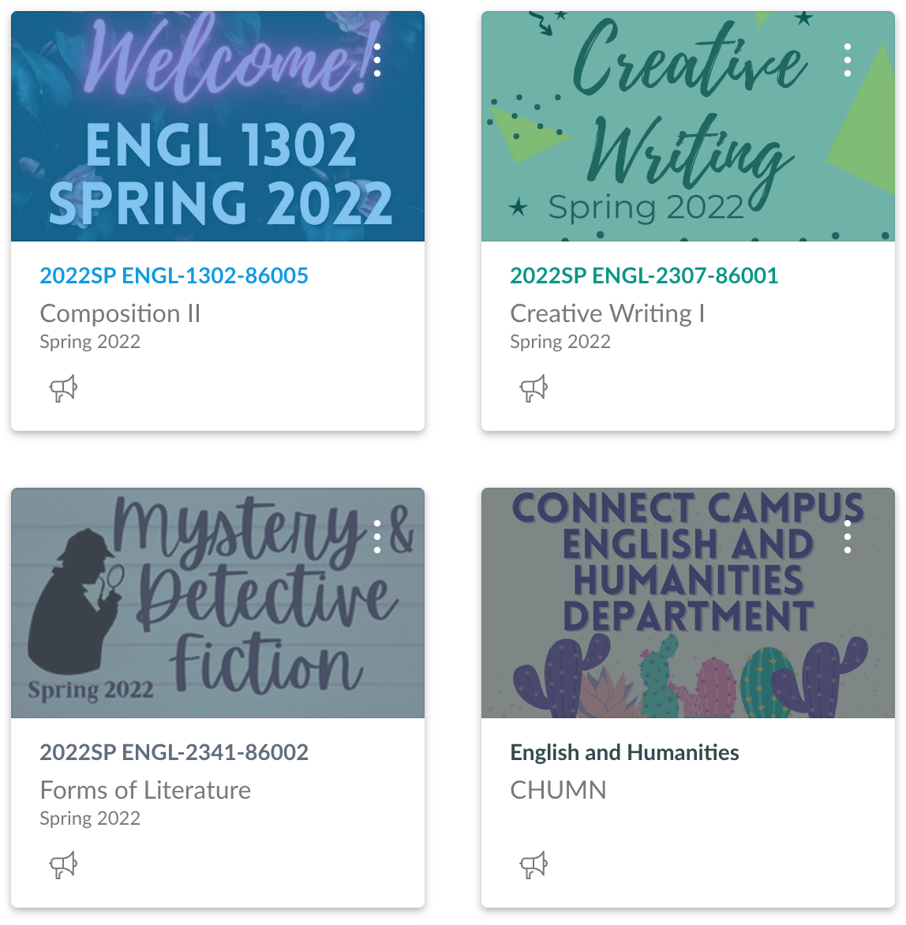
About English Courses at TCC Connect
ENGL 1301, ENGL 1302, and ENGL 2311 (Composition 1, Composition 2, and Technical Writing):
  Use “Peer Developed Courses” – Master courses built by faculty teams
  Allow faculty to add content, customize content, and modify assignments
Literature Courses and Intro to Creative Writing
  Built by faculty who teach the courses
Faculty learn about instructor presence and best practices in initial certification and in ongoing efforts like faculty conferences and webinars

Slide 4
Choice Assignments
Focus on the objectives​
They choose: Students can submit Word documents, videos, audio files, slide sets, or photos of handwritten / hand-drawn documents​
Students must include certain elements, or answer certain questions to ensure all assignments show mastery ​

Slide 5
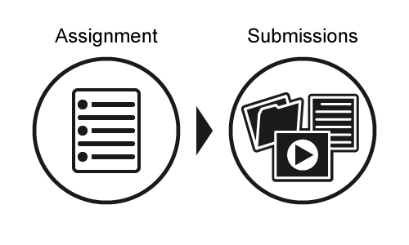
To remember:
Students tend to be more motivated when they choose the task
3-5 choices is best
Give students a “basic” option and creative options
UDL’s “designing for the margins” principle

Slide 6
What Do the Assignments Look Like?
Link to assignment instructions: Book Preview​
Link to assignment instructions: Consulting Detective

Slide 7
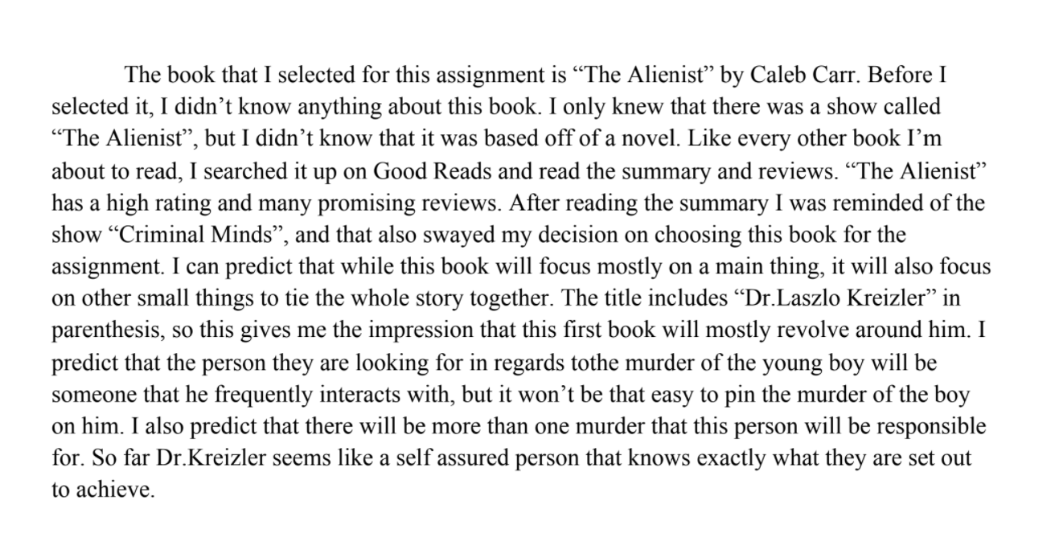
A Text Submission: Book Preview

Slide 8
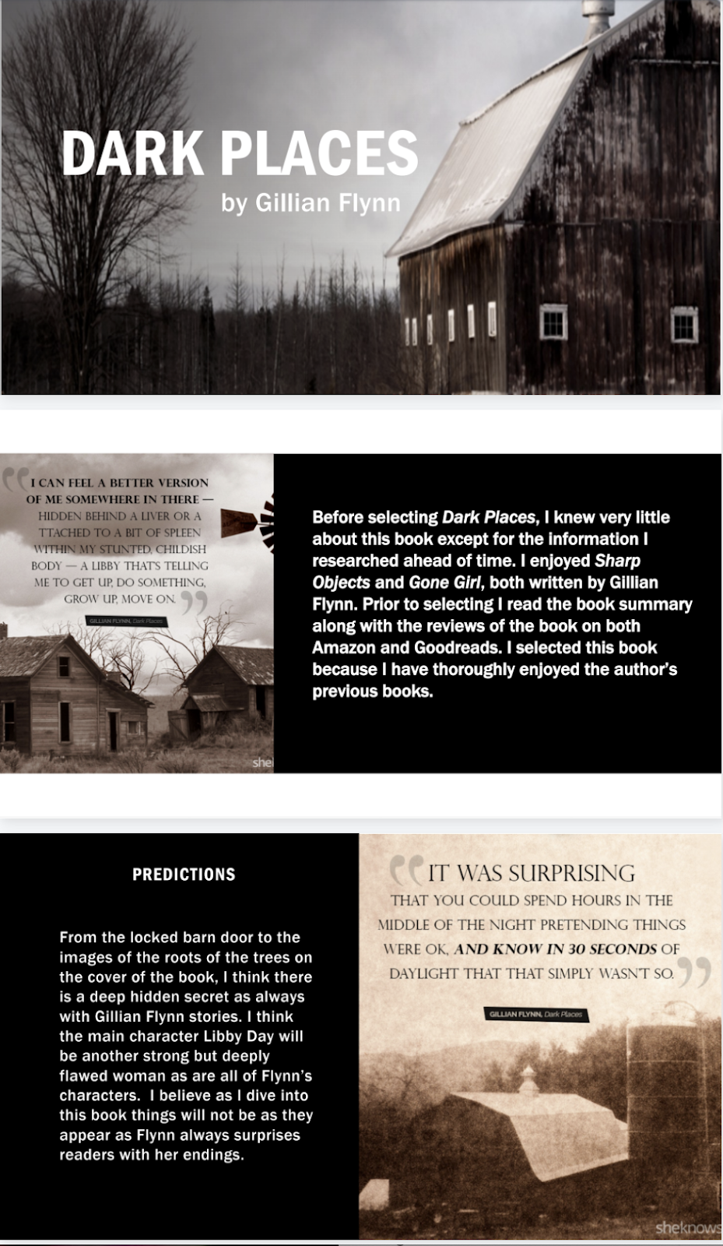


Other Submissions: Book Preview

Slide 9
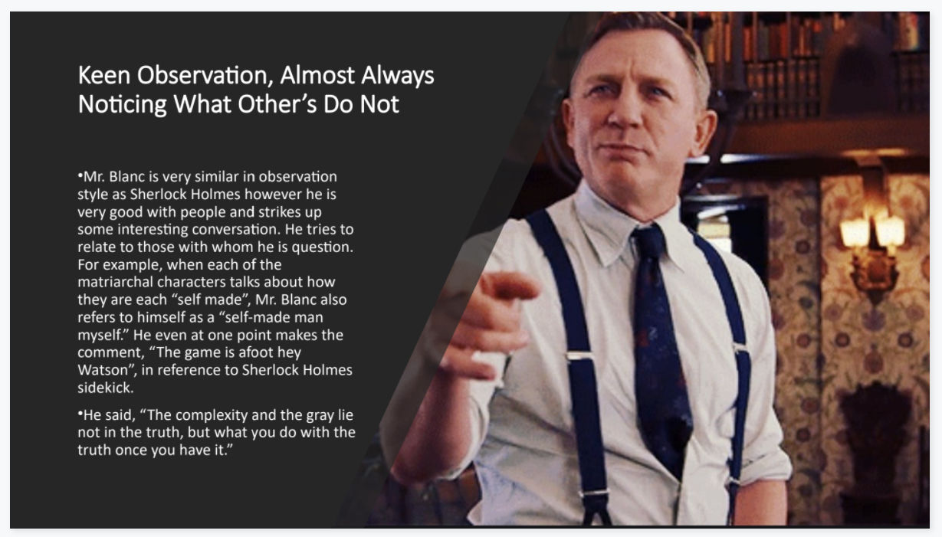
Consulting Detective Project Examples

Slide 10
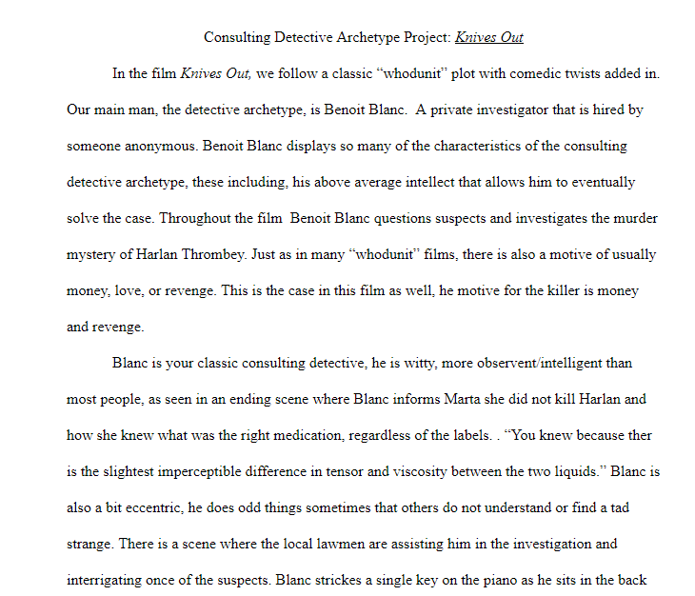
Text examples

Slide 11
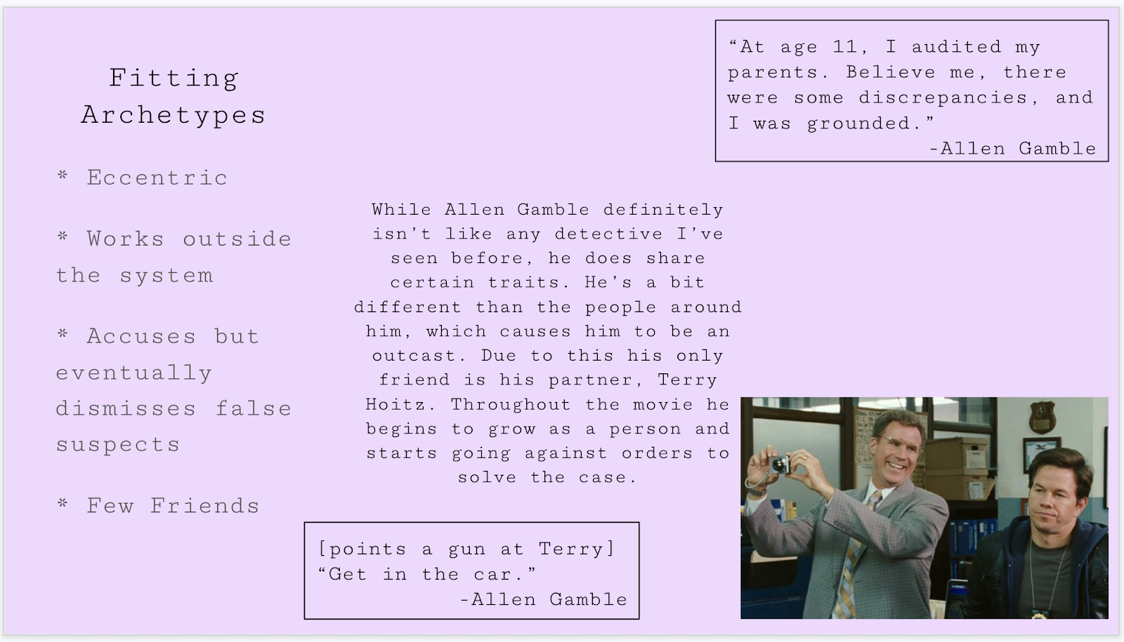
Other Submissions: Consulting Detective Project

Slide 12
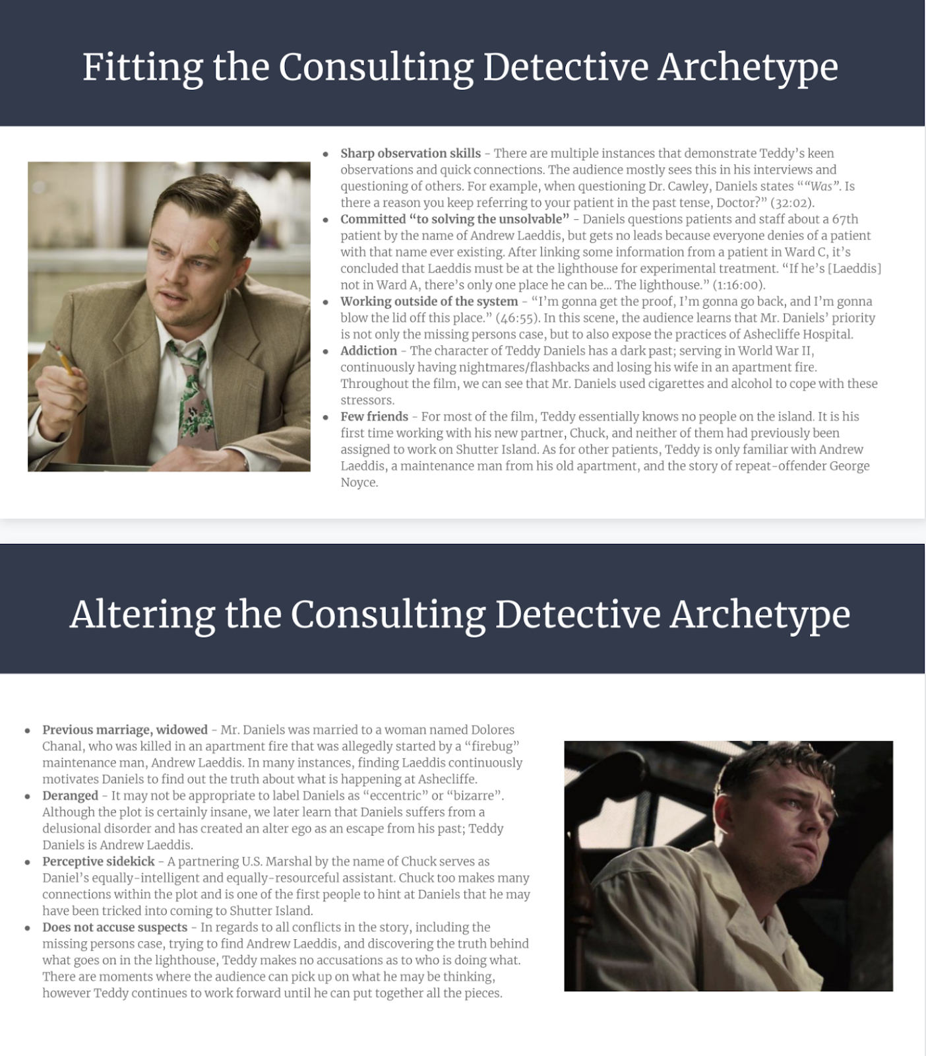

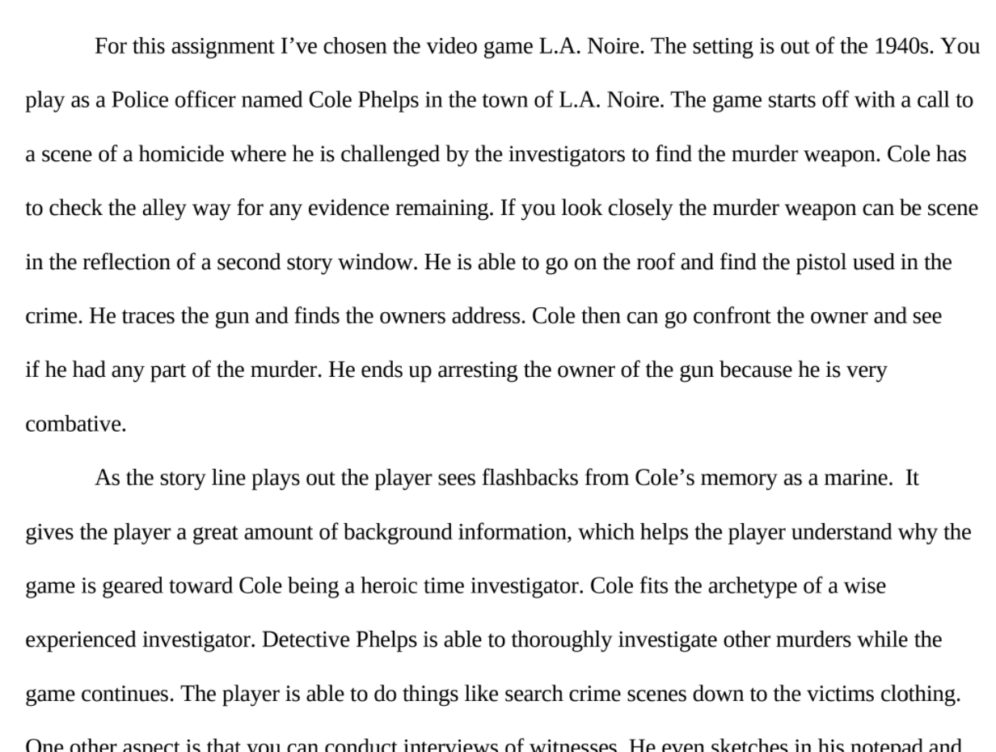
More examples

Slide 13
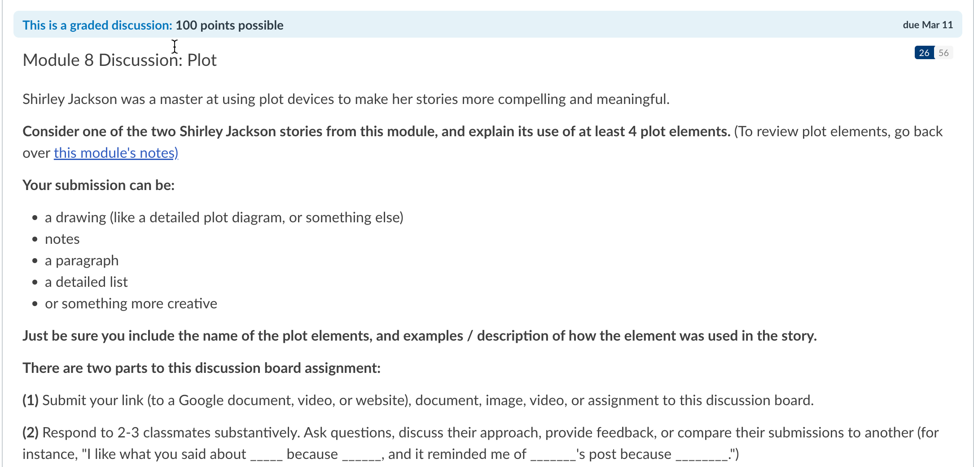
Discussion Prompt

Slide 14
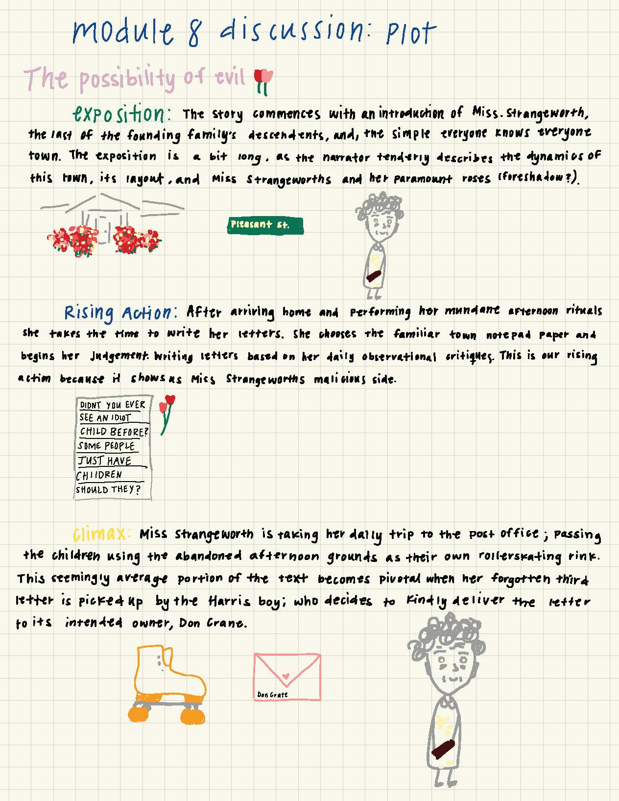
Discussions as Choice Assignments

Slide 15
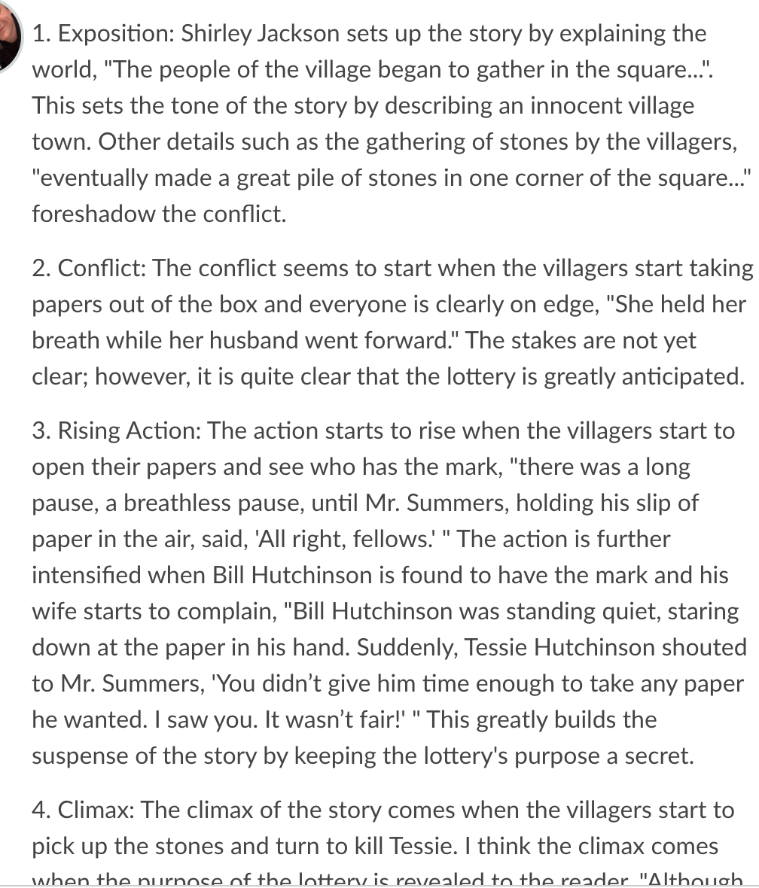
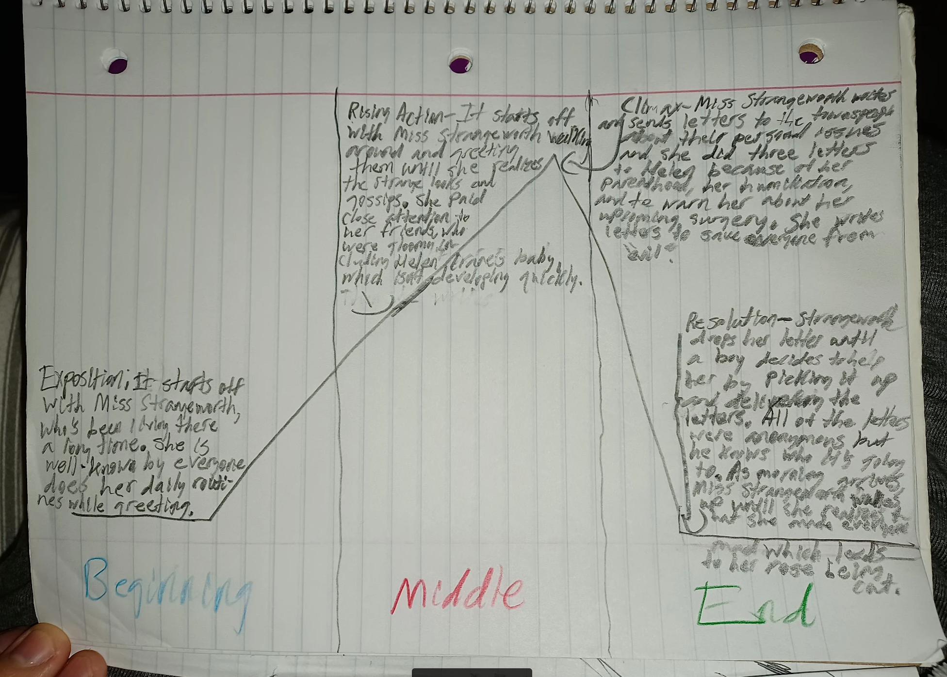
Discussion Posts

Slide 16

Why? Multiple Means of Expression
Design for the Margins
  Disabilities, cultural differences, and even past experiences can shape how students prefer to learn and demonstrate that learning, and UDL suggests that we address these preferences by designing for the margins.
Every person learns (and prefers to showcase that learning) in a slightly different way.
Thus, instead of designing with this average student in mind, we need to plan for the idea that there will be differences in learning between students and focus design decisions on the needs of those at the margins of “normal.”
When you do this, you also meet the needs of those between those margins.

Slide 17
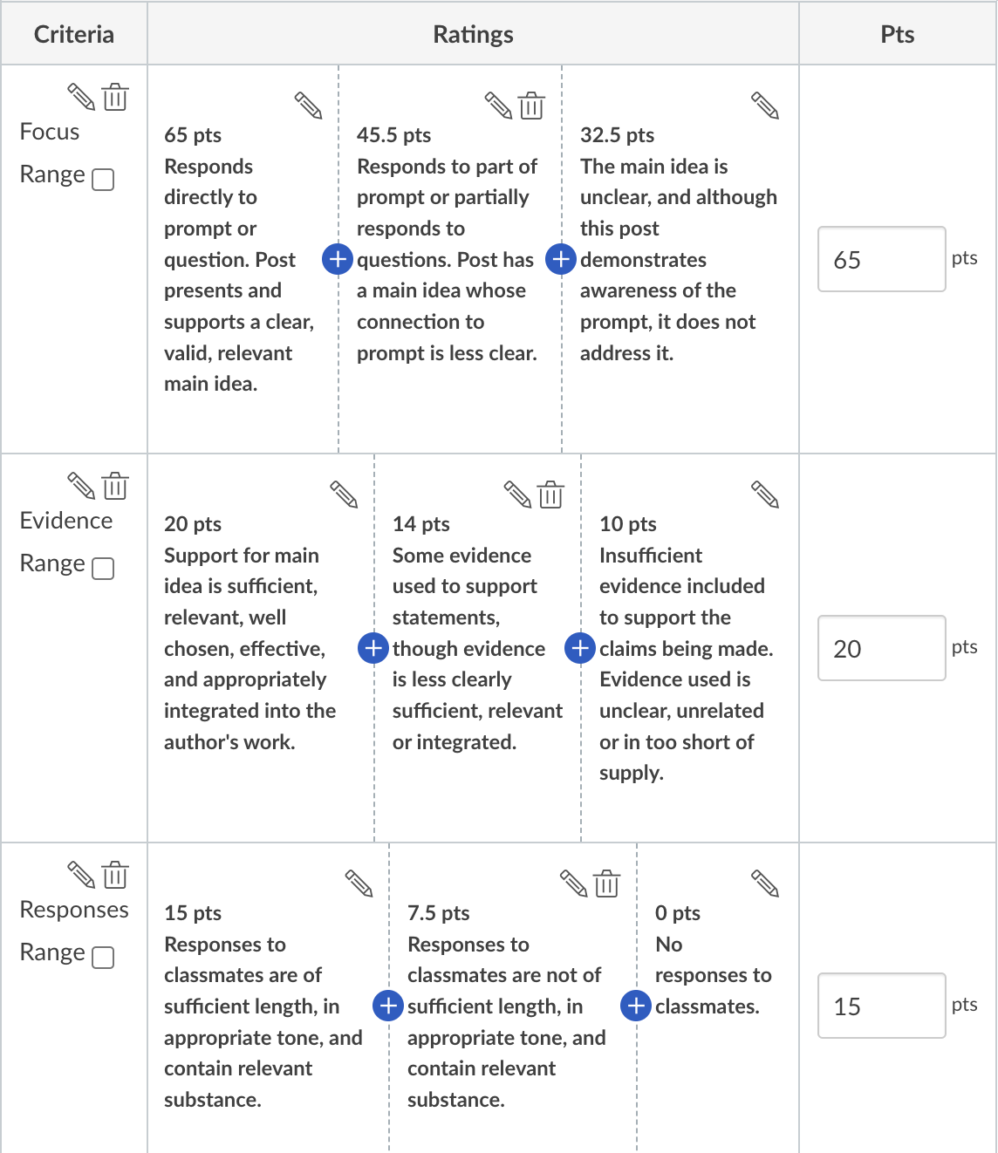
How to Grade?
Take medium-specific language out of rubric
Avoid words like “write” or “punctuation”

Slide 18



Ideas from Other Disciplines
Math: Submit handwritten, audio or video explaining how you solved a problem
Science: Photos, videos, or recordings explaining a concept or doing an experiment
Social Sciences: Replace tradition discussions with choice options or allow videos, slides, or audio instead of journal entries

Slide 19


Who has the first question?

