Slide 1



Oh, I See: Online Instructor Certification, and Online Faculty Development
Presented by:
Allegra Davis Hanna, Humanities Department Chair
Dr. Cristina Martinez Sullivan, Dean of Everything
Tarrant County College Connect Campus

Slide 2
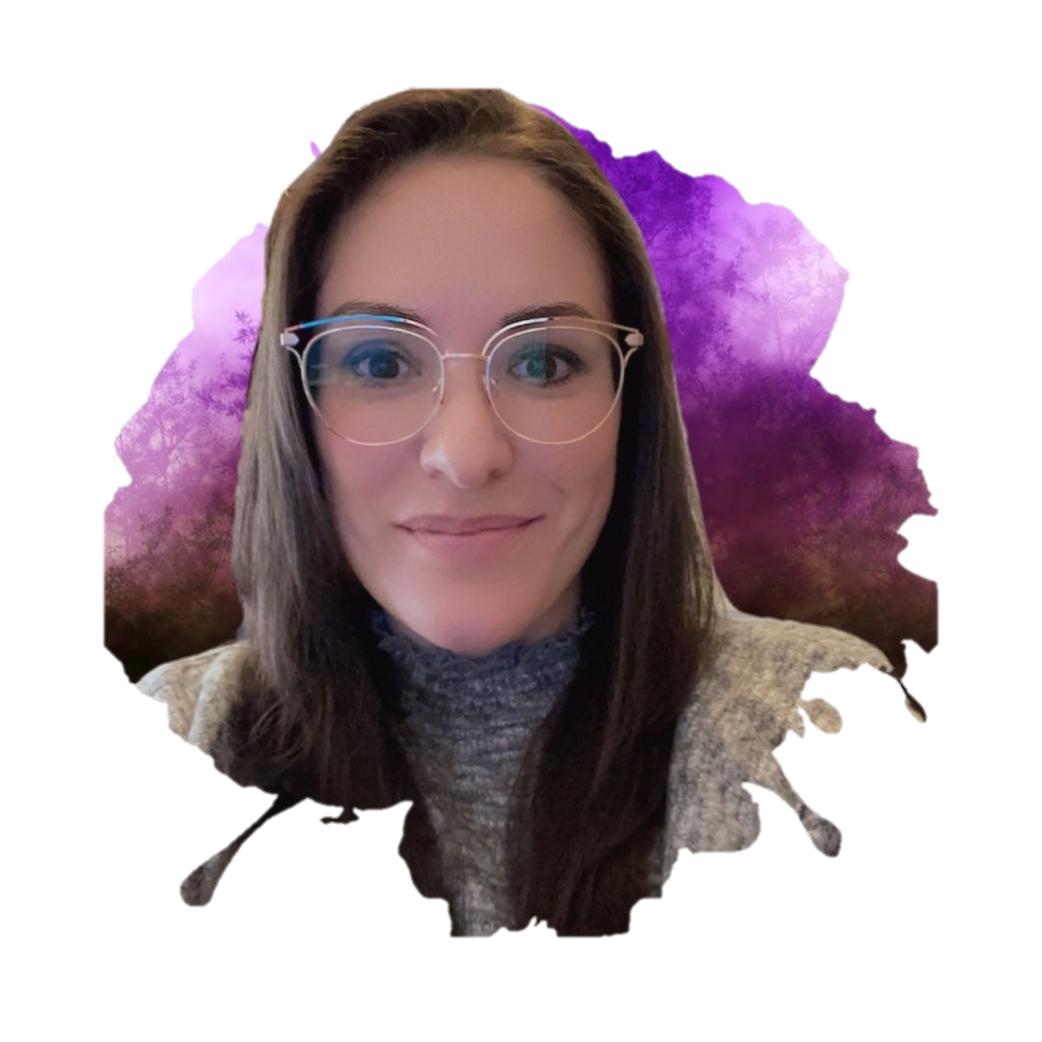
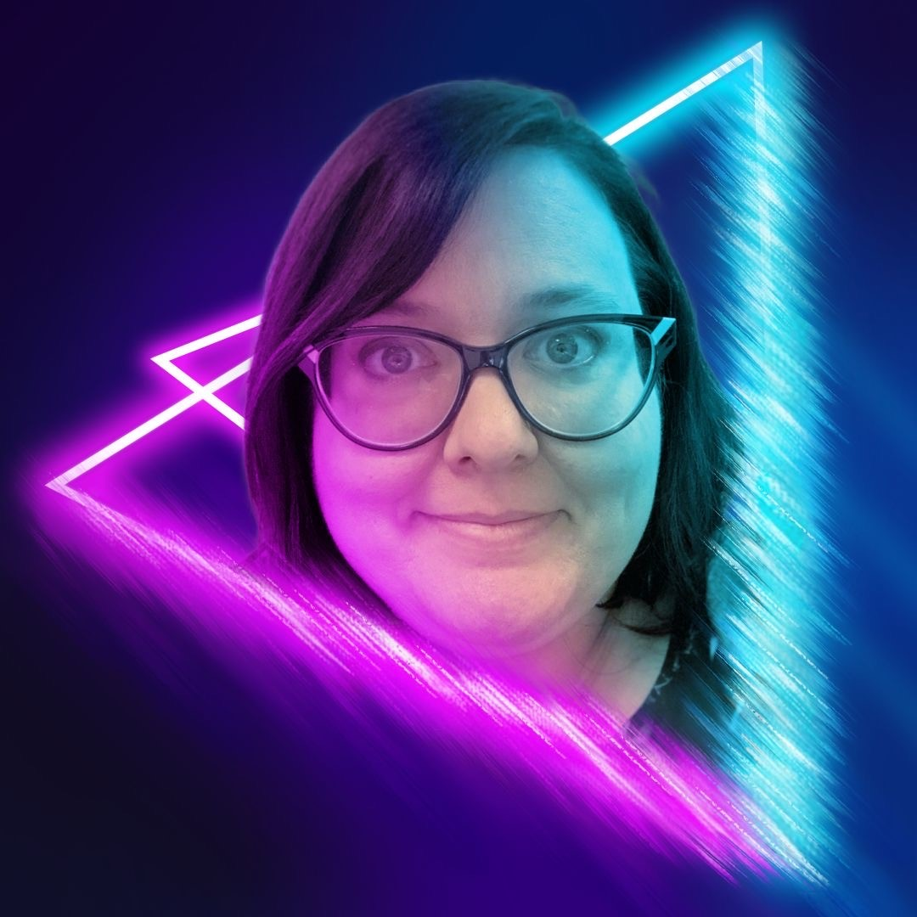
Presenters

Slide 3
Do your faculty go through training or certification to teach online?
More consistent courses
More control of training materials
Faculty build content during training
Certification and required re-certification
Institution-created online training
Easier for institution
Fewer barriers for faculty
Faster onboarding
External training certificate
LMS basics only
No training

Slide 4
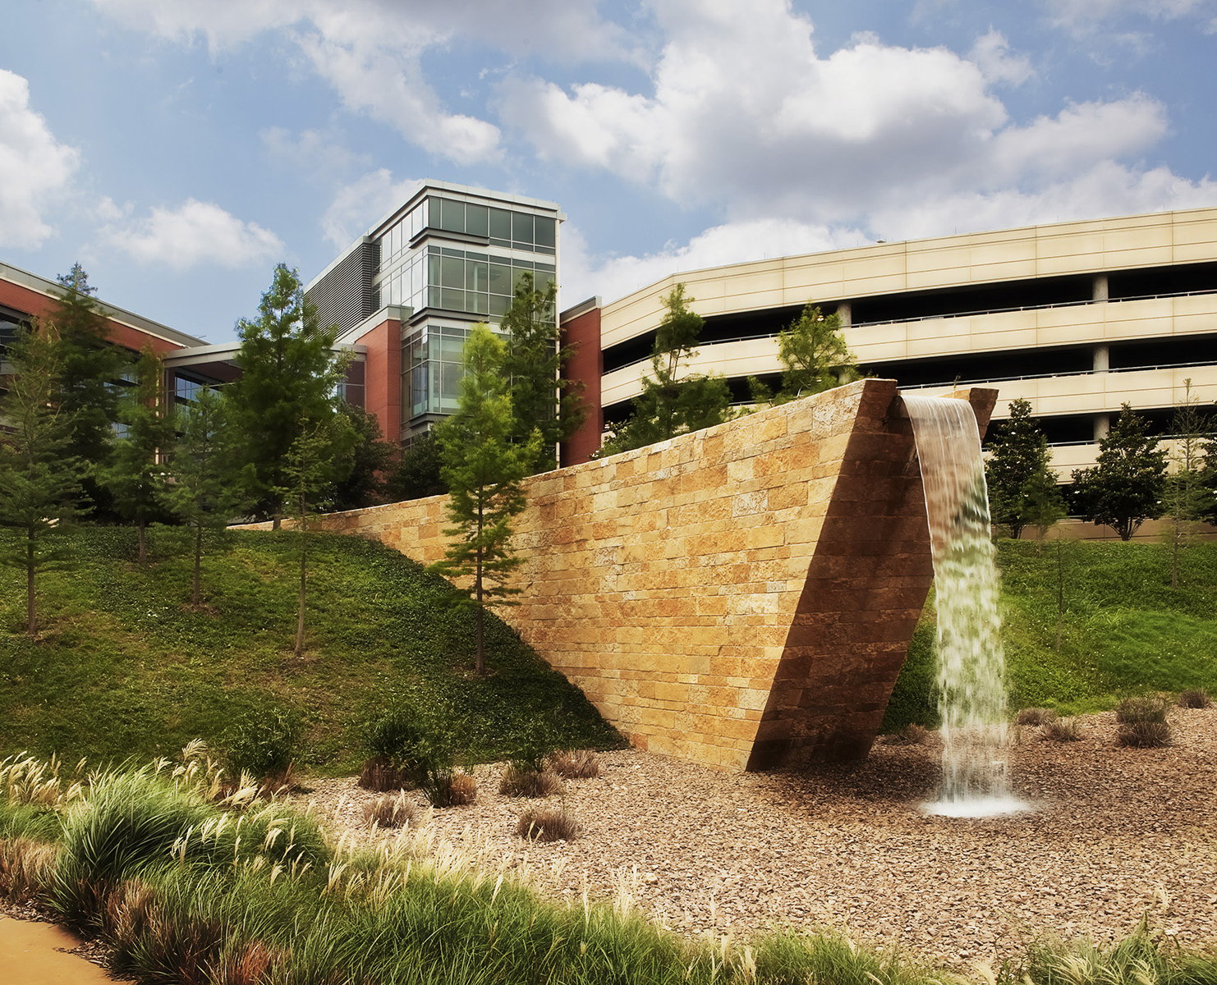
About our Campus
Spring 2022 headcount: 15,584
Spring 2020 headcount: 12,372
Fully online campus with:
  21 FT faculty dedicated to online teaching
  1 Senior ID
  5 ID staff
  1 Dean

Slide 5
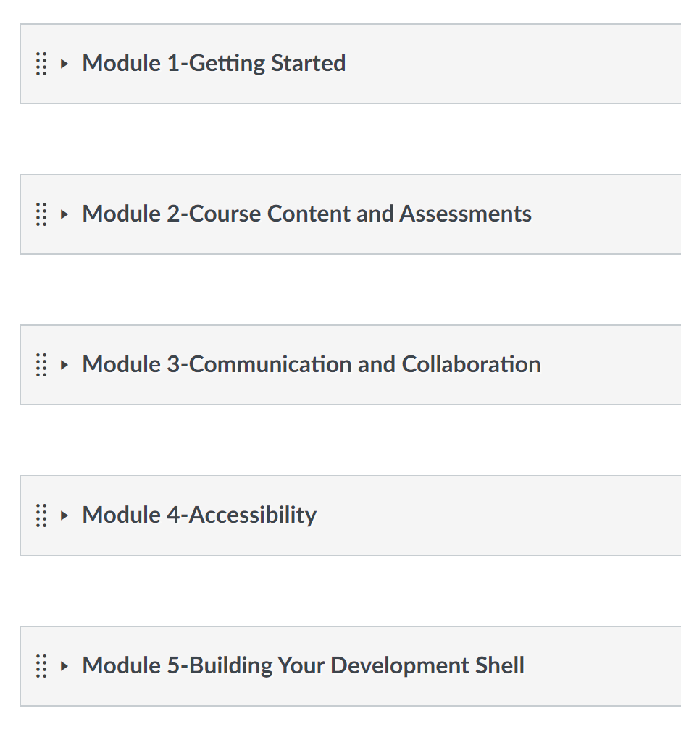
Thriving Online Faculty Certification Program (OIC)
Run in the LMS
Designed by ID team, reviewed by department chairs and administrators
Facilitated by ID team
Concludes with building modules in a course

Slide 6

From Struggling to Successful OIC

Slide 7
What does OIC focus on?
LMS
Navigation
Tools
Add-ons
Requirements
Course Design
Homepages
Modules
Alignment
Variety
Online Teaching
Accessibility
Types of lectures, content, assessment

Slide 8
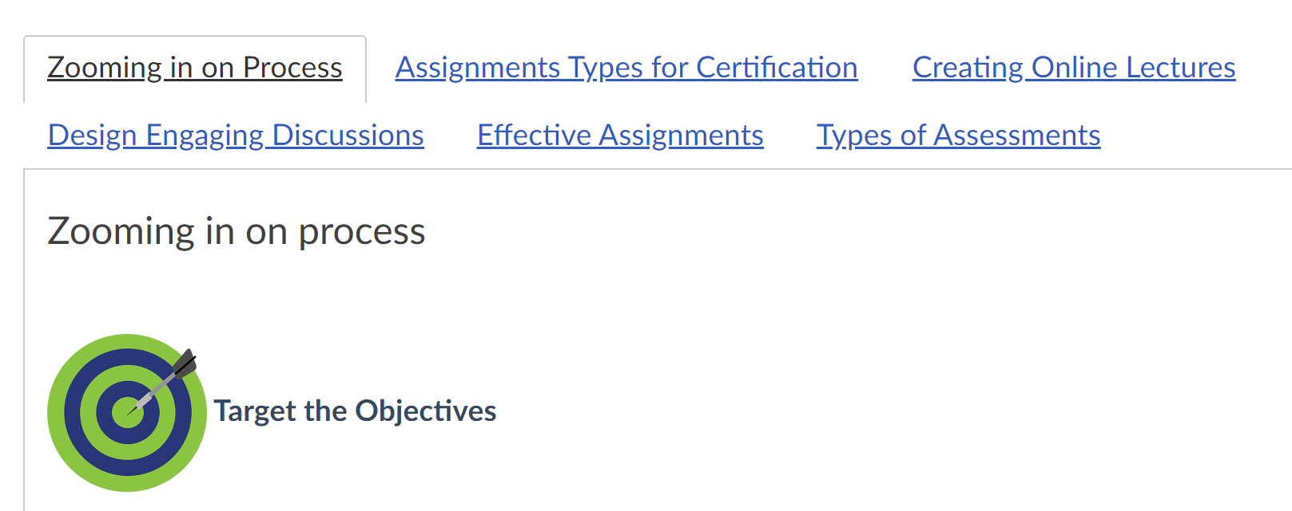
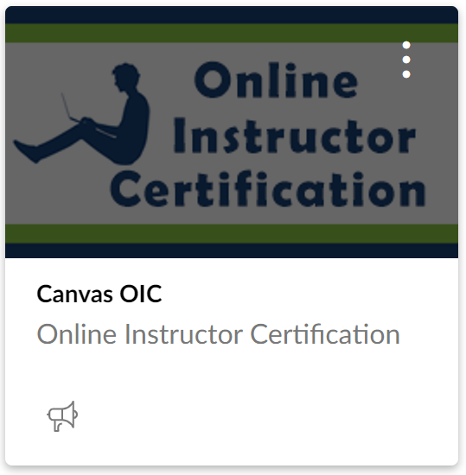
OIC at TCC

Slide 9

OIC Expirations, Boosters, and Transfers

Slide 10

Faculty Buy-In (And Faculty Love)
Listen to feedback from faculty
  “Wasn’t a model course”
  “Doesn’t have enough examples”
  “Missing direct practice”
Redesigned and current
Reviewed and vetted by department chairs
Friendly facilitation
Includes college and campus expectations, policies, and technologies

Slide 11

Who designs and leads faculty training?
Faculty
Administration
Self-led
Instructional designers
CTL / Trainers
IT / Academic Technology

Slide 12

LMS Training
Faculty-designed
Faculty-led
Train-the-trainer
Required (both Level 1 and Level 2) for all faculty at college
  21st century focus and meeting students’ needs
  Academic Continuity Plan
Adjunct faculty were paid for 5 hours of PD
Created and shared standards of practice for LMS

Slide 13
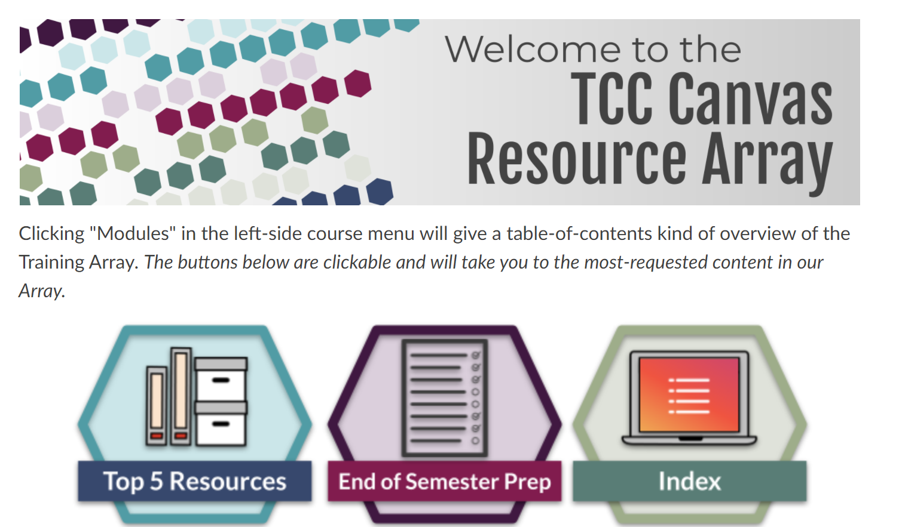
Canvas Resource Array

Slide 14
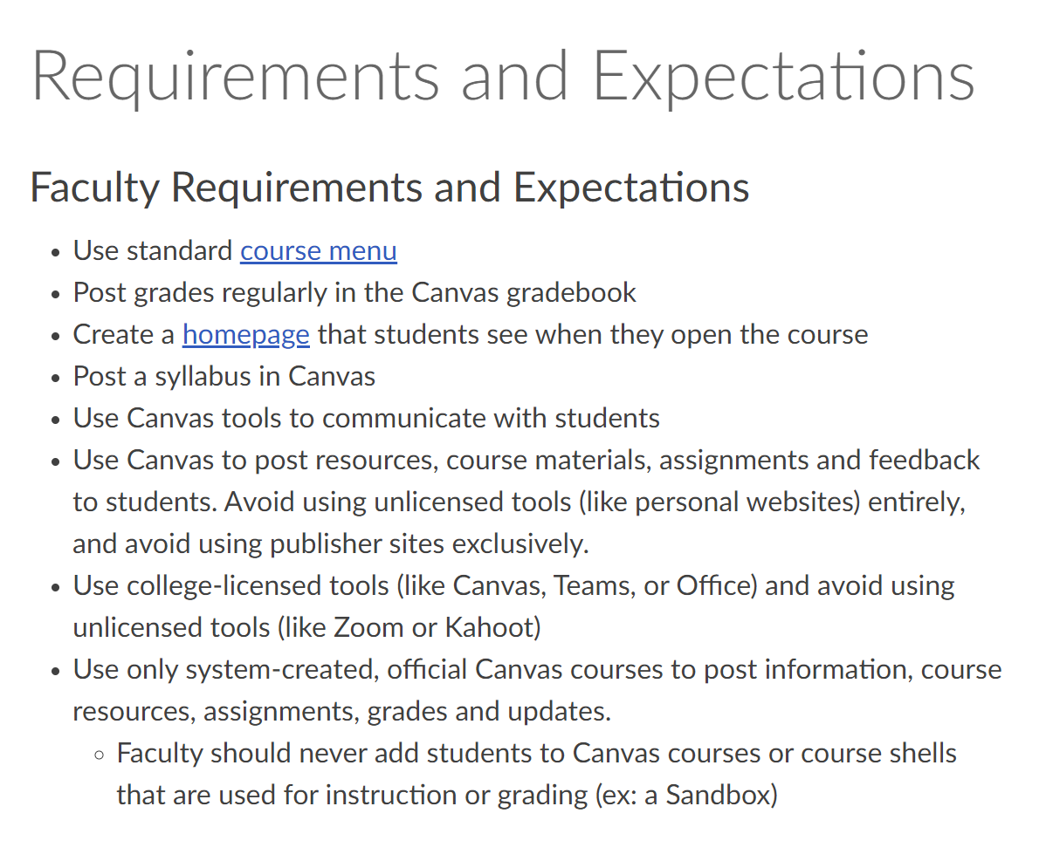
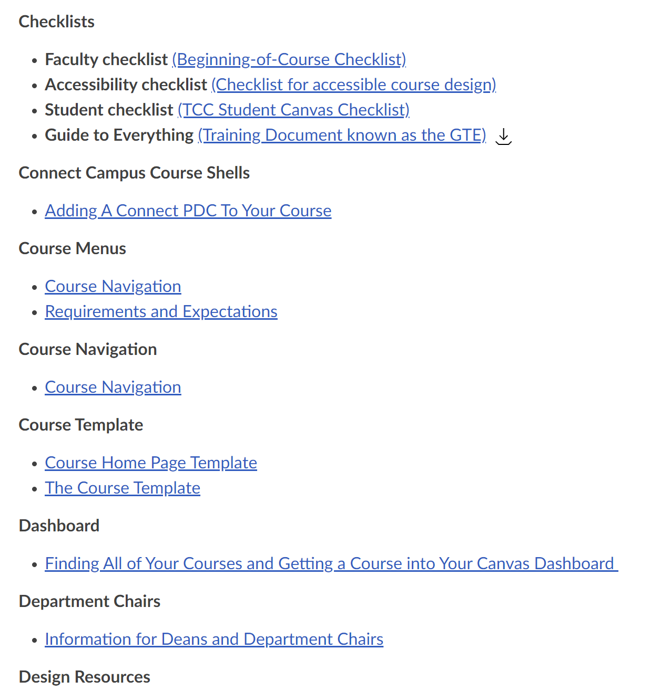

Slide 15
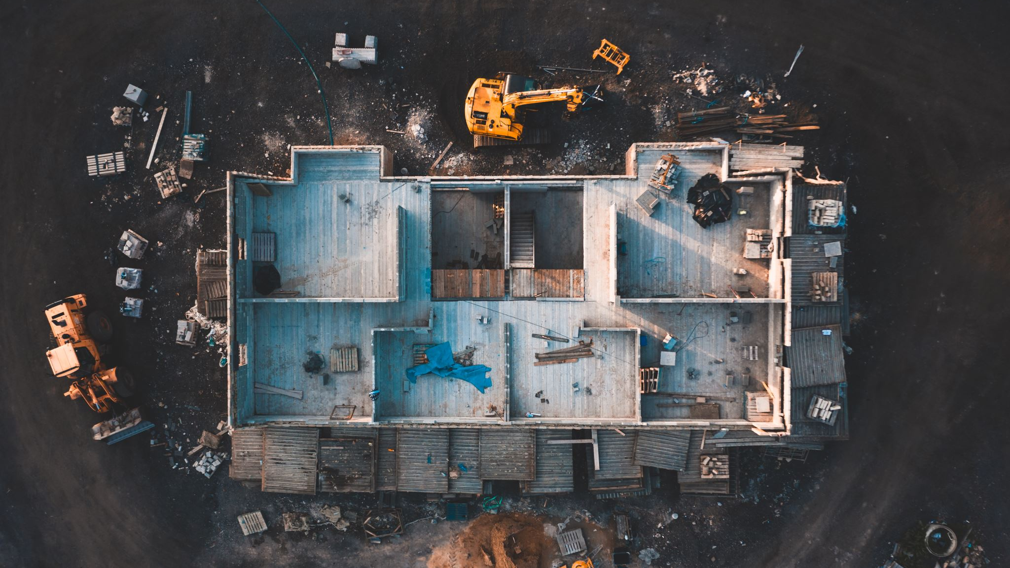
Ongoing Faculty Development

Slide 16
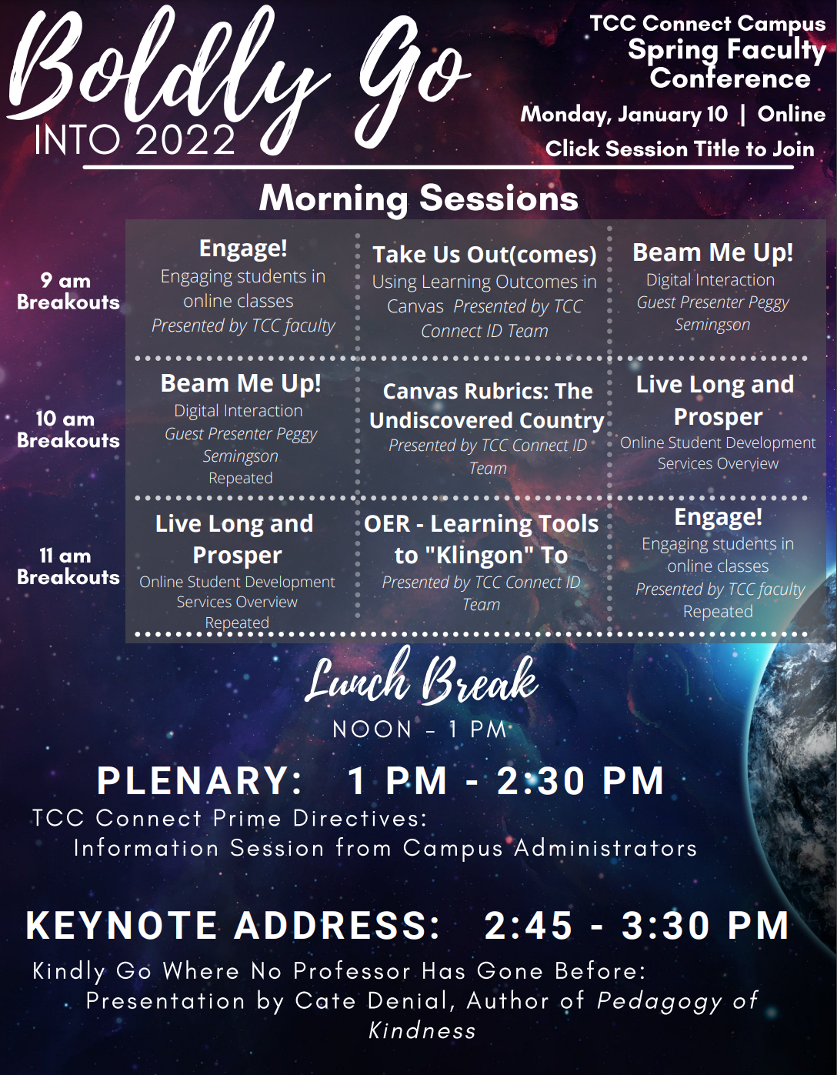
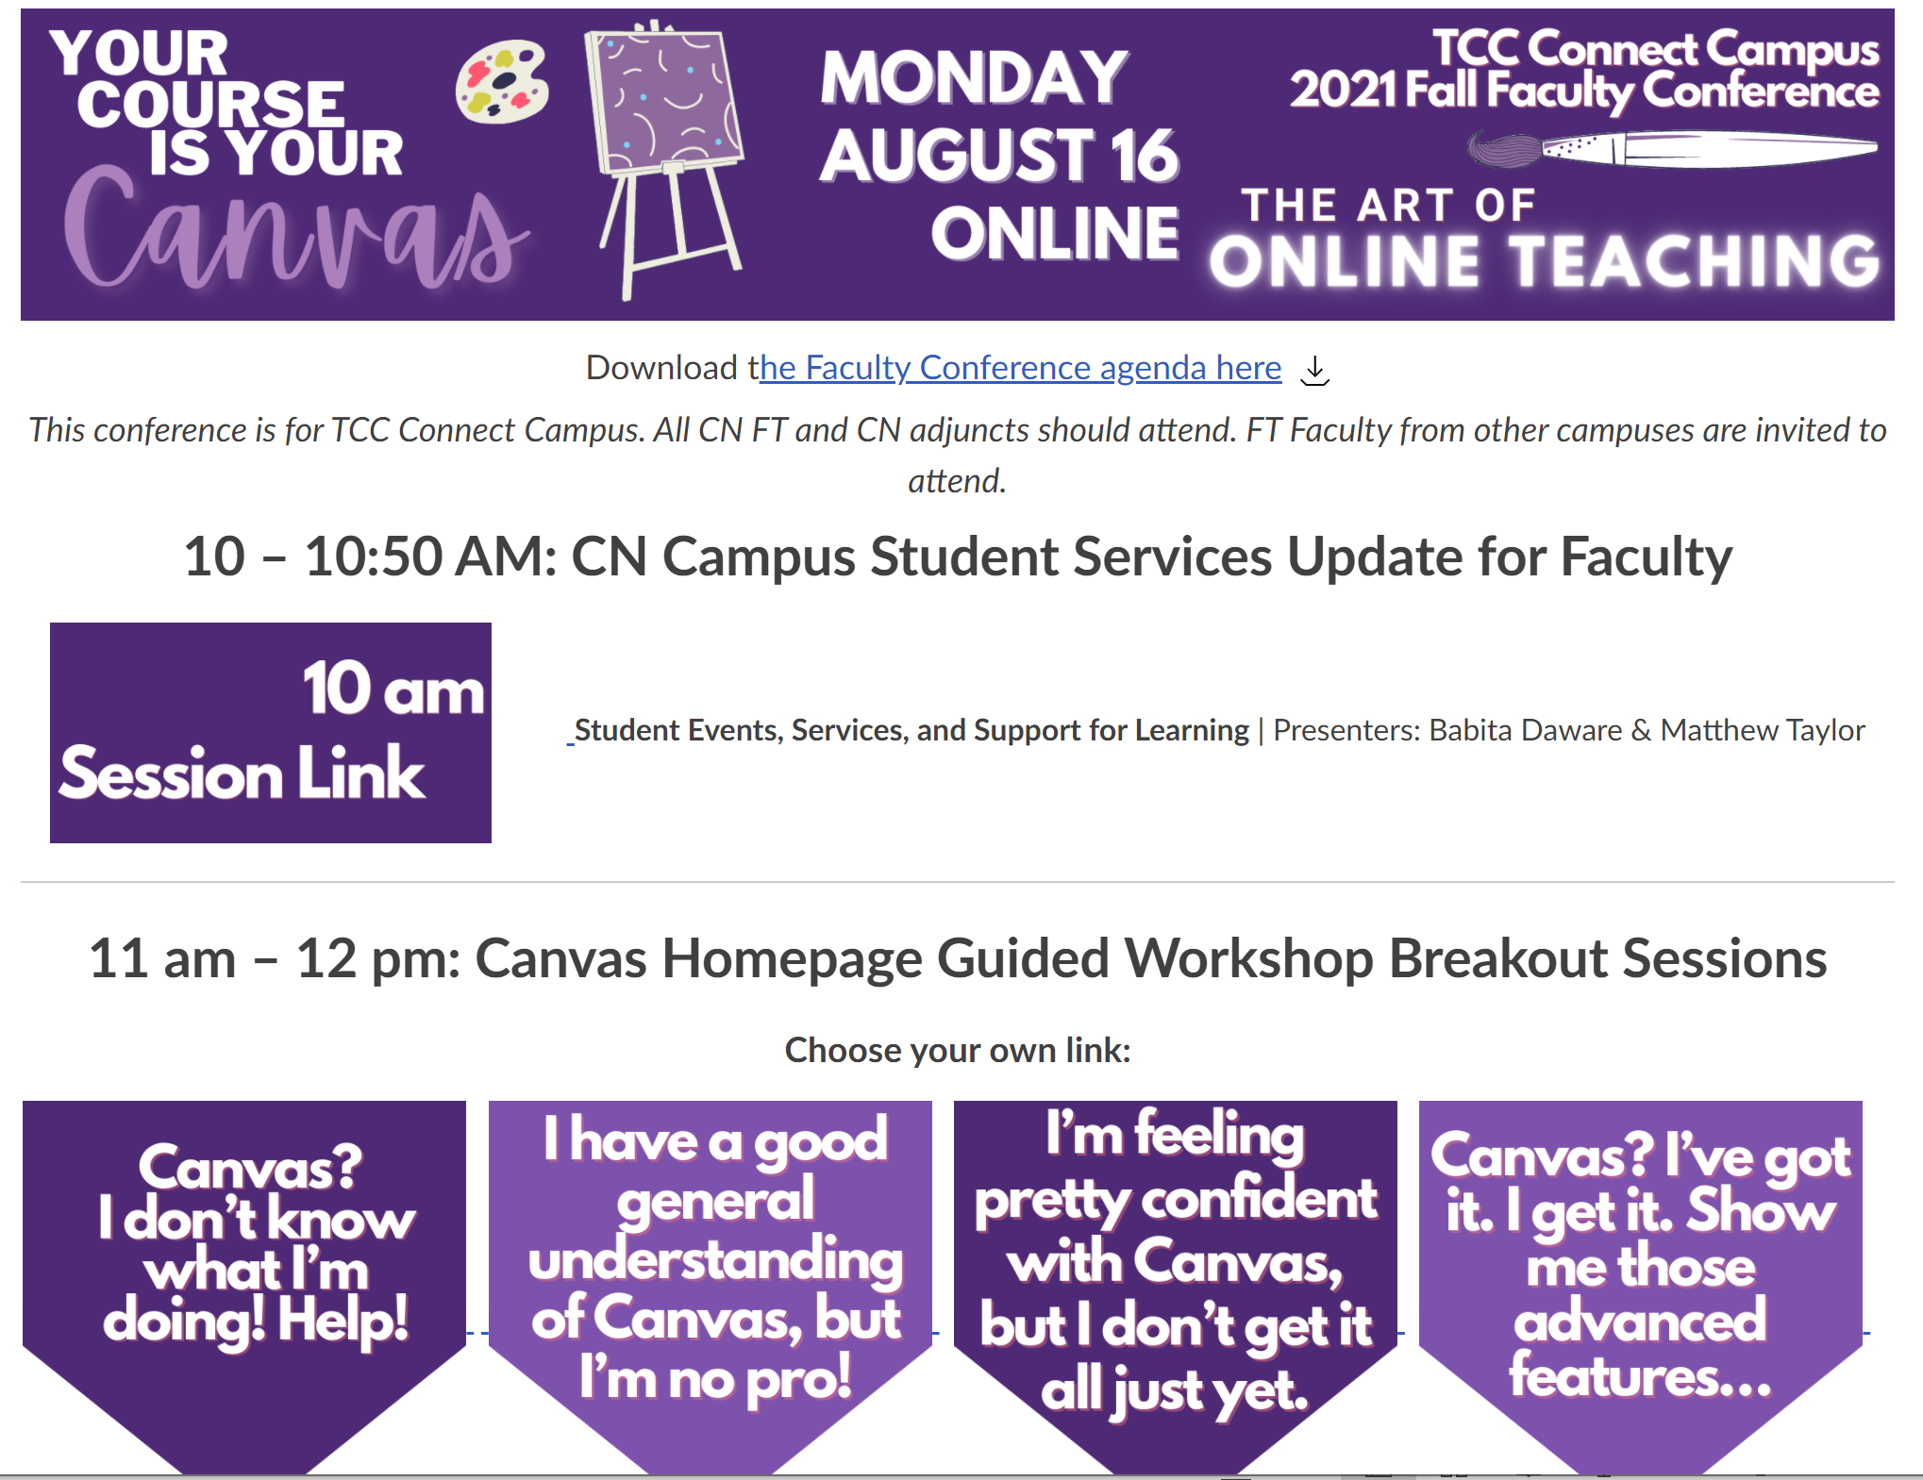
Conferences

Slide 17
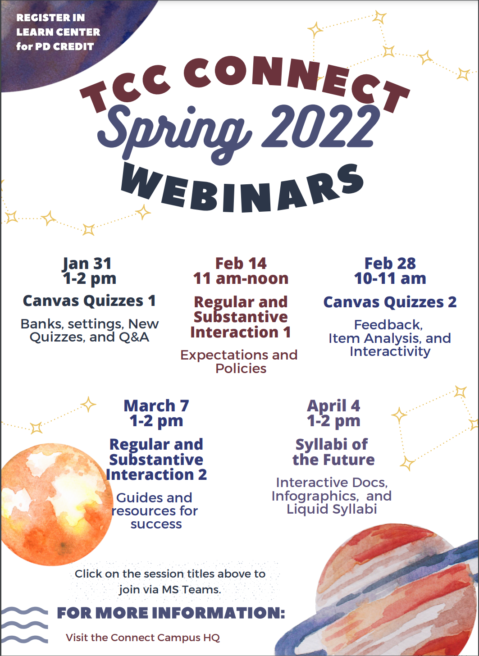
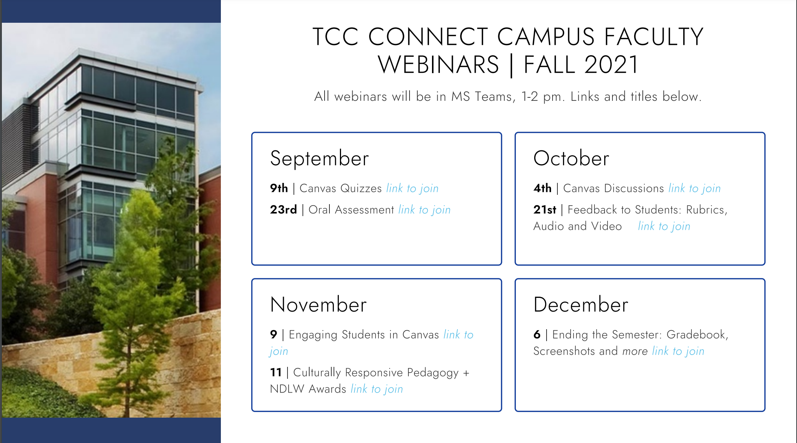
Monthly Webinars

Slide 18

Questions?

Slide 19

Presentation Materials
allegrahanna.com

