Slide 1
That Wasn’t Easy: A Faculty-Led LMS Transition
Allegra Davis Hanna
English Faculty
Department Chair
Faculty Development Campus Chair
Technology Work Team Lead
LMS Project Faculty Lead
Sometimes people accidentally call me “Canvas”

Slide 2
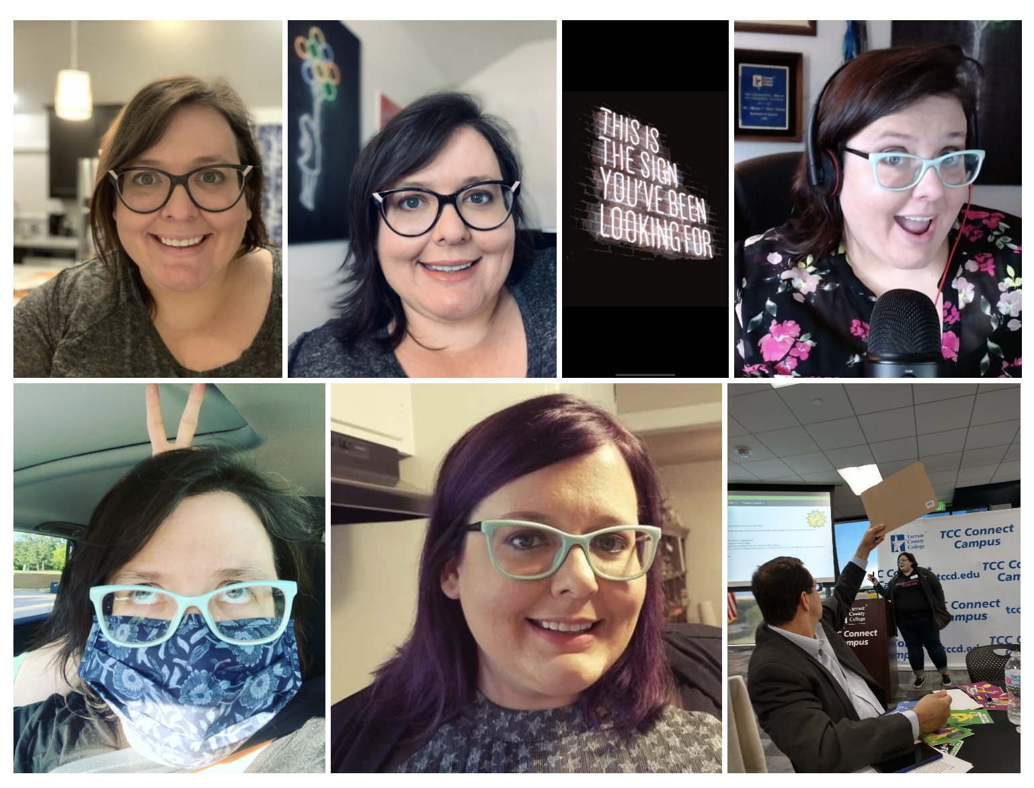

Slide 3

A LITTLE CONTEXT
Blackboard (2010)
50,000+ enrollments
6 campuses
  Including 1 online campus
670+ FT faculty
1,300+ adjunct faculty
Online since March 2020

Slide 4
Faculty Feedback
Anything but Canvas
I like Blackboard
We need Canvas
Making us change is evil
Blackboard is awful
Why now?
Why me?
I just learned to use Blackboard
We need training
Who gets to decide?

Slide 5
Six Faculty-Led Steps
Training Plan
Training Array
Communication Needs Assessments
LMS Criteria and Needs Assessment
RFP: Internal + Demo
Evaluation + Selection

Slide 6
LMS Selection Process
Fall 2019 – Spring 2020
IILE LMS Focus Team Formed
Gather LMS needs from faculty, staff, students
Create LMS Functional Criteria document
Feedback and Input from Advisory Panels
Spring 2020 – Summer 2020
LMS RFP Team Formed
RFP Created Using Functional Criteria
Partner with Procurement and IT for RFP Process
Feedback from Vendor Demos

Slide 7
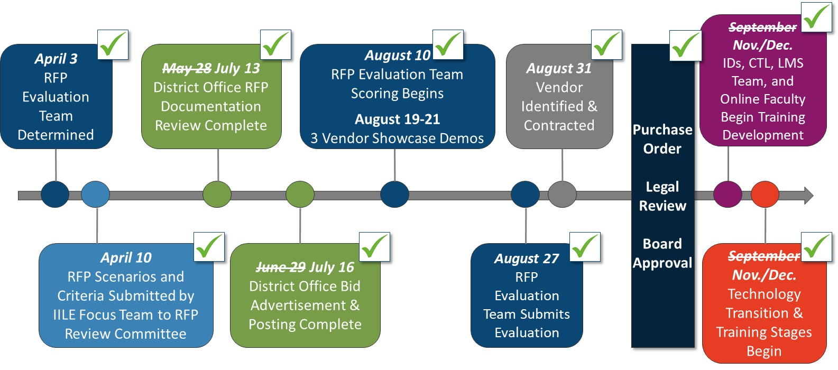
LMS – RFP and Procurement
Notes:
<Dr. Blankenbaker>
The last time we discussed the LMS, IILE shared the news that after almost a year of strategic work with many of you, Canvas had been selected as the LMS of choice for TCC. It feels like just yesterday when we were gathering and reviewing essential and functional components of an LMS. This with the goal to make sure our selection would be founded on our objectives to both advance the cultivation of student world-ready skills and support learning facilitation inside and outside the classroom.
Since then, the Canvas LMS was approved by the Board in November and we have moved from formulating concept and strategy in identification and selection to now implementation and operationalization of the Canvas LMS platform. The IILE Advisory Panel has been elbows deep in developing the training plan, in tandem with IT, EPMO, and Communications moving forward with technical transition, course conversion, and communications planning.
To tell you more, joining me this afternoon are: ​
​
Dr. Caroline Hamilton, CTL Director of Academic Technology and Canvas Implementation Project Lead, to discuss the IT Implementation, and​
​
Faculty member and Program Chair, Allegra Davis Hanna, Lead for the IILE Technology Work Team and Canvas Training Focus Team to discuss the IILE Canvas Training Framework.
​
I will now turn it over to Caroline for her Canvas implementation update.

Slide 8
Step 1: LMS Criteria and Needs Assessment
IILE Technology Work Team created the LMS Focus Team
Functional Criteria Document
  Represent all campuses
  Inclusive and comprehensive
  All modalities and programs
  Categorized and ranked
Notes:
Faculty Senate request faculty be involved in LMS discussions
Strategic panel: Integrated Instructional Learning Environments is asked to lead the process
IILE Technology Work Team create the LMS Focus Team

Slide 9
Focus Team Process
Jan.-Mar. 2020
  Each meeting comprised of “workshop time” to complete line-by-line review compiled functional criteria, organization and categorization, addition of items, and removal of duplications
  Team members actively provided suggestions by email throughout the three-month period
  Also included suggestions from campus surveys, Principle Advisory Panel and ACT meetings, and staff
Gathering Cross Campus Feedback
  To ensure we captured input across TCC, members were asked to:
    solicit feedback and list items from their campuses, ACTs, and advisory panels
    share the team’s discussions and draft lists with those same stakeholders
Notes:
The IILE team’s focus between January and March was to develop the instructional LMS functional components document, which was sent out previously today. Members collected information from their campuses and any district group to which they belong, and that information was incorporated in the document.
With a deadline of Spring Break to create a criteria list of LMS functionality, the focus team began meeting in December, and held meetings through March.
During our meetings, we worked on the list itself. The focus team decided how to organize and sort items, added and revised items, and removed duplicates. Before and during meetings, we carefully combed through the list to be sure it was clear, and consistent with the instructional needs of students and faculty not only from each campus, but in each teaching modality. During the last meeting, we discussed how to prioritize items, and voted on whether each item was something we considered to be “required” or something faculty wanted or “requested.”
Each member was asked to solicit input from their campus faculty, and also from the members of any advisory panels and/or ACTs they served on. Members were asked to gather criteria for the list from their home campuses, and to also share back with their faculty what the focus team had done so far. Our goal was to be transparent and inclusive. The Dean and VPAA from Connect campus were also informed regularly of updates from the focus team, in order to answer any related questions that arose at academic council or other meetings.
Team members were able to make suggestions, and forward items received from campus surveys, meetings, and other sources by email for this three-month period. We ensured that this was raised at least once at LCAP and ISSM meeting and input from those members was sent by email.
We have had to change direction with our plan for getting student feedback, and are currently working to get some student input.

Slide 10
Development of LMS Expertise
Demo Courses
Experience
Conferences
Focus Team Members Gained Broad Understanding of Needs and LMS Functionality
Development of Demo Courses
  Canvas
  D2L Brightspace
  Blackboard
    These three vendors comprised more 85% of all 2018 higher education institution LMS adoptions
Members have personal experience with LMSes
Several team members attended national or local eLearning conferences or webinars related to use of LMSes, or process of selecting an LMS
Notes:
Through our knowledge gathering and research, we found that 85% of higher education institutions use Canvas, D2L Brightspace, and Blackboard. We focused on these three vendors to deep dive into demo courses as we created our functional components document.
In addition to creating and organizing the criteria list, members of this focus group were asked to gain a broad understanding of LMS functionality. We wanted to be sure that we reached beyond what we were familiar with, and included functionality that our students would benefit from. Members were able to create demo courses in the other LMS systems, communicated with other faculty, and relied on their own personal expertise. Many of our team members have taught or taken classes using other LMSes, and several of our group attended conferences or webinars that allowed them to become more familiar with possible LMS functionality. We primarily focused on the functionality, not the LMS (we asked faculty what they needed to be able to do, not which LMS they preferred), but we focused our demo course development on the three leading LMS products. Canvas is the most-used LMS in higher education institutions in the country, and Blackboard is the second leading vendor. D2L’s Brightspace is the third-most used LMS (with a remarkably smaller market share), but has recently undergone an overhaul that makes it more mobile-friendly than previous iterations. Combined, these three vendors make up over 85% of the US higher ed market, so in creating and exploring demo courses, we focused on these three.

Slide 11
LMS Focus Team
Faculty, IT, Admin and Staff
3-Month Team
Every Campus
Programs and Disciplines
Learning Commons
Functional Components

Slide 12
Functional Criteria: Most Vital
Ease of Use
Lesson Building
Mobile Functionality
  Effective, easy-to-read text input (text entry or pasted text stays formatted and ADA compliant)
  Universal common course cartridge support (courses can be added to or from other LMSes)
  Ability to see whole course in an outline view (all modules, items, assignments, in order)
  Clear and easy navigation within and between lessons. Students can get from one item to the next easily, moving through a lesson intuitively. Lesson items are grouped within lesson
  ADA features (text entry, images, videos, design elements – faculty are guided to build course elements compliant with ADA)
  Rubrics (custom, can be copied between courses, can be shared with other users)
  Can add inline links, media, LTI
  Clear, simple, easy-to-use, built-in system for organizing lesson content
  Variety of assessment types, including tests, quizzes, discussion boards (threaded and unthreaded), surveys, essays
  All users can access lessons, full gradebook, quizzes on all devices in a functional manner (easy to read, navigate, and complete assignments)
  Mobile app (or mobile responsive browser application) allows access for faculty to gradebook, student information, in-LMS messaging, alerts, quizzes, assignments, etc.
  Student mobile app includes a calendar, notifications (including announcements for all courses), and access to email / messaging
  Ability to grade and interact with the gradebook on all devices
Notes:
The full criteria document, that you have a review copy of, includes 17 categories, and over 200 items. The next few slides will give a broad overview of those categories and some of the criteria in each.
Ease of Use, Lesson Building, and Mobile Functionality were determined to be the most vital.
The first category, and easily the most requested by faculty and staff, is ease of use. We need a system that is easy to learn, and easy to use on a daily basis.
The second category is lesson building. These are tools that allow faculty to create learning objects and assessments that serve students. This includes ADA features, rubrics, clear, simple, lesson organization systems that are built-in an native to the LMS, and a variety of assessment types.
The third vital category is mobile functionality. Mobile functionality is increasingly important, as more and more of us use tablets and phones to access the LMS. Many students don’t have reliable internet connections, other than on their phones, and everyone uses a phone as a back-up when computers or internet connections fail. Instructors need to be able to quickly access items using mobile devices, and students should have full functionality on all devices.

Slide 13
Functional Criteria: Core Instructional Tools
Integration
Announcements
  MyMathLab
  Turnitin.com
  Portfolio tool
  Colleague
  Google
  Remote proctoring
  Pearson
  Video platform
  Instructors can post announcements that include audio, video, images, links, files, attachments
  Faculty can choose to make an announcement to one or multiple class sections
Gradebook
Calendar Tools
  Grades can be weighted, unweighted, categorized
  Customize what grade columns are shown / hidden
  Grade by annotation, rubric, audio, video, comment, number grade
  Send customizable emails from within gradebook (for instance to non-submitters)
  Change date anywhere on an item and it changes everywhere
  Dates update to student and faculty calendars and to-do lists
  Option to see and update all dates at the same time (course outline view)
Groups
Attendance
  Student group resources for interactive assignments – instructors can create groups, groups can discuss, share files, communicate
  Take attendance in LMS
  Attendance information accessible by Financial Aid, advisors
Notes:
These are other categories that represent our core, in-class, instructional needs in an LMS.
For each of these 6 categories, I’m including only a sampling of the criteria. Some categories have 15-20 criteria listed. In addition to ease of use, lesson building, and mobile functionality, we consider “in-class instructional” categories to include integration with third-party systems, like MyMathLab, Turnitin, colleague, Google, Pearson, and remote proctoring services.
In addition, if the LMS does not come with an add-on video platform, we want to make sure it would work with most leading vendors for that type of tool – video platoforming would allow us to create video assignments, online tutoring, and allow student video submissions for assignments.
Gradebook functions include how to set-up grading, how to grade student work, and how to share information. Faculty would like options when it comes to providing grading feedback, and want their LMS to enable grading by annotation, rubric, audio, video, typed comment, written comment, and number grading. Some classes require students to work in groups, and we need our LMS to be able to facilitate that. Announcement tools are essential communication tools, and we need more options for how to create and send those announcements, including the ability to send one announcement to multiple sections. Faculty need more advanced calendar tools, including the use of to-do lists, and would like to ensure that they only have to change dates for an item or assignment once, and have it be changed everywhere in the course.
Being able to take attendance in the LMS is one of the most frequently asked for items.

Slide 14
Functional Criteria: Instructional Tools
Collaboration
Tutoring
  Messaging within the LMS
  Built in tools for video conferencing, conference calls, remote office hours
  Students can easily find and communicated with classmates
  Can create in-course links for students to access tutoring
  Writing Centers can create organizations, conferences, meetings
  Online tutoring (video / voice / annotation)
Analytics
One-Click Access
  Information on how often students log in, time spent in class, how many assignments were submitted on time, late
  Student contact information and profile accessed by one click
  Dashboard to track student performance and attendance
  Course, discipline, and campus level reporting options
  Student retention information that can be shared with advisors
  Students can navigate to grades
  Students can navigate to calendar and/or to-do list
  Access to syllabus
  Faculty can turn on/off content
  Drag and drop within the course
Assessment
  Use for assessments and outcomes measurement
  Rubrics can be connected to SLOs, and reports can be generated – faculty grading becomes SLO reporting
Notes:
These are categories that include other instructional uses of the LMS. As you see, many of them directly relate to instruction and learning – but are tools that faculty and staff can use inside and outside of classroom spaces. This includes tools that allow staff to analyze student attendance and retention data, record and track assessment information, and allow students to access tutoring entirely online. Collaboration tools include resources that faculty would use in class, like messaging, conferencing, and online office hour tools – this also includes the important need that students have of being able to find and contact their classmates.

Slide 15
Functional Criteria: System Tools
LMS Administration
Organizations – Faculty & Staff
  Support for transition, including training and technical support, help with course conversion, training trainers, supporting faculty, etc.
  Training courses, guides, and resources for faculty and students already exist in LMS
  Custom user roles (examples: department chair, dean, SI, faculty observer, LMS support, etc.)
  Real-time Colleague updates and integration possible. Functionality can be turned on / off
  Reports can be run on faculty and/or student activity in courses
  Faculty groups (like ACTs, JCC committees, etc.) can create course-like spaces to share information and communicate
  Faculty can share assets, documents, and items with other faculty
  Training modules can be housed in LMS. Training for LMS already exists in LMS
  Librarians can create modules that can be easily integrated into courses as needed
  Groups and shared items are easy to find, add users to, copy and export from
Customization
Organizations – Students
  Institutional announcements can be made through LMS (to appear prominently when students or faculty open the LMS)
  Users can customize preferences for display, communication, notifications
  College branding on launch page, and elsewhere in LMS. College customization in look / feel to some degree is possible
  Faculty can customize banners, decide where / if courses appear in their launch page
  Groups like PTK can leverage LMS for organization management
  Those same tools available in courses, such as announcements, file sharing, modules, and discussions, are available for organizations
Notes:
These final categories refer to more administrative functions of the LMS, including the functionality needed by our LMS systems team, and supporting faculty, staff and students in management of their organizations.

Slide 16

Inclusive of COVID-19 needs
Communication tools
Easy navigation
Content authoring
Mobile functionality
Video platforming
Shared content
Assessment tools
Accessibility / ADA / SAR
All ACP contingencies
Notes:
The Team reviewed our Instructional LMS Functional Components to confirm the needs which have emerged in the past month are included within our requests. We are happy to report they were indeed already incorporated.
If the past month has shown us anything, it’s that Blackboard is a very reliable system, but that it doesn’t have all of the features our students and faculty desperately need in order to be successful. Being in close contact with faculty at other institutions, I can state without question that schools with other systems have had an easier time transitioning, providing easier access to richer resources. Faculty at UNT, for instance, have been easily able to share their courses and course modules with others at the university. UTA has been able to use Canvas and its Video Platform Studio to quickly create and edit high-quality lecture video that is hosted within the system. Students in courses that require student demonstrations or skills testing have been able to create and submit videos as documentation of competency.
While we cannot attempt to exactly replicate the in-person experience online, we should be able provide an equitable experience, and Blackboard simply cannot provide that for us. Students cannot access materials on mobile devices, neither students nor faculty can share videos easily or privately, lesson building and assessment creation is tedious, time-consuming, and requires more support and training than should be necessary. We have people developing “work arounds” to meet students’ needs instead of being able to rely on our instructional LMS to provide all of what we need. For instance, our current LMS has no way for faculty to share lessons, modules, items, or even entire courses with other institutional faculty. The longer we keep Blackboard, the more we do a disservice to everyone who comes to TCC.
We are aware that the use of our LMS is increased in times like these, when all learning must be done remotely. We kept the academic continuity plan in mind during the creation of the original list, and have since reviewed it to make sure that all features needed in times of emergency are included. Two members of the focus team were authors of the Blackboard Essential org, which is being used by all faculty as a guide and resource for transitioning their courses. Their expertise in LMS functionality is reflected on the list. We also investigated how other colleges were responding to these needs, and surveyed the technology resources provided to faculty, and how faculty were advised to use which resource.
There are features on our list, that our current system does not have, that would have been helpful during this rapid transition to remote teaching. These include easier navigation, one-click access, interfaces that make content and modules easier to make and move, tools that would enable faculty to share lessons, items, or whole courses with their colleagues, and video platforming. We have classes, like public speaking, performance, and business courses, that required students submit videos to earn credit, and currently we have no tools that allow for this.
We have also verified that necessary accessibility, ADA, communication, collaboration, and authoring tools are included on our criteria list, so that any future need for rapid transition to online can be responded to quickly and completely.
These past few weeks have highlighted the critical need for a video platform service that Connect faculty and staff have been mentioning for over a year. While the video needs are included on our LMS criteria list, it is likely that the video platform service will be an “add on” tool offered by the LMS vendor (like Canvas + Studio), or a product offered by a separate vendor (like Relay, Kaltura, Panopto, or VidGrid, etc.). It is the hope of our FOCUS TEAM that we can address this need either before or during the LMS adoption process, as it is a critical need for all online-delivered courses. The video platform tools would allow remote delivery of lecture and instructional content, and would provide analytics, captions, interactive assignments, and would allow students in drama, speech, and business classes to create and submit video assignments.

Slide 17
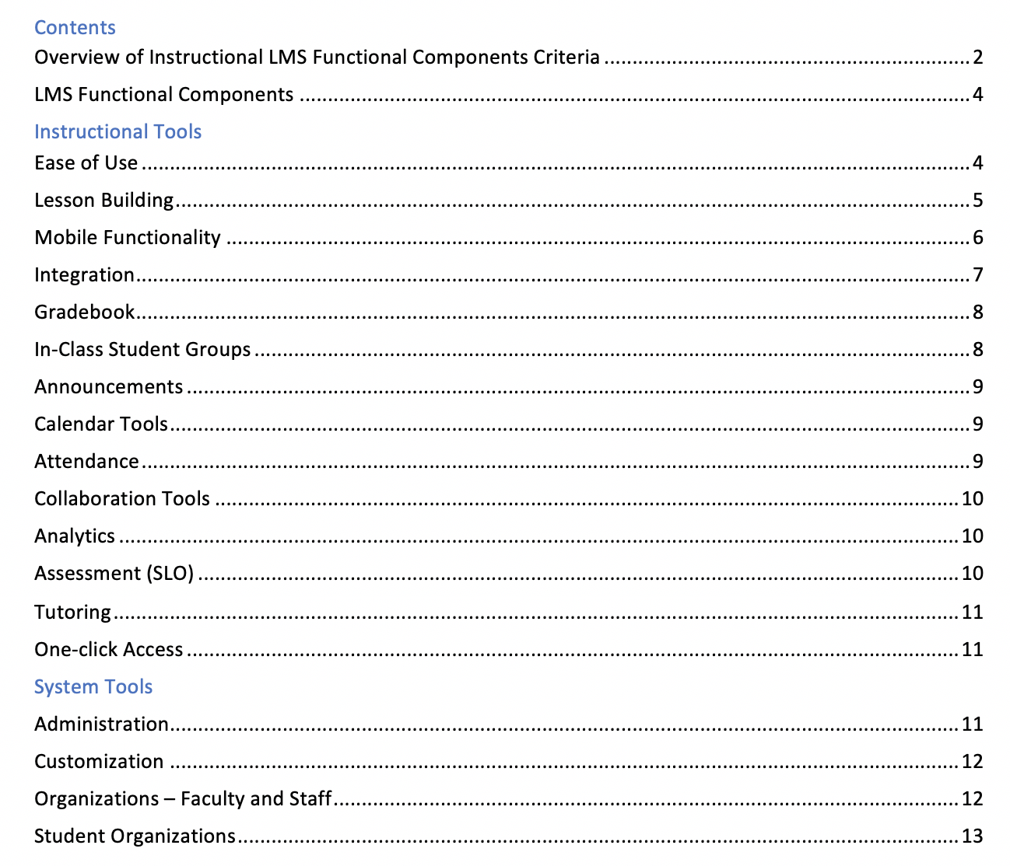
Final
Product

Slide 18
Step 2: RFP (Internal and Demos)

Slide 19
RFP Evaluation Team
Name | Campus or Department | Position | 3G8P Membership | Additional Roles
Allegra Davis (Lead) | Connect | Faculty, Department Chair | IILE Advisory Panel IILE Technology Work Team IILE LMS Focus Team SFU Student Engagement Work Team | Faculty Senate JCC Technology Committee Connect Technology Team
 | Northeast | Faculty | IILE LMS Focus Team | Software Utilization Team JCC
 | IT | LMS Systems Specialist | IILE LMS Focus Team
 | IT | Director, Academic Technology | IILE Advisory Panel IILE Technology Work Team Workspace Environments
 | IT | Manager, Application Development | IILE LMS Focus Team
 | South | Library Director | Learning Commons
 | Academic Affairs | District Director of Institutional Effectiveness, Accreditation and Planning | IILE Advisory Panel IILE Pedagogy Work Team IILE LMS Focus Team | District Assessment
Notes:
Dr. Blankenbaker to introduce Allegra
The RFP Evaluation Team is a core team of made up of 7 people, including faculty and academic learning staff representatives. This team includes faculty and staff who represent a broad perspective and bring to the table their experience and expertise across TCC. This small team represents our TCC LMS end-users, and will attend every vendor demo, and score the LMS vendors based on the criteria developed by the college faculty, learning commons and staff.
This team will work with other teams, including the EPMO, purchasing and procurement and selected external consultants, and leverage the LMS RFP Scenarios developed by the IILE focus team. These scenarios were created from the perspective of IILE and Learning Commons functional needs and include the areas we would like vendors to demonstrate during their presentations.
An example of a scenario is “as an instructor, I want to see my entire course in a module view, and move a quiz from one lesson to another using a single drag and drop, without having to change or reload pages” or “as a student, I want to take a proctored test in MyMathLab, and have the grade show in the LMS gradebook immediately”).

Slide 20
Informed Decision Making
LMS Evaluation
Advisory Panels
Academic Affairs
IT and IT Security
Faculty and JCC
Instructional Designers
Notes:
Allegra
The 7-member evaluation team made informed decisions, with input from across the college. The scenarios, criteria lists, and evaluation scorecards were created using the functional criteria documents Dr. Blankenbaker just reviewed. All faculty and staff had the opportunity to contribute to those documents, and criteria were created with multiple advisory panels and divisions in mind.
The evaluation team was joined by William Jeskey from IT Security during the longer demonstrations. He was able to verify that all vendors would be secure within the IT framework and infrastructure.
Because of your support, College-wide invitations were sent for LMS Showcases, with 120-150 attendees at each. Surveys were provided to solicit attendee feedback based on the Showcase demonstrations.
7-member LMS RFP Evaluation Team, plus Phung Nguyen from Procurement and William Jeskey from IT Security

Slide 21



LMS Showcase Demonstrations
August 19, 2020
August 20, 2020
August 21, 2020
Faculty
110
69
104
49
39
36
Administrator
Staff
9
8
2
Not Identified
4
4
-
172
120
142
TOTAL
Notes:
Allegra

Slide 22
Step 3: EVALUATION AND SELECTION

Slide 23
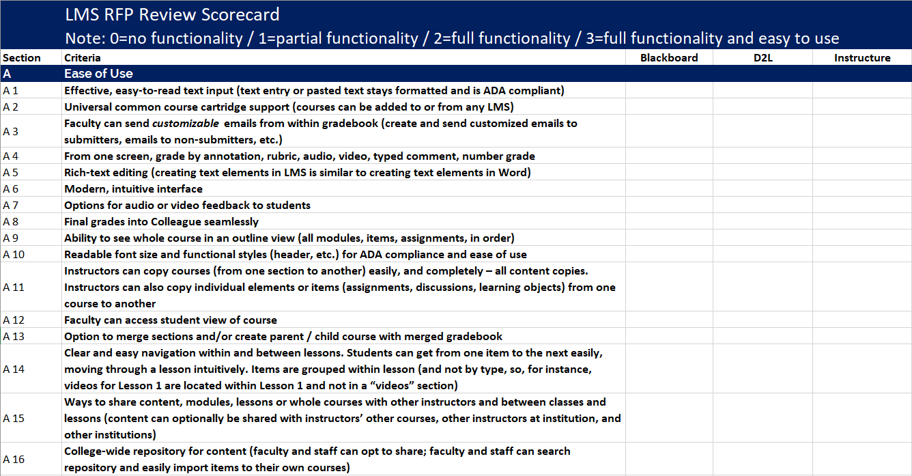
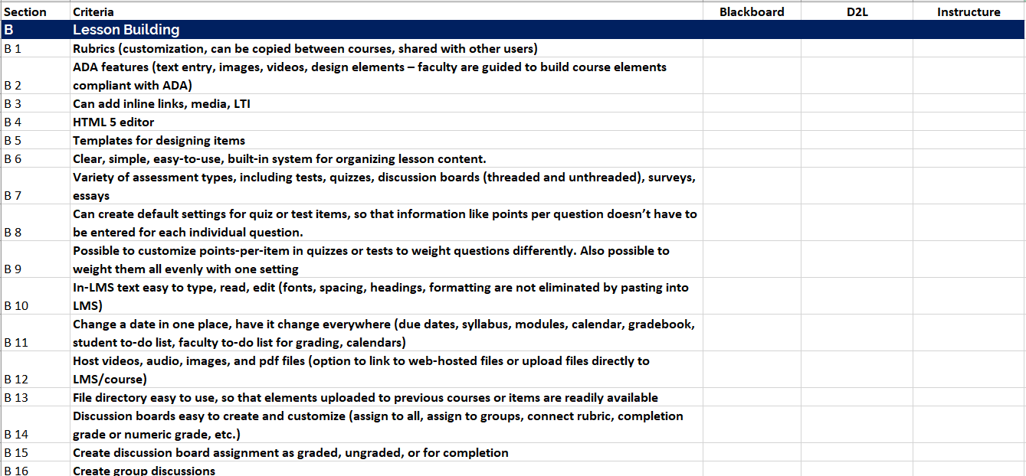
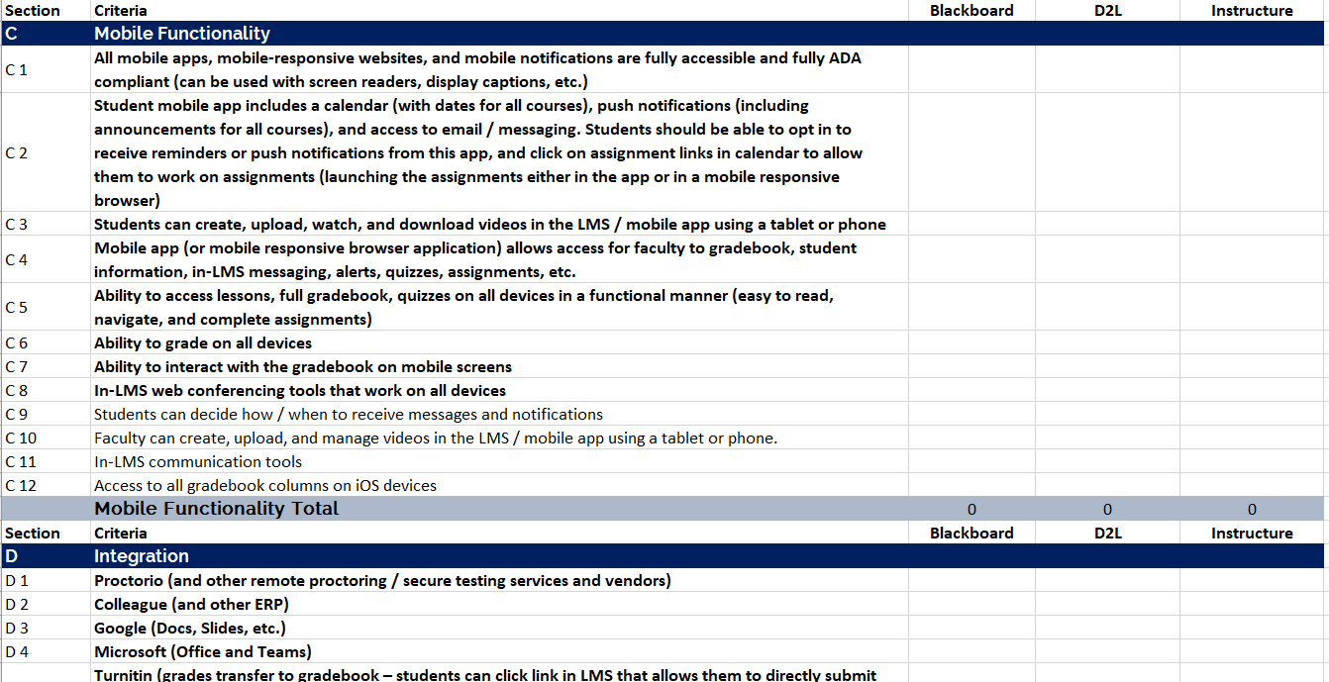
LMS Evaluation
Notes:
Allegra
The functional criteria and non-negotiable criteria documents were used to create scorecard for evaluation team members’ own notetaking during day-long vendor presentations. Each participant asked questions, required vendors to demonstrate usability and functionality, and scored the LMS solutions.
RFP Written Responses read by team
Evaluation team attended 4-hour, in-depth demonstrations for each responding vendor
LMS vendors went through required scenarios and answered questions from team members

Slide 24
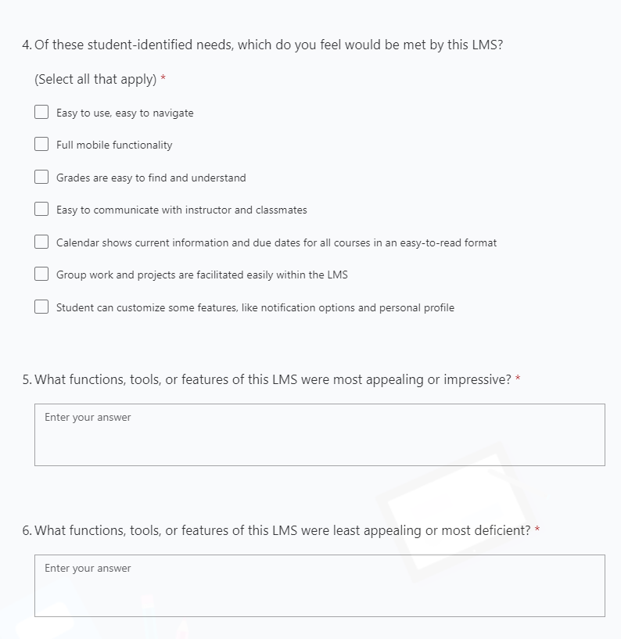
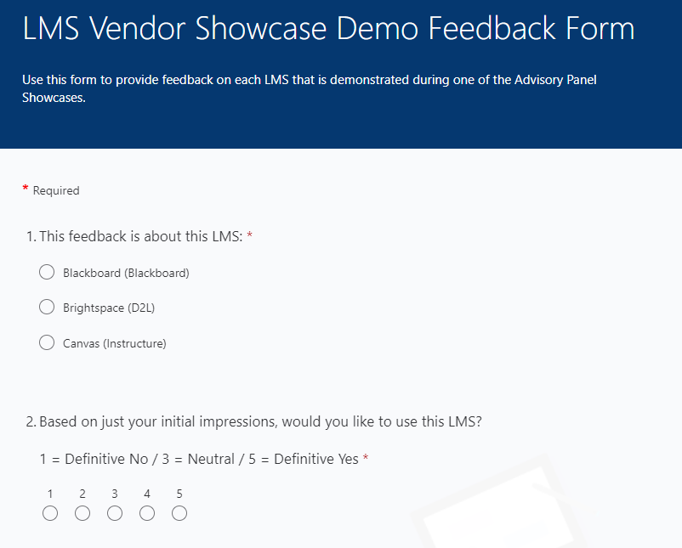
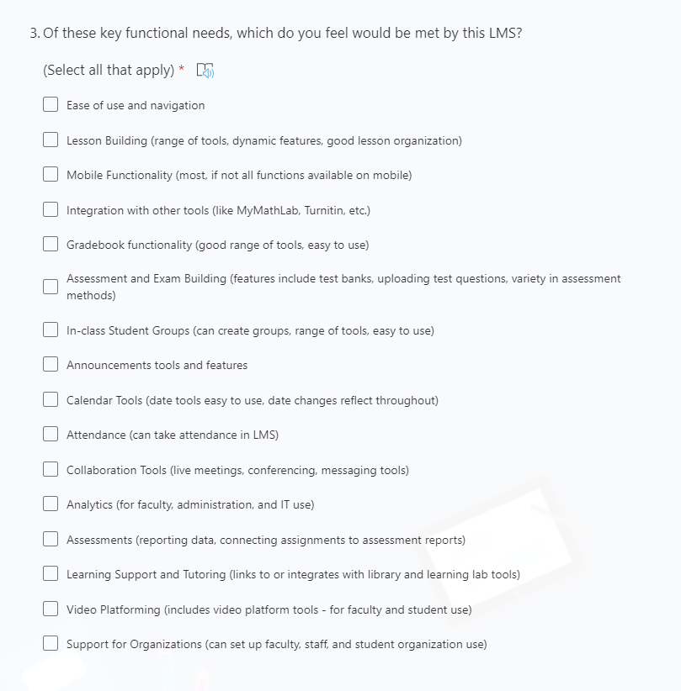
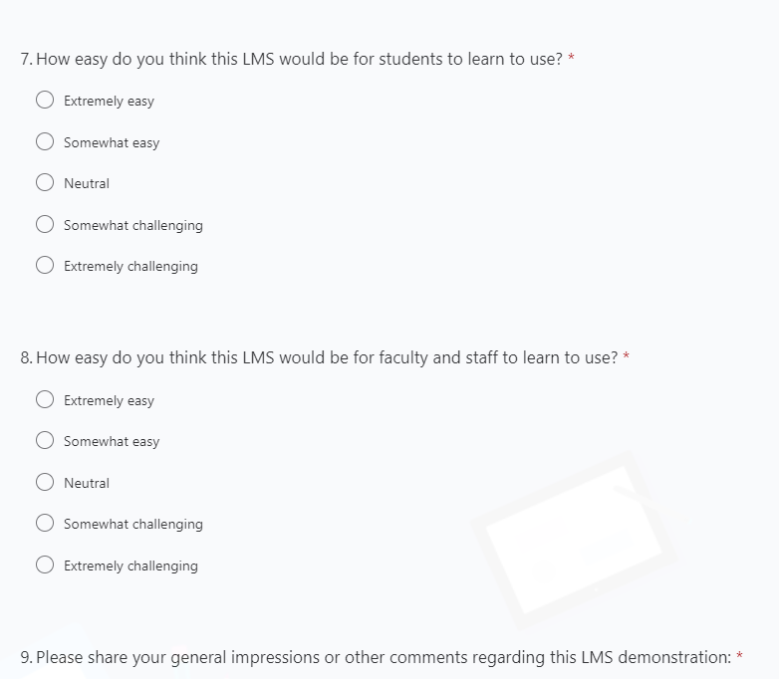
Survey
Notes:
Allegra
All evaluation team members had access to the survey feedback, and had access to the chat comments and questions from the conversations during the Showcase Demonstrations. This qualitative feedback provided input on what functionalities were priorities for attendees.
If asked, total respondents: 107

Slide 25
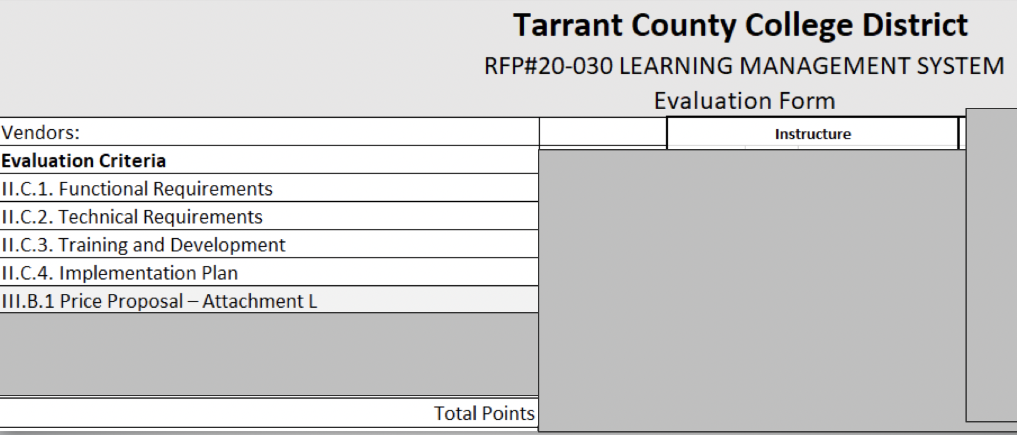
LMS Evaluation
Notes:
Allegra
Scores were submitted to procurement using the official evaluation form, which weighted functional and technical requirements as 55% of the score. The team also ranks the vendors’ plans for training and implementation. Procurement provided tabulation and added scores for pricing and MWBE, using standard process.

Slide 26
Implementation Begins

Slide 27
Next Steps: Now Through November 2020
Procurement Process
Purchase Order
Legal Review
October Board Meeting
Contract Begins
IT Processes Begin
Notes:
Dr. Blankenbaker
This fall, procurement and legal will work on contracting, and the plan is for this to be presented at the October board meeting for final board approval. Only after contracts are final can IT begin their work, since we cannot share data with the LMS vendor until after those contracts are signed and agreed to.
I will be back in November to share the cutover and implementation plan to seek your input on professional development training.

Slide 28
Canvas Implementation Timeline
Fall 2019
Request for new LMS from JCC
Spring 2020
Functional and technical data collected
Summer 2020
RFP development
RFP release
Fall 2020
Canvas selected
Board approval
January 2021
Authentication completed
Integration initiated
Communication plan initiated
February/March 2021
6000 courses migrated
Training released
Canvas open for faculty access
Notes:
<Caroline Hamilton>
As Dr. Blankenbaker mentioned, the Canvas contract was approved at the November board. It was then signed in early December. Because of the timing of the contract signature we unfortunately lost a few weeks for the Holidays. However, the implementation team has been hard at work since returning and I have learned we are ahead of schedule in some areas. We do have some key milestones that will be hitting us for February and March. There are some dependencies that could impact the specific release dates but in general we anticipate migrating 6000 courses using K16 a Canvas partner early spring, releasing faculty and staff training, and opening the Canvas platform for faculty use.

Slide 29
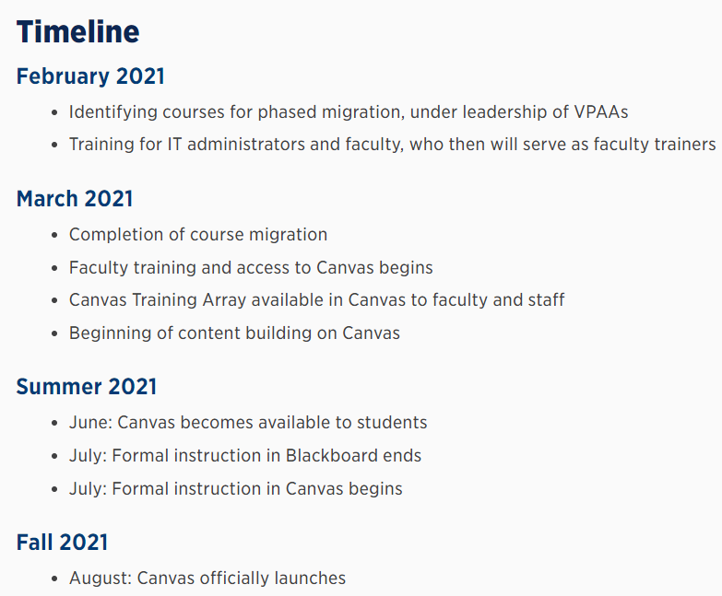
Updates on insideTCC
Notes:
<Caroline Hamilton>
Through insideTCC our TCC community can gain real time information on where we are and where we are going with the Canvas Implementation. The current placement is under the Center for Teaching and Learning umbrella. We have considered that this may not deliver parallel visibility to the ERP project currently underway. I believe there is a desire to increase the visibility to promote easier access for our constituents.

Slide 30
Current TCC Canvas Strategic and Implementation Teams
Strategic Team
Core Team
Communications Team
Training Team
Technical Implementation Team
COO, CTO, 2 Campus Presidents, Director of Academic Tech, Program Manager (plus me!)
IT LMS Team, Project Managers
Director of Academic Tech, Me, IT LMS lead, Communications Lead, Program and Project Managers
Faculty member from each campus, from IDs, CTL
District Communications Team (Plus Director and Academic Tech and me!)
Notes:
<Caroline Hamilton>
We just need a single sentence regarding responsibilities, expected length of time in which team will be active, who is on the team-what Instructure team member works with the team
Strategic Team
Provides overarching thematic guidance through implementation
Members: Susan Alanis, Bob Pacheco, Dr. Caroline Hamilton, Dr. Zarina Blankenbaker, Dr. Carlos Morales, and Victoria Yen
Core Team
Addresses tactical activities and delivers communication to senior leadership and the TCC community
Members: Dr. Caroline Hamilton (Lead), Allegra Davis, Suzanne Groves, Victoria Yen, Jessica Rogers, and Shonda Powell
Communications Team
Develops communication plan and delivers clear and timely communication to TCC community
Members: Suzanne Groves (Lead), Samantha Windschitl, Stephen Fornal, and David Wissore
Training Team
Organizes professional development activities to create a cycle of sustainable training practices.
Members: Allegra Davis (Lead), Sean Foushee, Brian Tatum, Candice Torres, Marlon Mote, April Trafton, Ryan Ferguson, Katherine Smith, David Denny, Stephen Fornal, and CTL members James Gills II, Pradeepika Samaranayake, Shannon Stoker
Technical Implementation Team
Responsible for implementing day-to-day technical tasks per the Implementation Plan as well as for configuring, deploying and testing the Canvas modules.
Members: Jessica Rogers (Lead), Maria Johnson, Shonda Powell, Robert Bauer, Kerry Neal, Robert Gainer, Chase Jowell

Slide 31
Step 4: TRAINING PLAN

Slide 32
TCC Canvas Training Contributors
Canvas Training Administrator (CTL)
Canvas Training Administrative Support (CTL)
Canvas Faculty Trainers (10)
TCC Staff Canvas Trainers (2)
IILE Canvas Training Focus Team
Connect Campus Instructional Designers
Notes:
<Allegra Davis>
Canvas Training Administrator: Create and manage schedule of live, online Canvas training, and oversee the live, online training sessions and faculty trainers. Recommendation is for CTL to fill this role.
Canvas Training Admin Support: Administrative support to create session in LearnCenter, maintain records, help faculty with attendance tracking and documentation. Recommendation is for CTL to also fill this role.
Canvas Faculty Trainers: This group of 10 faculty will be trained by Instructure, and then conduct live, online training sessions for TCC faculty and staff via MS Teams. They will be paid via a stipend for hours spent conducting training, plus 30 minutes per session for preparation and documentation time.
Canvas Staff Trainers: 2 learning support staff members who will deliver staff-specific training to library and learning lab staff
IILE Canvas Training Focus Team: This is the focus team that will assemble training assets, develop training plans, and advise on curriculum scope for training
Connect Campus Instructional Designers: They are building the Canvas Academy Training, which will eventually replace the Online Instructor Certification. This resource will be available to all faculty.

Slide 33
Live, Online Training: Faculty Trainers
3,500 employees use the LMS (faculty, learning commons staff, administration, SI)
Foundational training (Level 1):
  30 seats per session
  3-hour sessions
  Up to 120 sessions
  360 training hours + 60 prep hours=420 hours
Advanced faculty training (Level 2):
  30 seats per session
  2-hour sessions
  Up to 50 sessions
  100 training hours + 25 prep hours=125 hours
By Session
170 total sessions (Level 1 + Level 2)
10 faculty trainers
Each lead 15-20 total sessions from March – July
By Stipend Hour
545 total hours
Each faculty would have up to 60 stipend hours
Notes:
<Allegra Davis>
Foundational training sessions are for any TCC employee who would be LMS users (faculty and learning support staff).
Advanced faculty sessions are more in-depth sessions with examples and recommendations.
These sessions will all be led by the Canvas-trained TCC faculty trainers who will be stipended for the hours they spend preparing for and delivering live training sessions.
Following the Full-Time Credit Faculty Stipend Pay Schedule process, the stipend form (the same form used for summer advisory panel stipends) will be submitted to the training administrator, and then to campus deans for final approval and processing.

Slide 34
Live, Online Training: Learning Support Staff Trainers
Advanced staff training (Level 2):
  30 seats per session
  2-hour sessions
  Up to 20 sessions
  40 training hours + 10 prep hours=50 hours
By Session
20 total sessions
2 staff trainers
Each lead 8-12 total sessions from March – July
By Hour
50 total hours
Each staff would have up to 30 hours
Notes:
<Allegra Davis>
Staff members who use the LMS will first attend foundational training. Those staff members who are interested in learning more about using the LMS are welcome to attend the advanced training specific to the needs of staff.
The focus team recommends that the staff members’ supervisors be apprised of their role as trainers, and that the training administration works with those supervisors to ensure that the staff members’ typical workload be adjusted to account for the approximately 10 hours per month the staff member would spend conducting training.

Slide 35
Faculty Trainer Criteria
Successful completion of online instructor certification, or alternate similar qualification (e.g., certified Adobe trainer, Quality Matters certification, or similar)
Experience with train-the-trainer model and with training faculty
Demonstrated success in online instruction
Knowledgeable about online teaching practices
Knowledge of and experience with training faculty using online, synchronous methods
Basic familiarity with Canvas UI and Training Portal
Ability to explain LMS functionality including LTIs, APIs, video embedding, test and quiz creation, media and content management, accessibility, course design, SaaS / Cloud-based systems, date management, course conversions, common course cartridges, and ADA compliance
Enthusiasm and excitement for the use of Canvas
Advocacy for optimizing Canvas features, and for redesigning converted courses
Experience with digital taxonomy
Experience teaching in multiple modalities (online, face-to-face, hybrid, dual credit, etc.)

Slide 36
Faculty Trainer Expectations
Faculty trainers will be nominated by Canvas Training Focus Team and approved by campus leadership
Attend training by Canvas staff
Train TCC faculty and staff
Share stipend hour limit to inform session assignments
Maintain and submit accurate records to training administrative support regarding attendance in sessions
Submit accurate hours worked
Provide feedback to Training Liaison
Notes:
TCC Faculty Canvas Trainers – This group of 10 faculty will be trained by Instructure, and then conduct live, online training sessions for TCC faculty and staff via MS Teams. They will be paid via a stipend for hours spent conducting training, plus 30 minutes per session for preparation and documentation time.
Faculty trainers will be nominated by Canvas Training Focus Team. Process: Canvas Training Focus Team will provide names of faculty trainers to training administrator. Trainers nominated through this process would be approved by campus administration (Dean or VPAA)
Attend training by Canvas staff. This live, online training will occur over a one-to-three day period early in the Spring 2021 semester. Train-the-trainer events will be coordinated by the Canvas Training Focus Team.
Train TCC faculty and staff. Lead training sessions as assigned, using resources and curriculum provided by Canvas and Canvas Training Focus Team. Training will be coordinator by training administration.
Share stipend hour limit to inform session assignments. Each faculty member is limited to 120 stipend hours per semester. Faculty earning hourly stipends for other duties during the Spring or Summer semesters should communicate that information, to be included in schedule planning.
Maintain and submit accurate records to training administrative support regarding attendance in sessions.
Submit accurate hours worked on stipend submission form.
Provide feedback to Training Administrator on curriculum, topics, or training array.

Slide 37
Staff Trainer Expectations
Attend training by Canvas staff
Be available to lead up to 12 live training sessions
Prepare for each session
Work collaboratively with other trainers
Train TCC staff
Communicate with supervisor regarding Canvas training schedule
Maintain and submit accurate records to training administrative support regarding attendance in sessions
Provide feedback to Training Liaison

Slide 38
Foundational Training Scope
Level 1 (Basics of new LMS, 3 hours)
This training would be for all TCC faculty and staff LMS users
  All trained faculty trainers conduct Introductory Training sessions
  Including full-time and adjunct faculty, and staff users, these sessions would train up to 3,500 people
Basic function and layout
Comparison of new and previous LMS (cloud-based vs. server-managed – including date management and other points of comparison)
Navigation of LMS and courses
Calendar and date functionality
Course conversion and importing content
How to find resources, and information literacy
Gradebook, assignment, and lesson basics
Copyright, ADA and 504 Compliance
Introduction to Studio
Notes:
Foundational training is for faculty and staff, and sessions would be led by Canvas-trained TCC faculty trainers.

Slide 39
Advanced Training Scope - Faculty
Faculty Level 2: Intermediate Training (Additional resources, 2 hours)
Available for all faculty – focus on optimizing Canvas for instruction
Assignments, assessments, quizzes, and integrating third-party tools, including online proctoring
More detailed sessions on building and structuring lessons, gradebook tools, and collaboration resources
Additional detail on ADA and 504 compliance with multi-media tools
Sharing content within college (making modules available, faculty sharing, etc.)
Overview and more detail about assignments, assessments, quizzes, lesson building, gradebooks
Functionality of Studio
Aligning lessons with learning objective, digital tools, and digital taxonomy
Notes:
Advanced training for faculty would focus on optimizing Canvas for instruction, and these sessions would be led by Canvas-trained TCC faculty trainers.

Slide 40
Advanced Training Scope - Learning Support Staff
Staff Level 2: Intermediate Training (Additional resources, 2 hours)
Available for all learning-connected LMS-using staff
How to use Studio, Portfolium
Building and sharing modules, courses, and content
Assignments, assessments, quizzes, and integrating third-party tools, including tutoring, scheduling, and additional tools
More detailed sessions on building and structuring lessons, gradebook tools, and collaboration resources
Additional detail on ADA and 504 compliance with multi-media tools
Sharing content within college (making modules available, faculty sharing, etc.)
Notes:
Conducted by Canvas-trained TCC staff trainers, this Level 2 training would address the needs of learning commons, student activities, and other staff who would use Canvas.

Slide 41
Step 5: TRAINING ARRAY

Slide 42
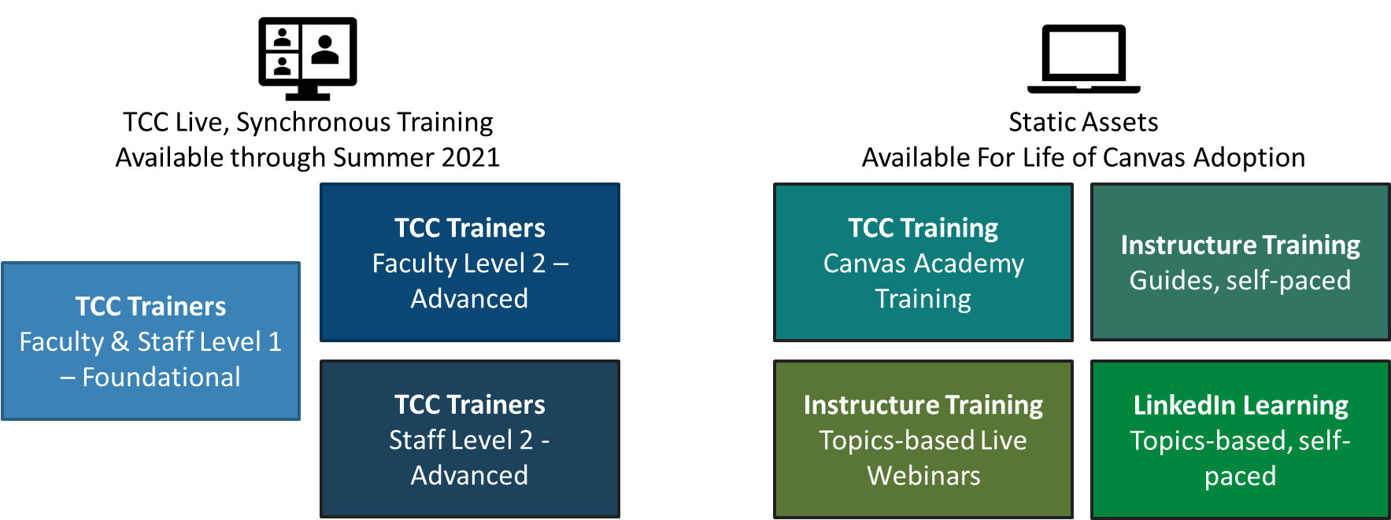
Canvas Training Array Overview
Notes:
<Allegra Davis>
Constructed by the IILE Canvas Training Focus Team, this Training Array is built as a course in Canvas. All TCC users will have this course in their Canvas dashboard. It will include
Template for Canvas Homepage
Template for Square One Student Course Orientation module
Sample Module
Information on Live, Online Training sessions
Guides, Videos, and Resources from Canvas (Community, videos, etc.)
TCC Canvas Academy Training (CAT)
Additional resources (for example, LinkedIn Learning)

Slide 43
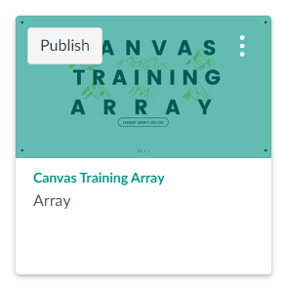
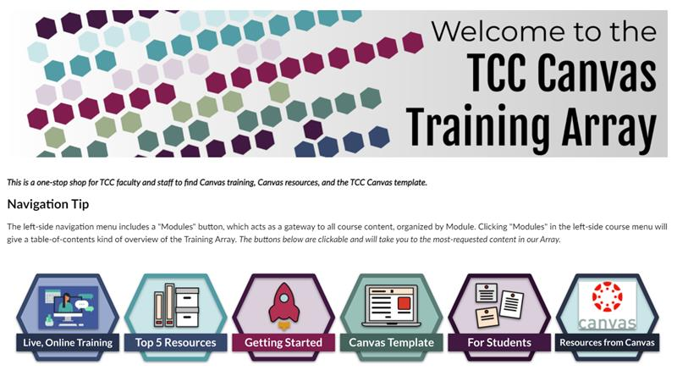
TCC Training Array in Canvas
Notes:
<Allegra Davis>
All faculty and LMS-using staff will have access to this TCC training array when Canvas becomes available.

Slide 44
WHY IT’S WORKING

Slide 45
WE WERE INTENTIONAL (and lucky)
Add-Ons
Size
Experience
- Change management and training support included on the contract
- VPS and ePortfolio tool involved Academic Affairs
- 6K courses converted (which is fewer than the number of sections offered in a semester)
- 2 LMS team members working on Canvas
- Contractors to handle Blackboard and Help Desk
- Contract additional ID support
- ID Team
- eLearning campus
- College poised to initiate strategic projects
- Listen to (and sometimes ignore) people who were here last time we changed our LMS

Slide 46
WE KEPT THREE THINGS IN MIND
TEACHING
INFORMATION
SHARING
PARTNERSHIPS
- Faculty in leadership role on every team
– Functional criteria document at the center of all decision making
- Faculty and student needs in training assessed
- Presentations to Chancellor, campus leaders, faculty associations, Academic Council
- Canvas Countdown site for months before the launch
- Open channels with all campuses through each team
- IT
- CTL
- Connect Campus
- Campus Presidents
- Learning Commons
- Faculty Association
- Assessment
- Procurement

Slide 47
PROJECT MANAGEMENT
RESPONSIBLE
Identifying who does the work (individuals or teams)
ACCOUNTABLE
Identifying who delegates and reviews – one per task
R
A
Asked for input, invited to discussions and ad hoc meetings
CONSULTED
Kept updated on big changes
INFORMED
I
C

Slide 48
Gantt Charts
RACI Matrix
Scrum Meeting
Operationalization
SOW
Hypercritical

Slide 49
DANGER ZONES

Slide 50


Lots of people want to coach, advise, cheer, and boo…
Who is carrying the ball?

Slide 51
HAZARDOUS
(NO MATTER WHAT YOU DO)
Communication
Change
Management
All the Chefs
- Never enough
– Never soon enough
- No matter what, people will “not know what’s going on!!!!!!!”
- 10/80/10
- Too fast
- Too slow
- Anxiety and hand-holding
- Lots of people are the experts
- Lots of people “should have been involved sooner”
- Lots of people have lots of reasons they need access sooner

Slide 52
Advice for working with Them:
Always give them something to do
Always give them someone to ask
Involve them
(in big or small ways)

Slide 53
QUESTIONS

