Slide 1


Reasonable Rigor
Natalie Russell
Allegra Davis Hanna
Misty Wilson-Mehrtens

Slide 2
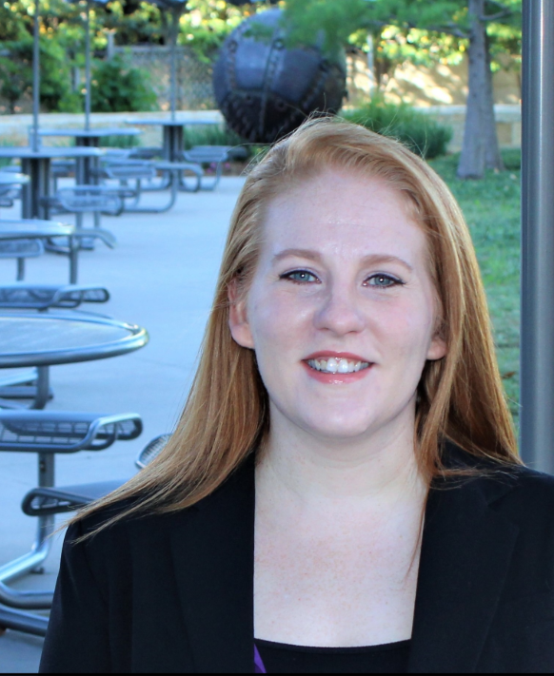
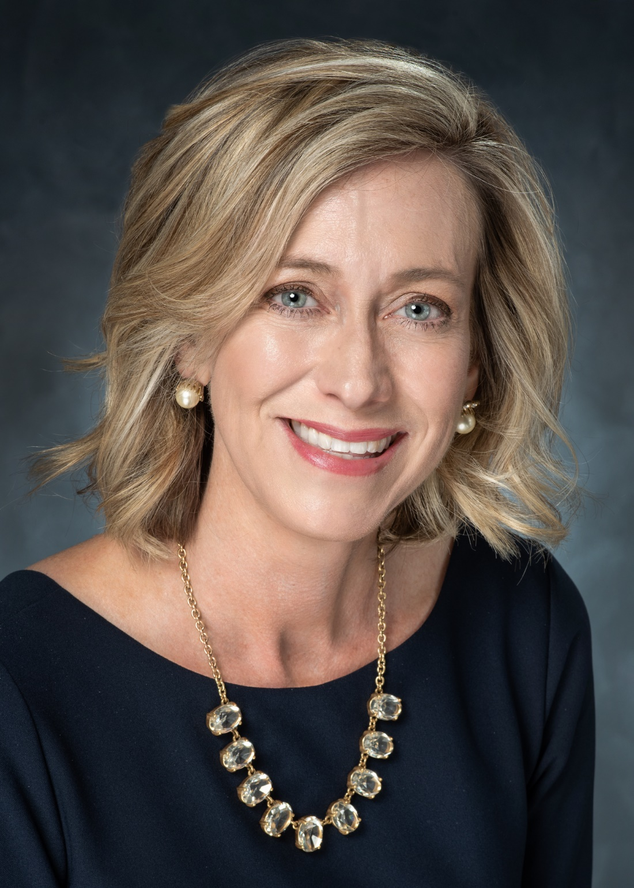
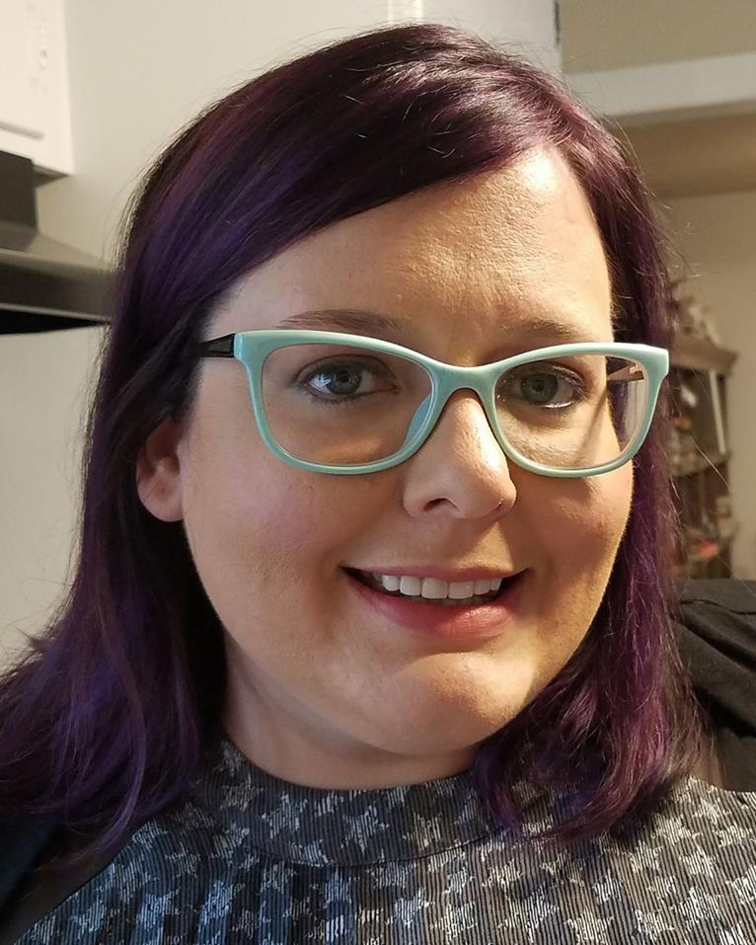
Reasonable Rigor Rangers
Misty Wilson-Mehrtens
Natalie Russell
Allegra Davis Hanna

Slide 3
Think of a time when
you wanted someone else
to “be reasonable.”
Notes:
Allegra

Slide 4
What is
Reasonable Rigor?
Notes:
Natalie

Slide 5
Communication
Course Policies
Flexibility
Technology
Notes:
Misty

Slide 6



Communicating
Announcements
Tone
Answering Questions
Notes:
Allegra

Slide 7
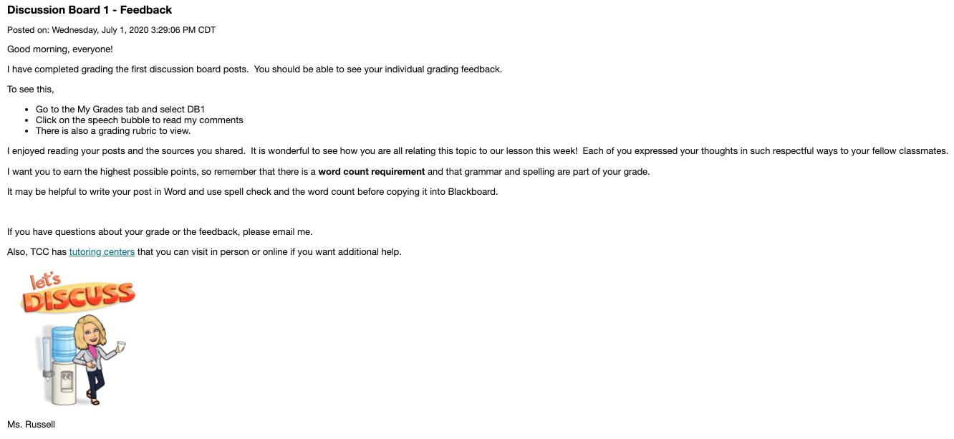
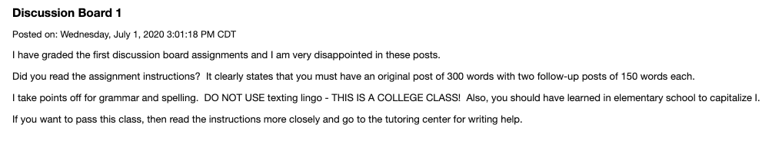
Announcements
Reminders are helpful and an encouraging tone goes a long way.
Post and send as email; leave this up for the duration of the term – no disappearing acts.
Notes:
Misty / Natalie

Slide 8
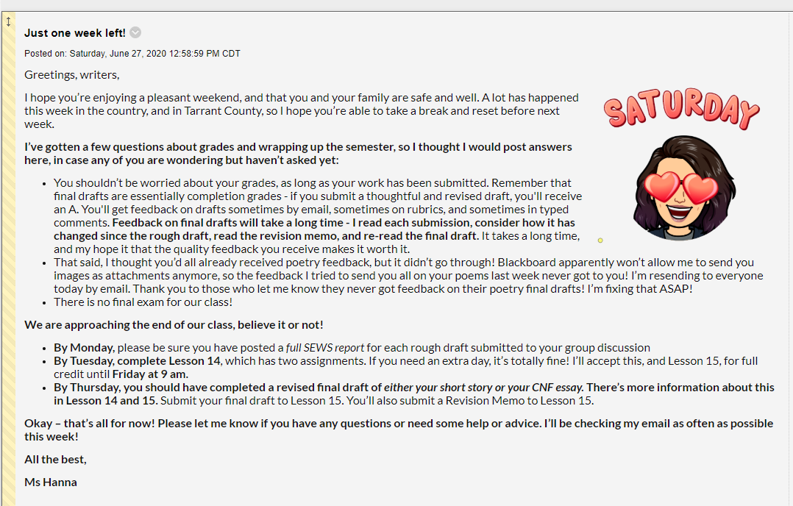
Notes:
Allegra

Slide 9
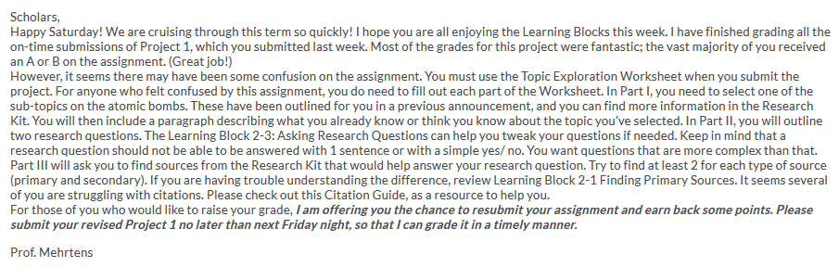
Notes:
Misty

Slide 10
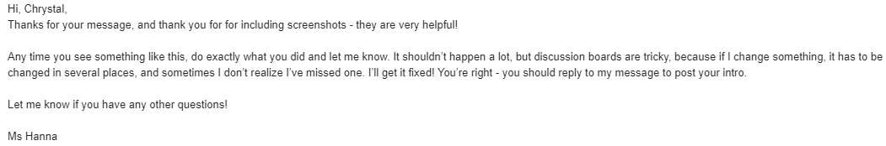
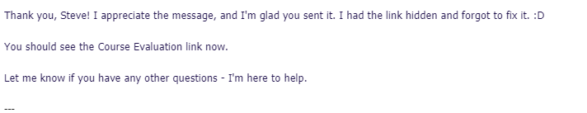
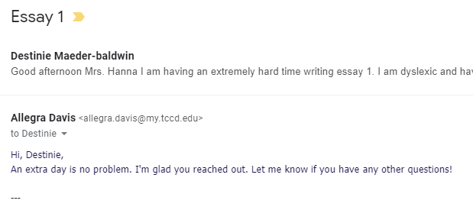
Notes:
Allegra (we make mistakes – nice emails)

Slide 11





Set the Tone: Course Policies
Attendance
Late Work
Discussion Board Etiquette
Extra Credit
Academic Integrity
Notes:
Natalie

Slide 12
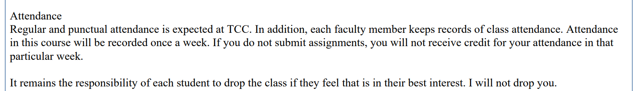
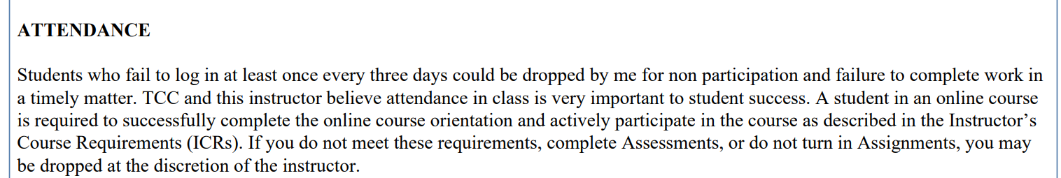
Attendance
You definitely need to take attendance
Your attendance policy should be clearly stated
Notes:
Natalie

Slide 13
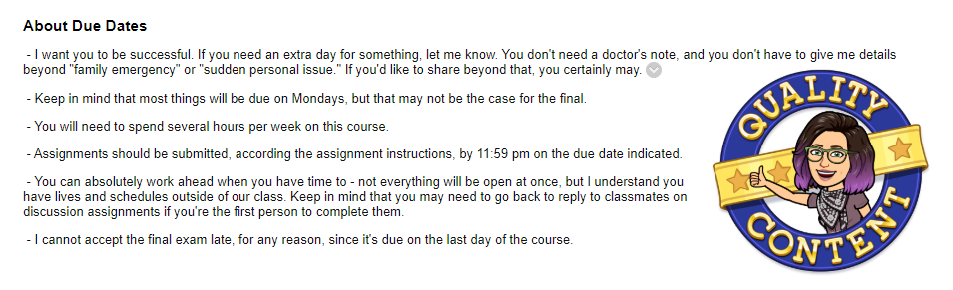
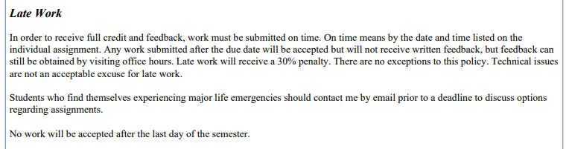
Late Work
Consistent policy (word it well and don’t make exceptions)
Avoid asking for documentation
Notes:
Allegra

Slide 14
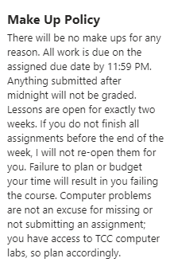
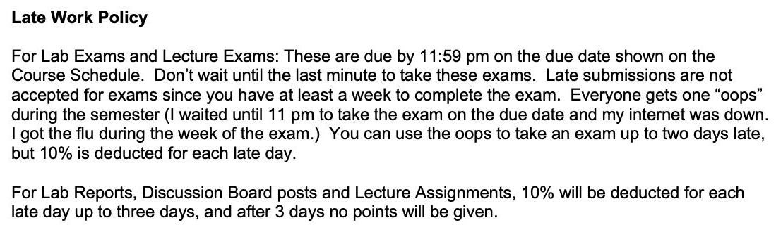
Notes:
Allegra

Slide 15
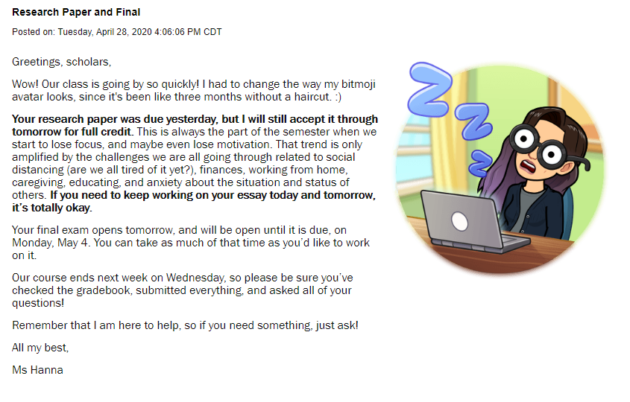
Notes:
Allegra

Slide 16
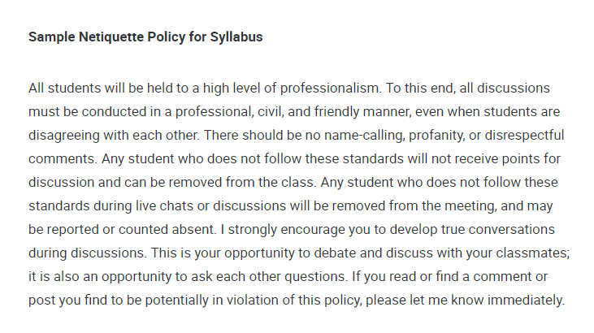

Discussion Board Etiquette
Be clear and proactive
Emphasize and prioritize this policy in syllabus, course intro and announcements
Notes:
Misty

Slide 17
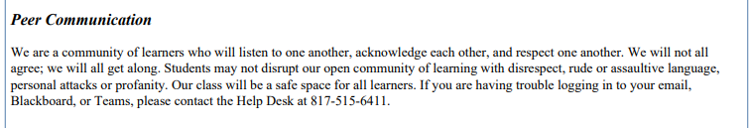
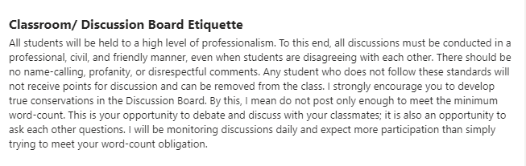
Notes:
Misty

Slide 18
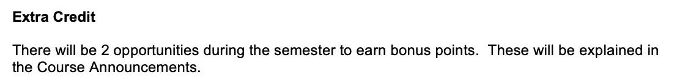
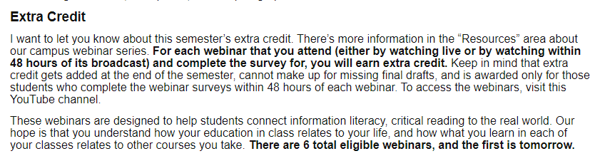
Notes:
Natalie

Slide 19


Extra Credit
To Do
To Avoid
  Consider
  Clearly explain
  Give options
  Make it relevant
  Exclusionary activities (like giving blood, voting, donating, buying)
  Excessive extras
Notes:
Allegra

Slide 20
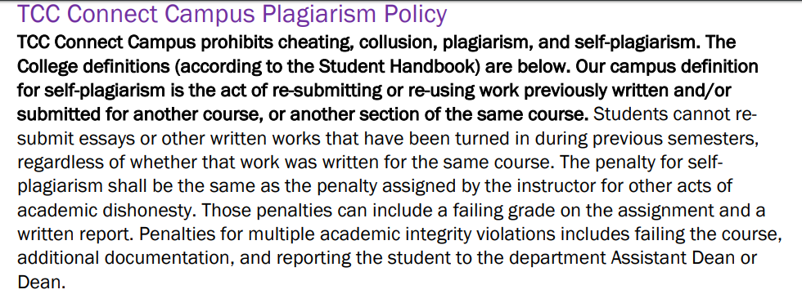
Academic Integrity
Notes:
Allegra

Slide 21





Bend, Don't Snap: Ways to Build Flexibility
Dropping Grades
Open Early
Oops Ticket
Optional Meetings
Re-Do
Notes:
Natalie intro
Dropping – Misty / Open Early – Allegra / Oops – Natalie / Optional Meeting – Natalie / Re-Do - Misty

Slide 22
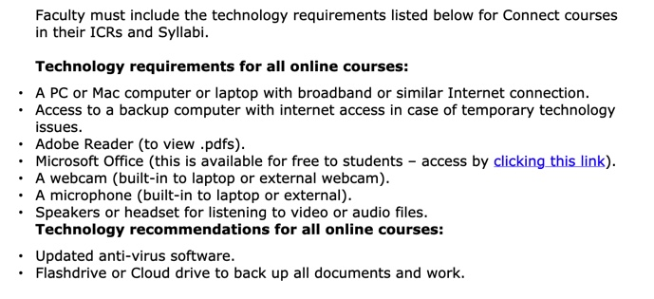
Technology: Clear Policies at the Start
What do students need to be successful?
Notes:
Allegra

Slide 23



















Technology: Simplify
Notes:
Misty

Slide 24

Technology: Synchronous Content
Notes:
Natalie

Slide 25
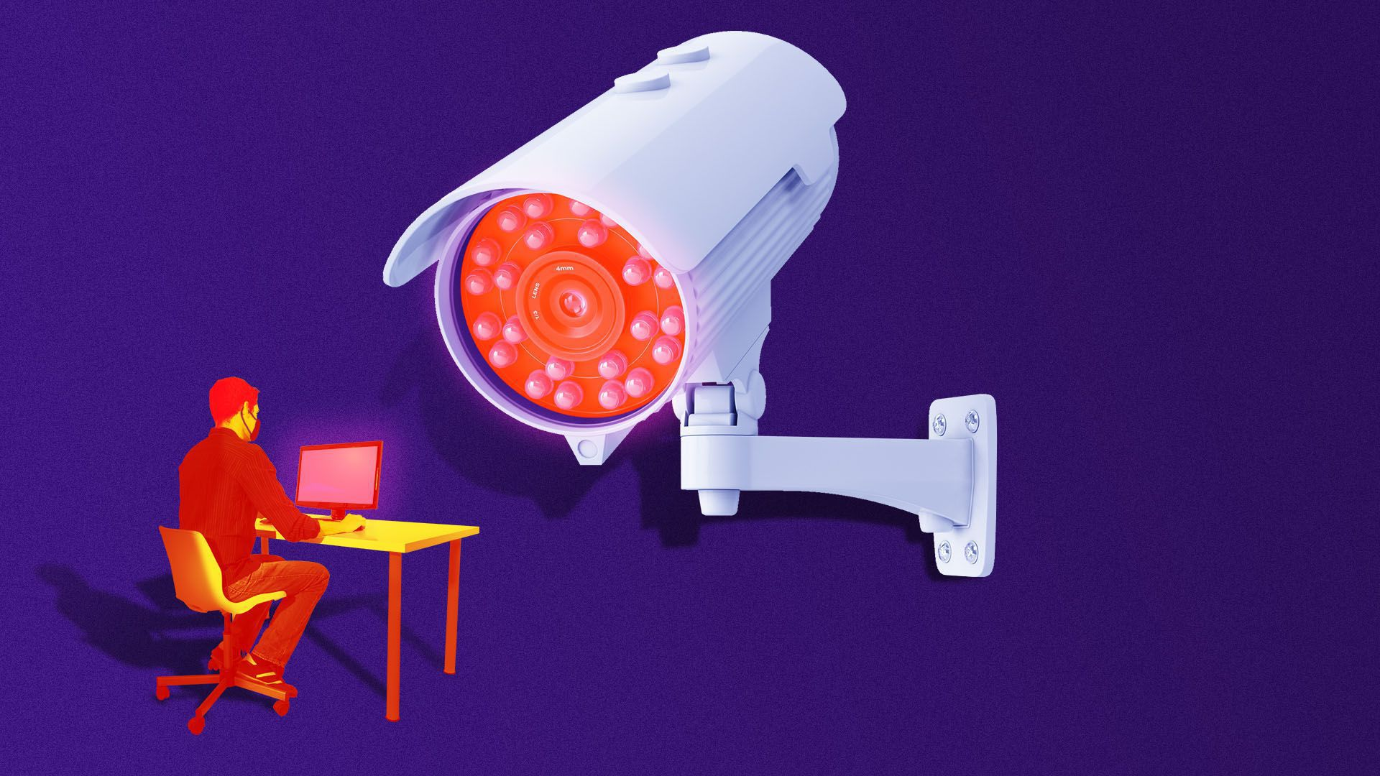
Technology: Cameras On?
Student comfort – Seeing themselves and being seen by everyone
Privacy – Would you want your professor in your home?
Bandwidth – Connectivity issues
Background – Bedrooms, living rooms, shared spaces
”Paying attention” – It doesn’t look the same for everyone
Penalties – If you require something, then there’s a consequence for not complying (grade penalties for something unrelated to course mastery)
Notes:
Allegra

Slide 26
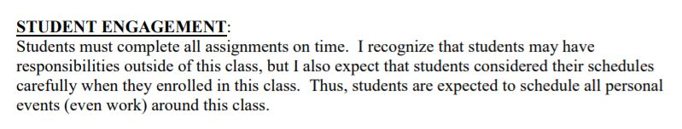
How You Say It Matters
Notes:
Allegra – most instructors mean well, but don’t realize how their “snark” makes students feel… prioritize classwork yes, unreasonable expectation no

Slide 27
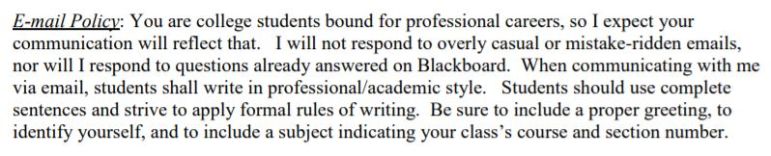
Consider Your Audience
Notes:
Misty – expect professional emails, and use mistakes as learning opportunities… refusing to reply

Slide 28
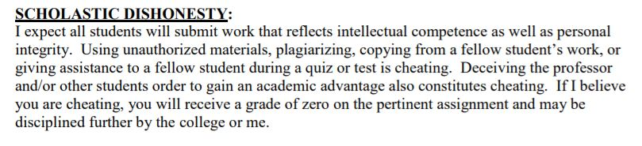

Check Your Phrasing…
Notes:
Misty - …don’t be rude. This makes students feel uncomfortable, and makes you unapproachable.

Slide 29
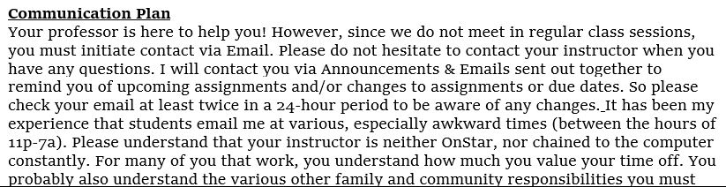


Leave Communication Lines Open
Notes:
Allegra – take every chance you get to encourage and invite students to reach out and ask questions, and be mindful that they might be working at “awkward times” and that’s okay.

Slide 30

Questions?
Natalie Russell
natalie.russell@tccd.edu
Allegra Davis Hanna
allegra.davis@tccd.edu
Misty Wilson-Mehrtens
misty.wilson@tccd.edu

