Slide 1


Slide 2
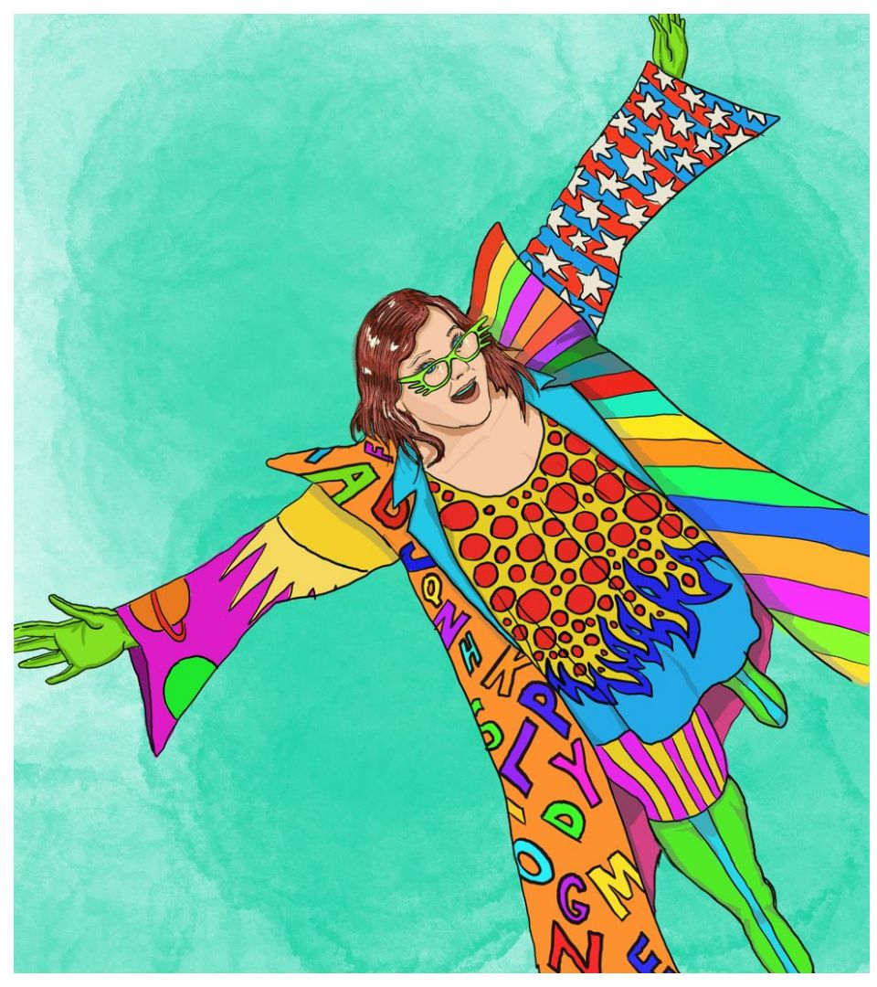

Slide 3


Slide 4
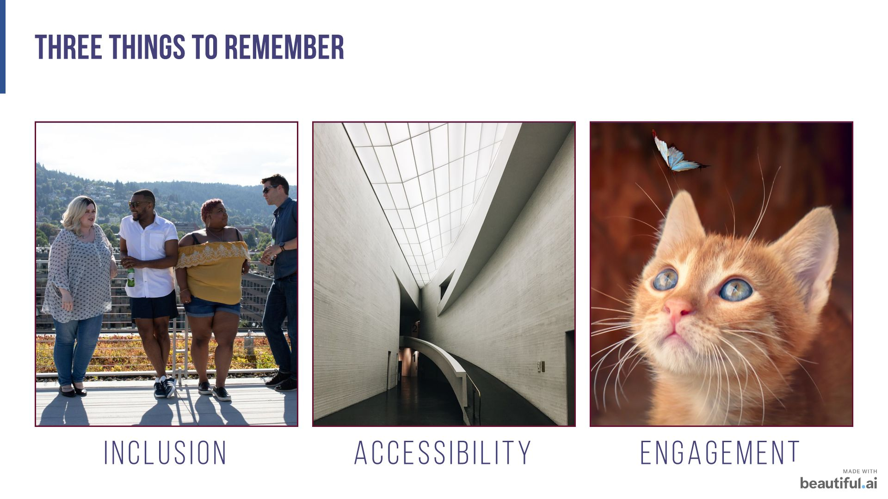

Slide 5


Slide 6


Slide 7


Slide 8
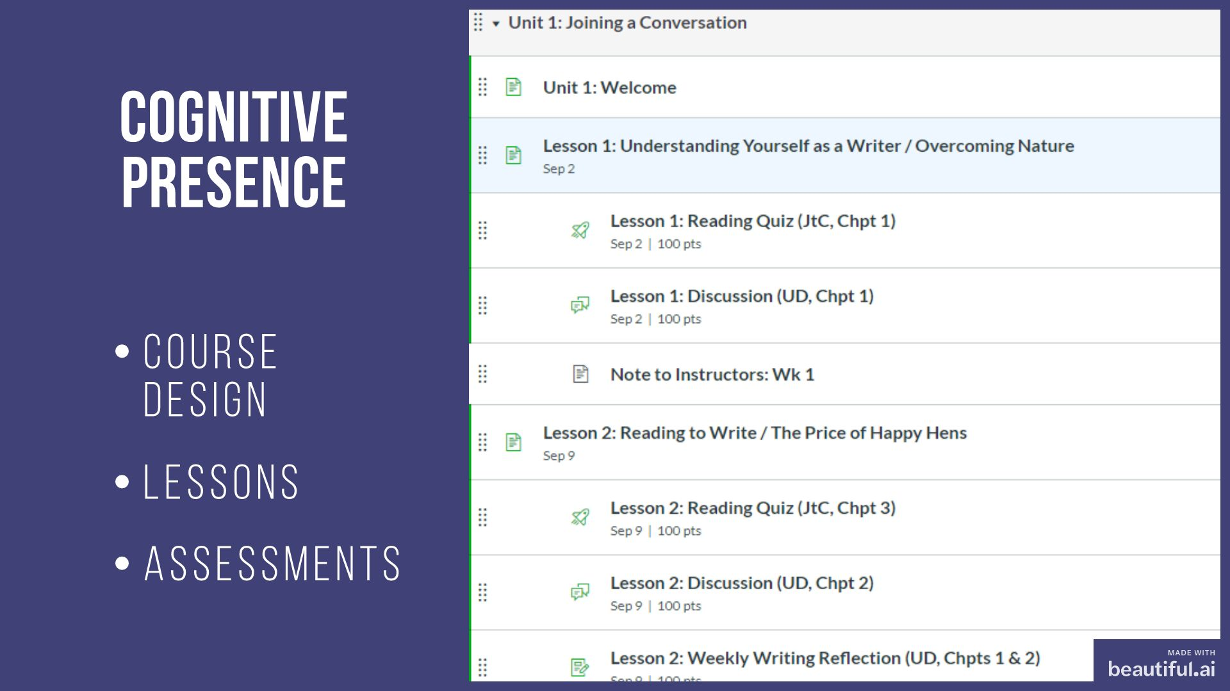

Slide 9
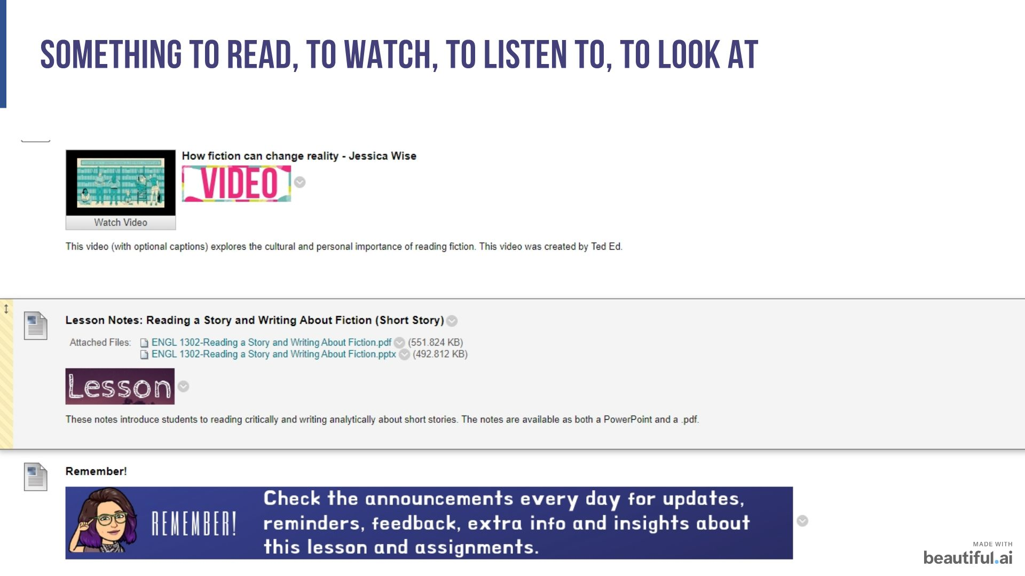

Slide 10
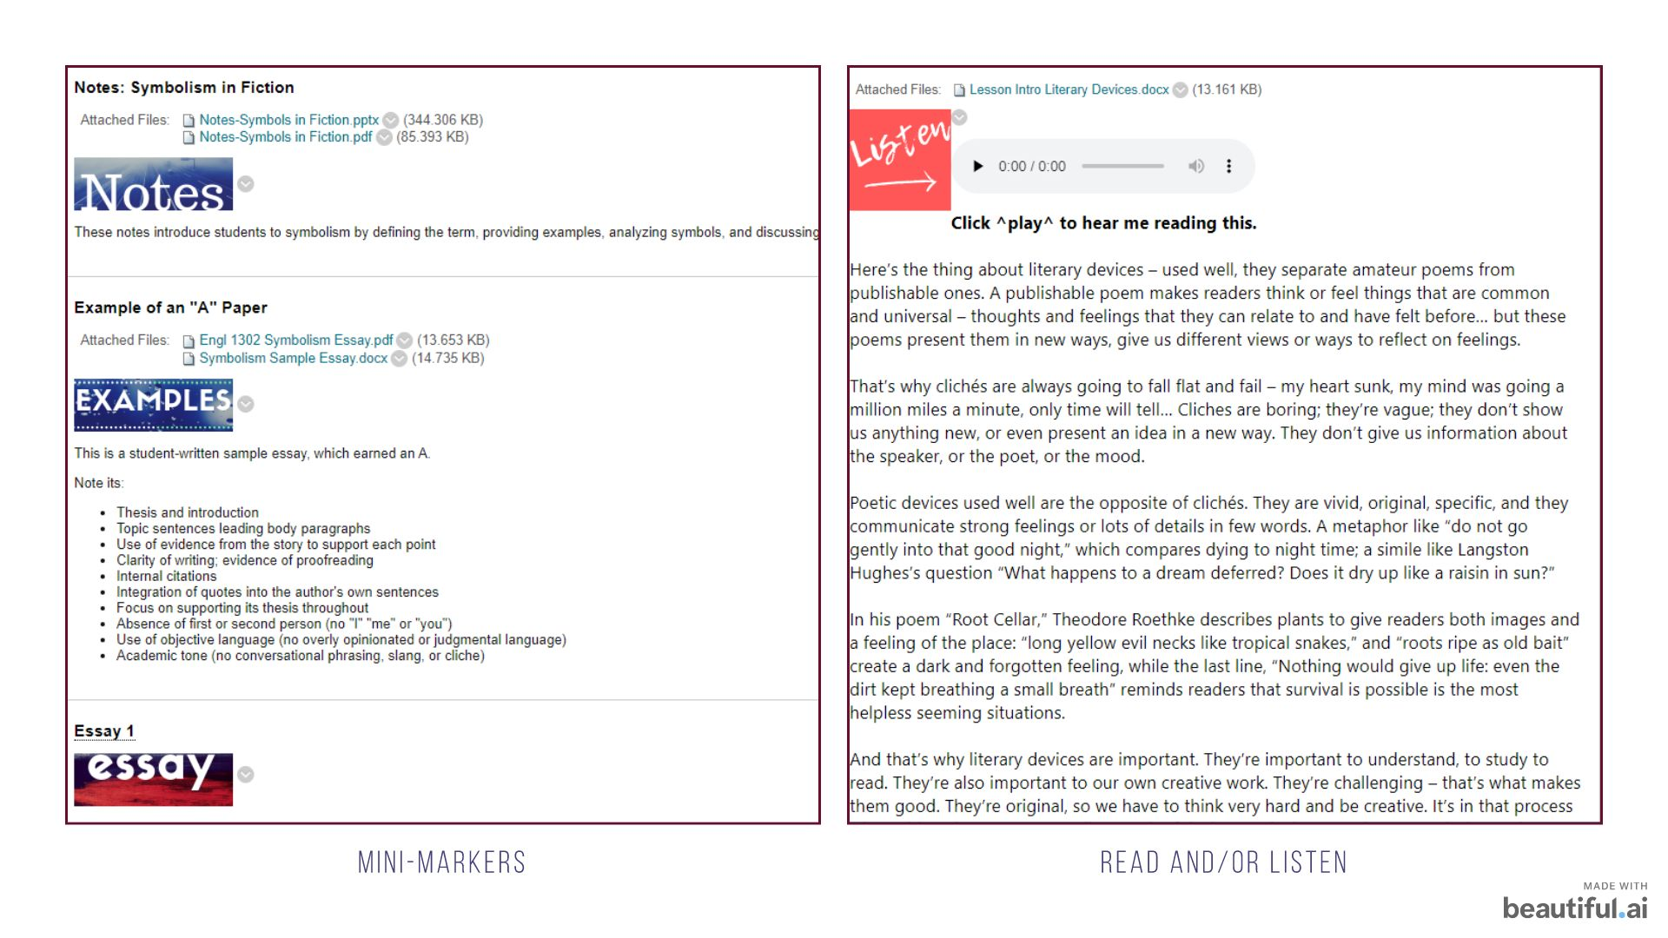

Slide 11
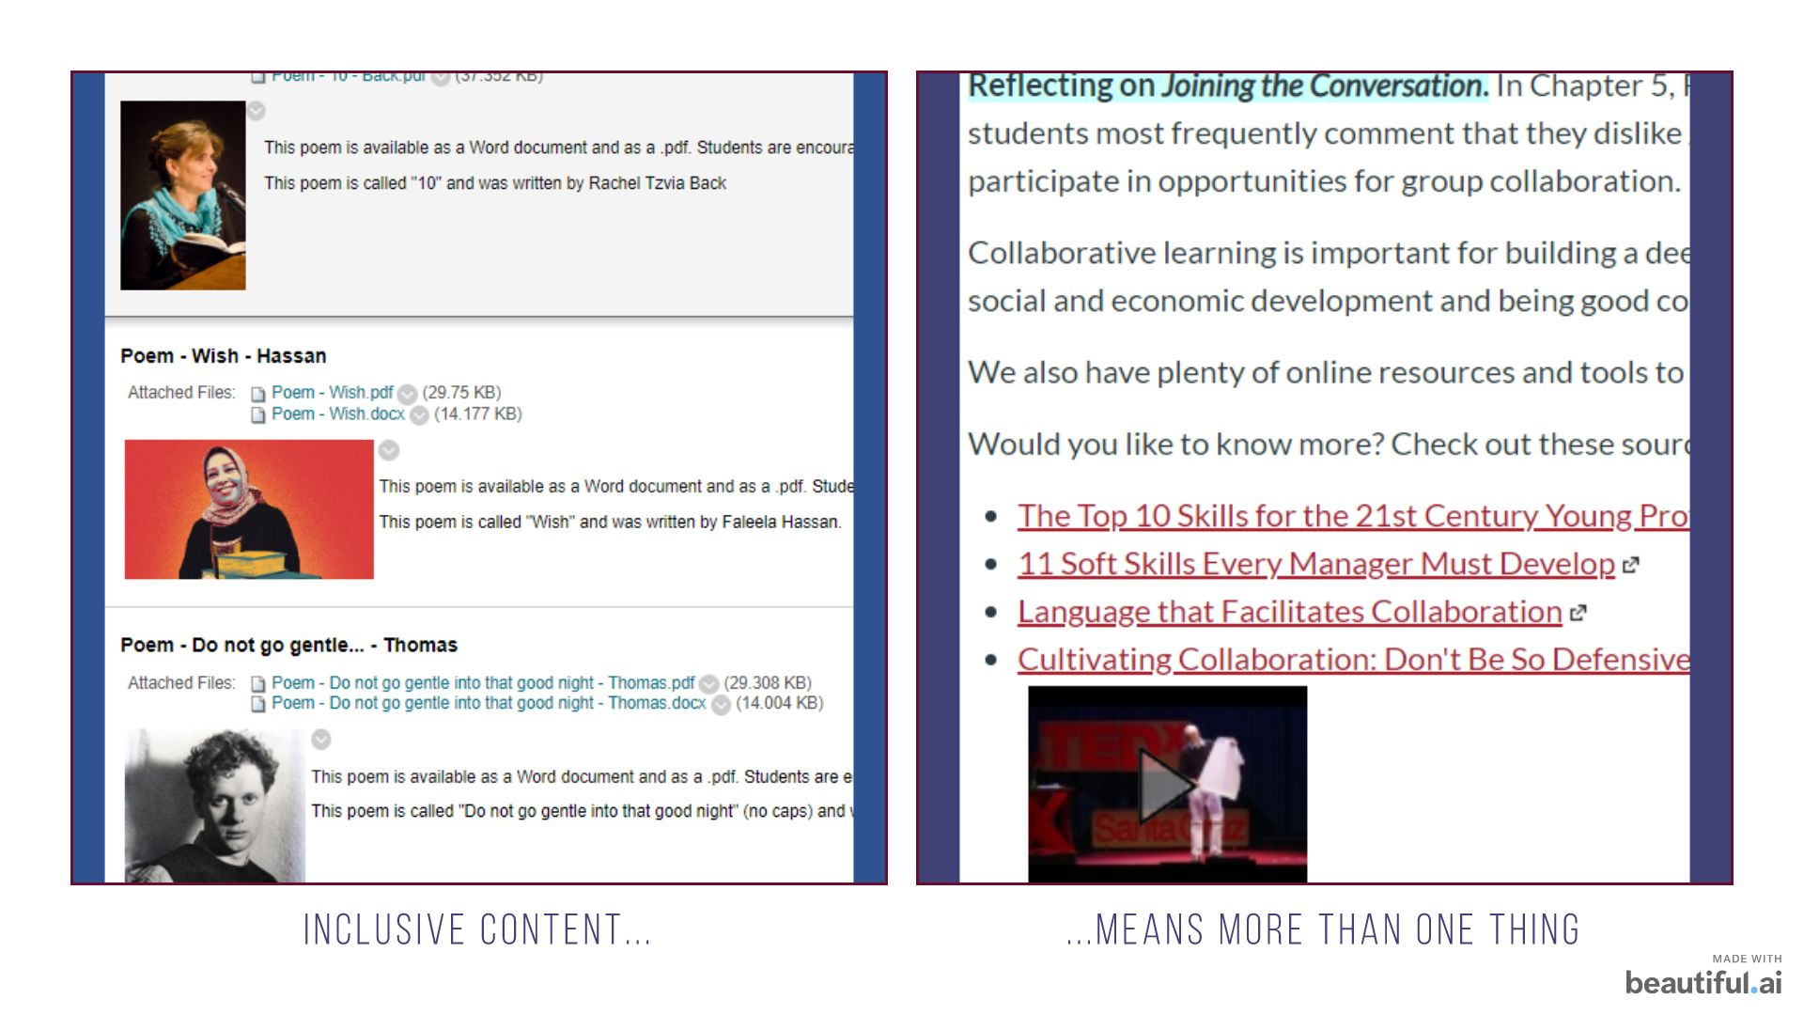

Slide 12
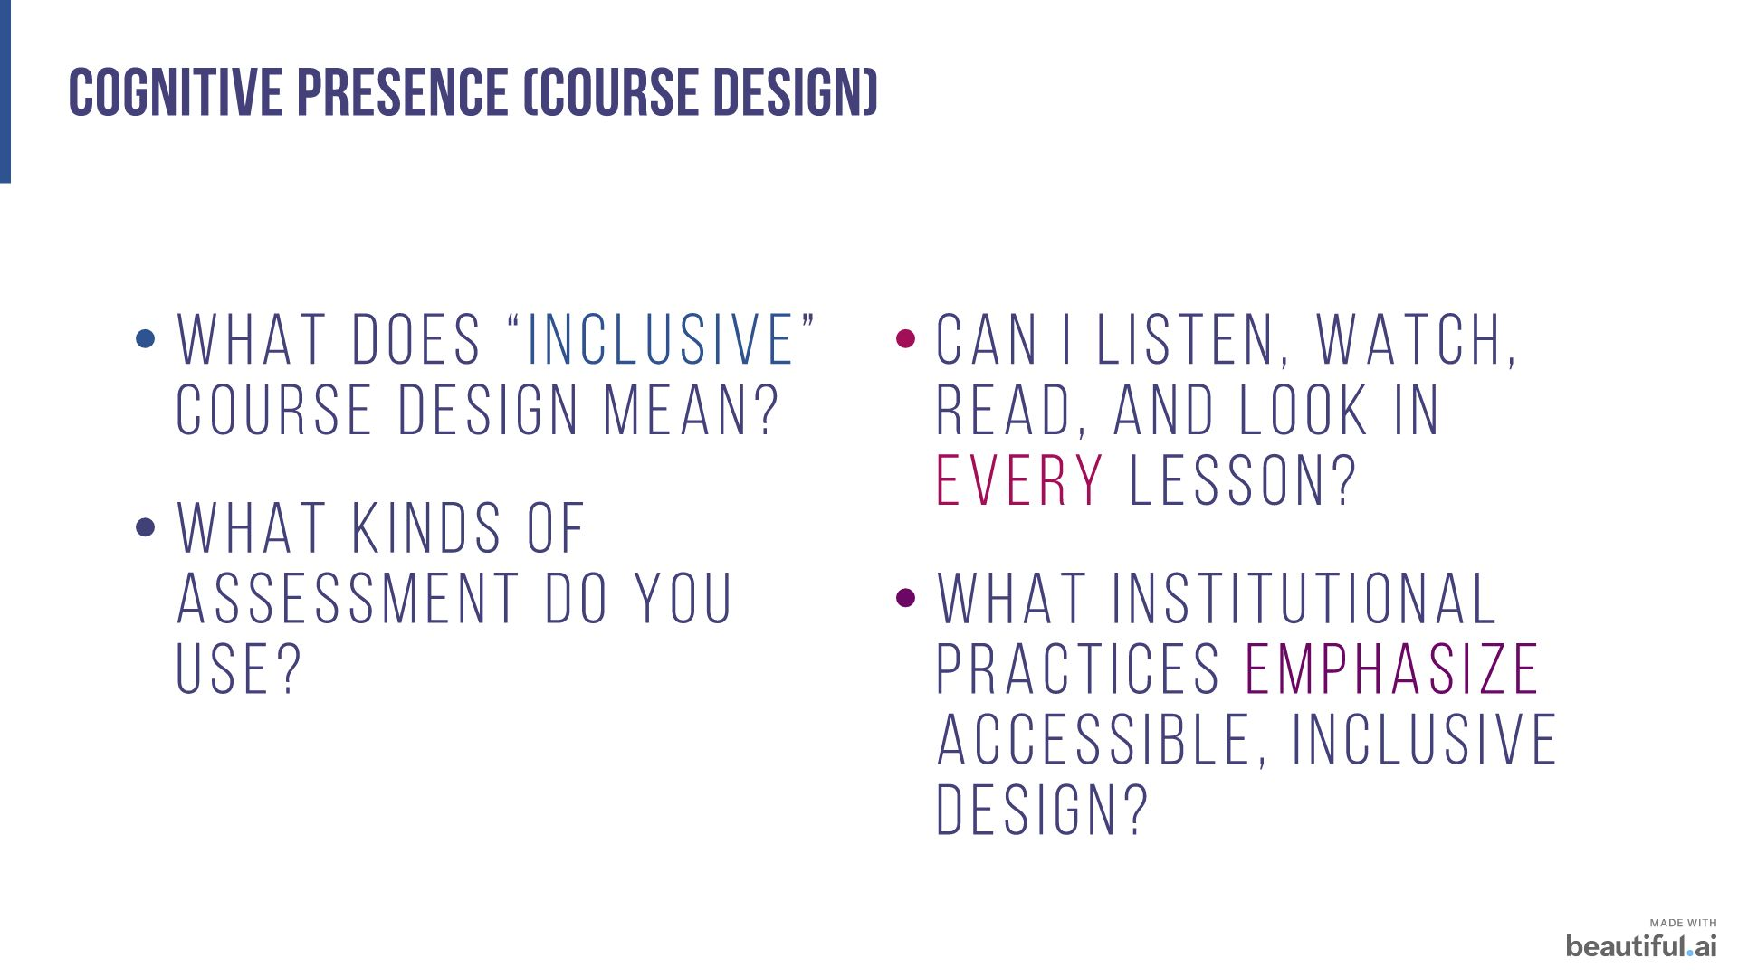

Slide 13
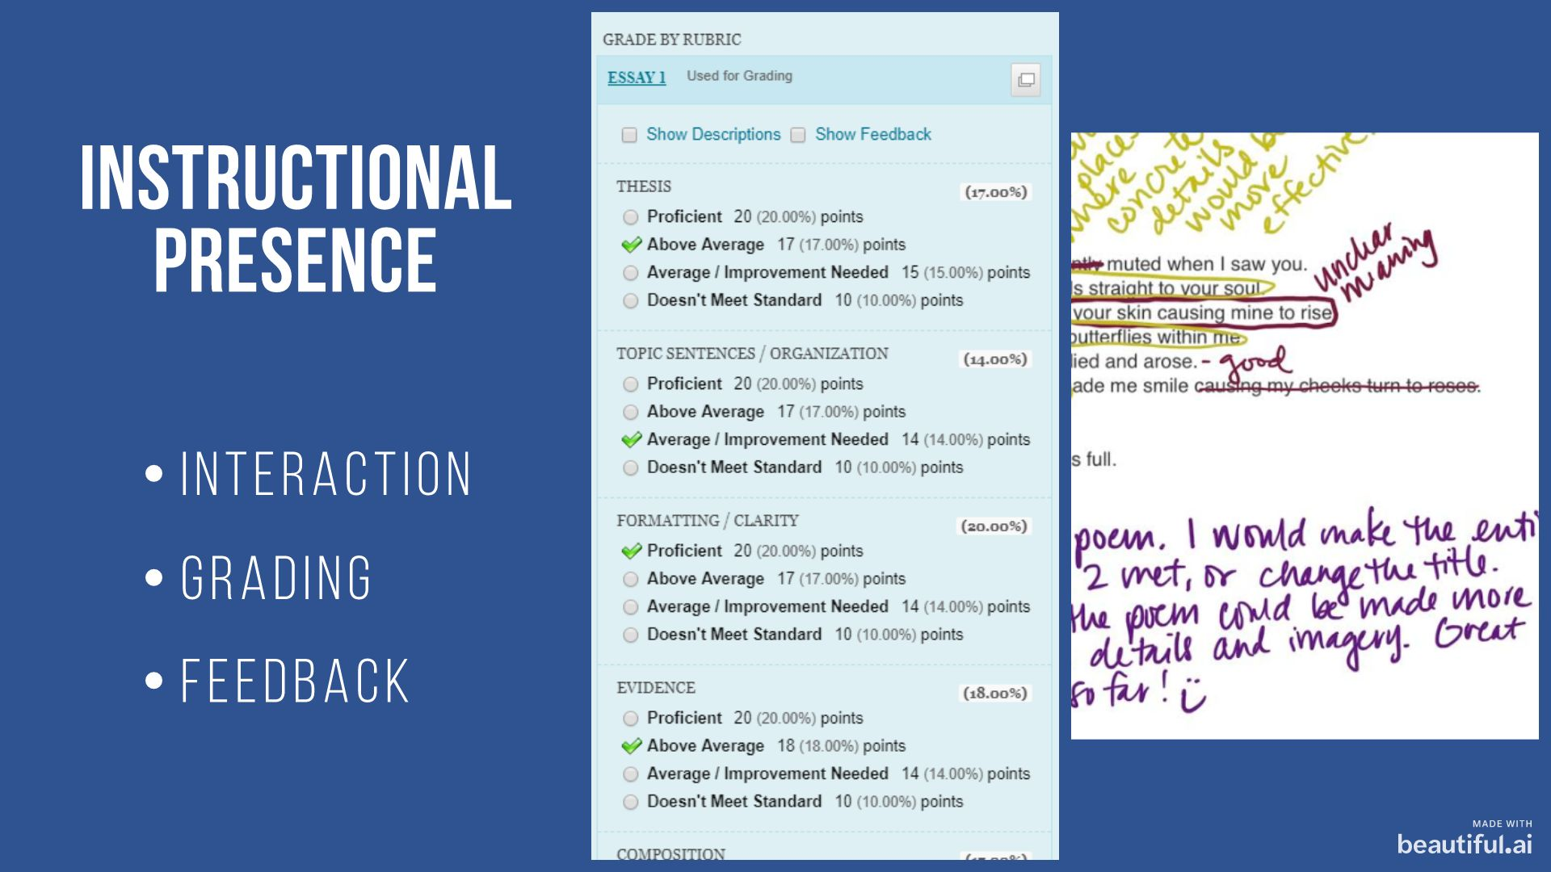


Slide 14


Slide 15
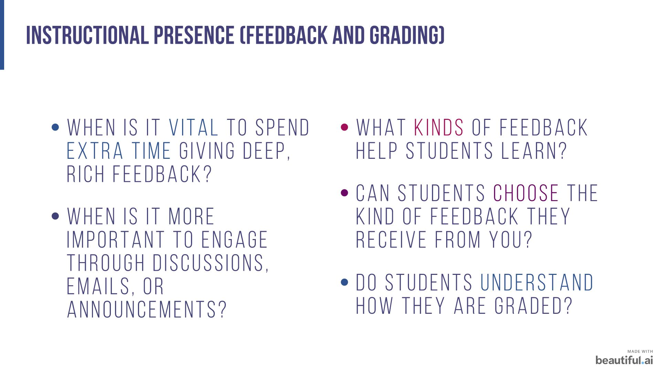

Slide 16
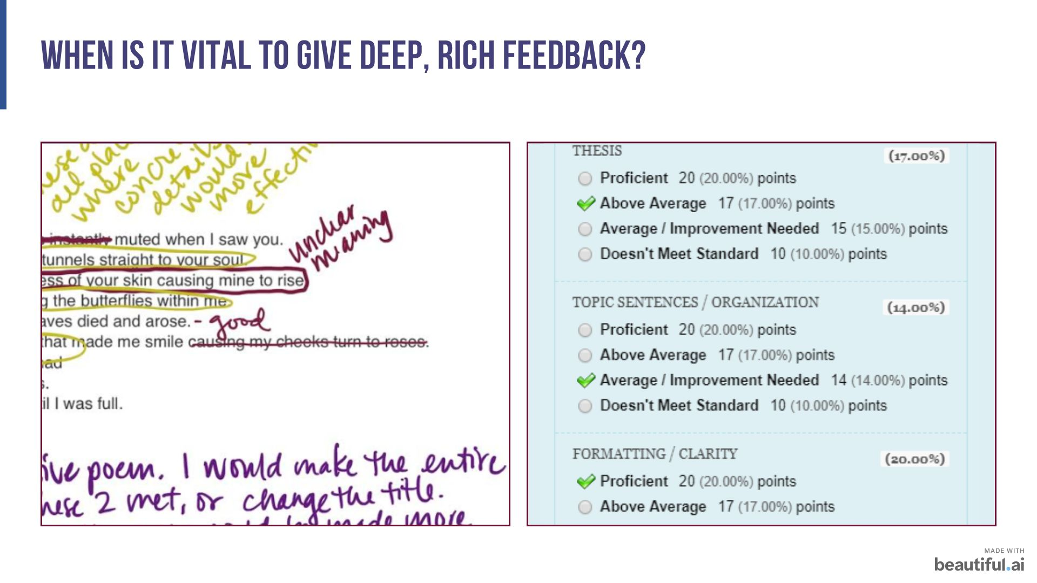

Slide 17
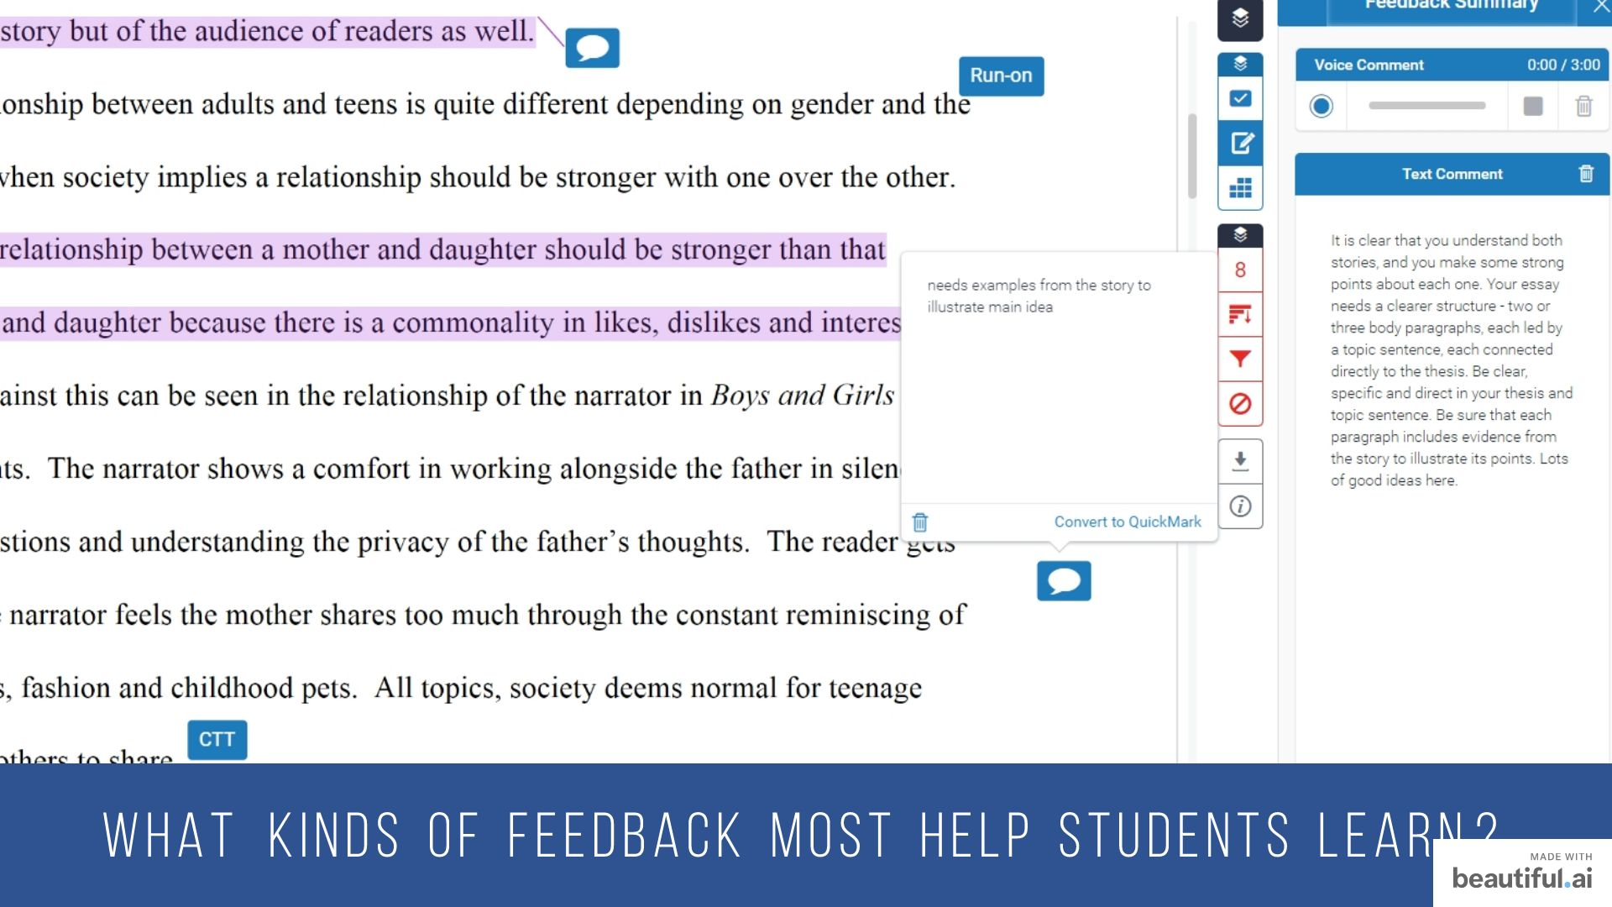

Slide 18
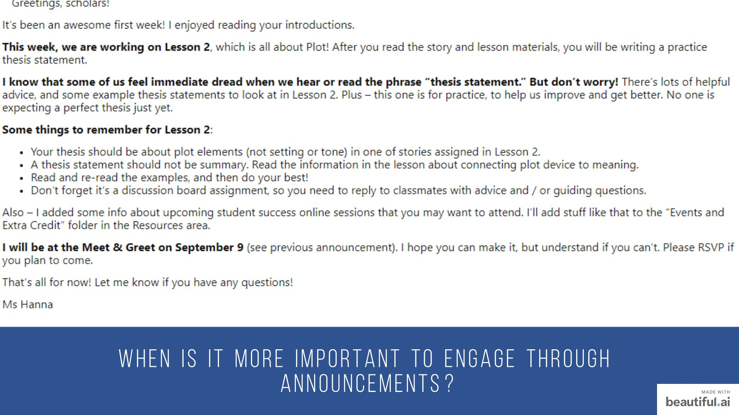

Slide 19
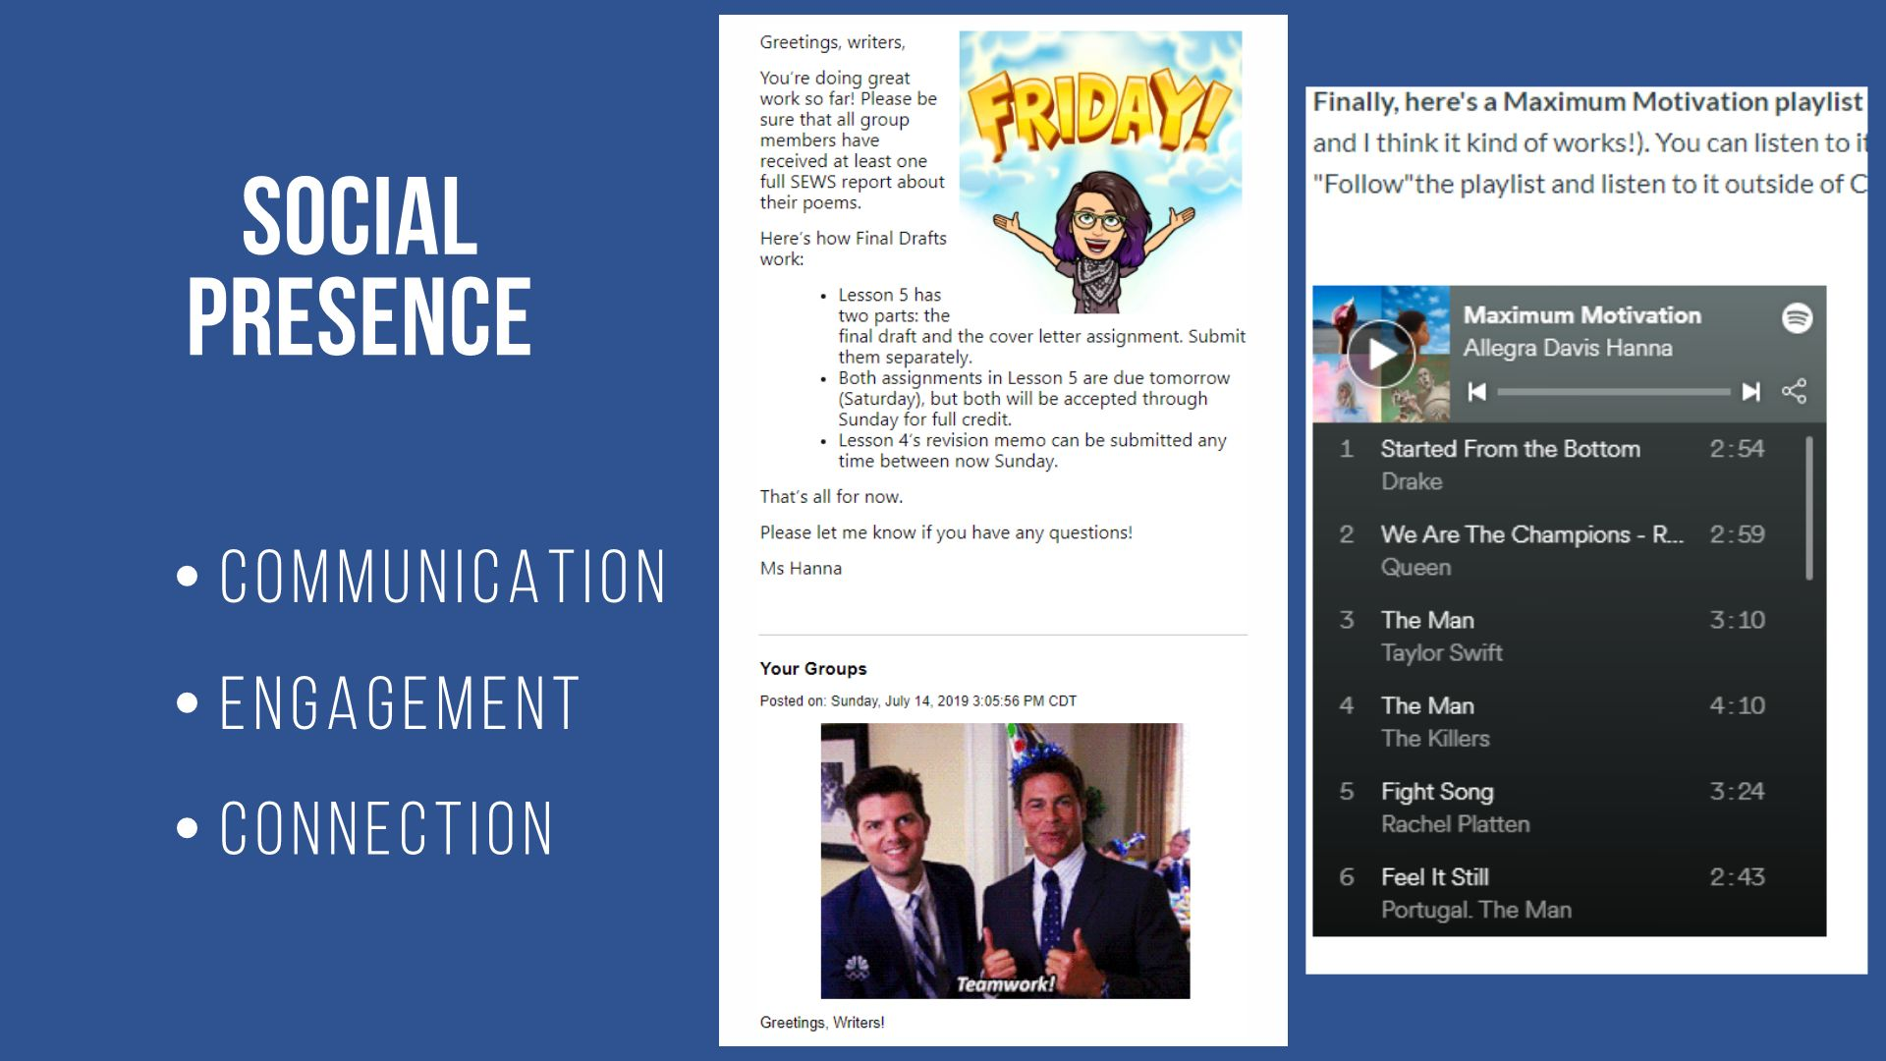

Slide 20
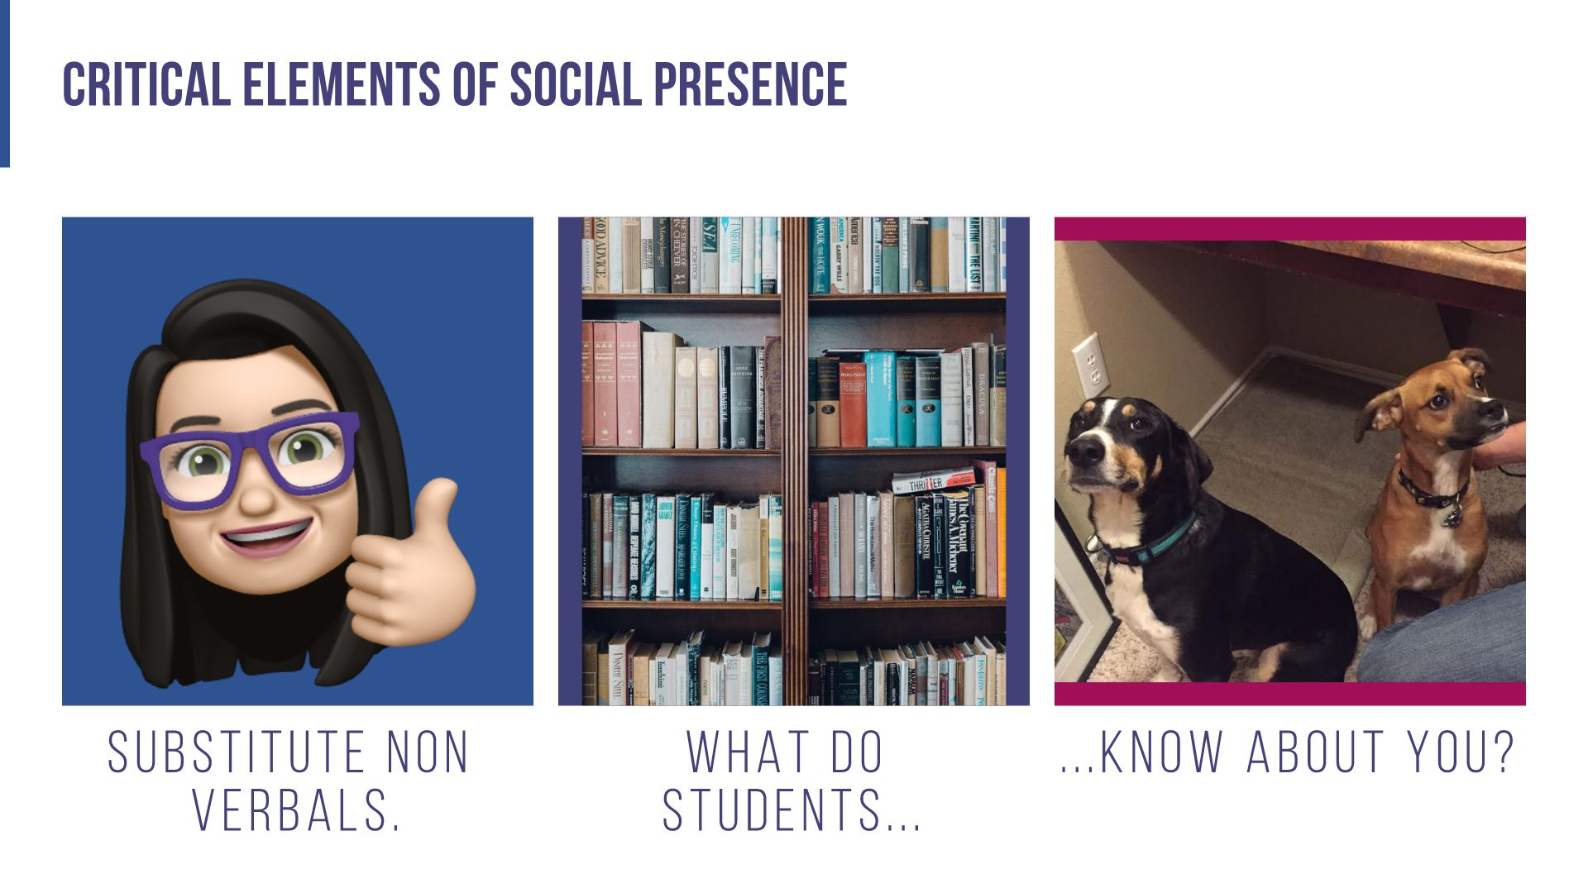

Slide 21
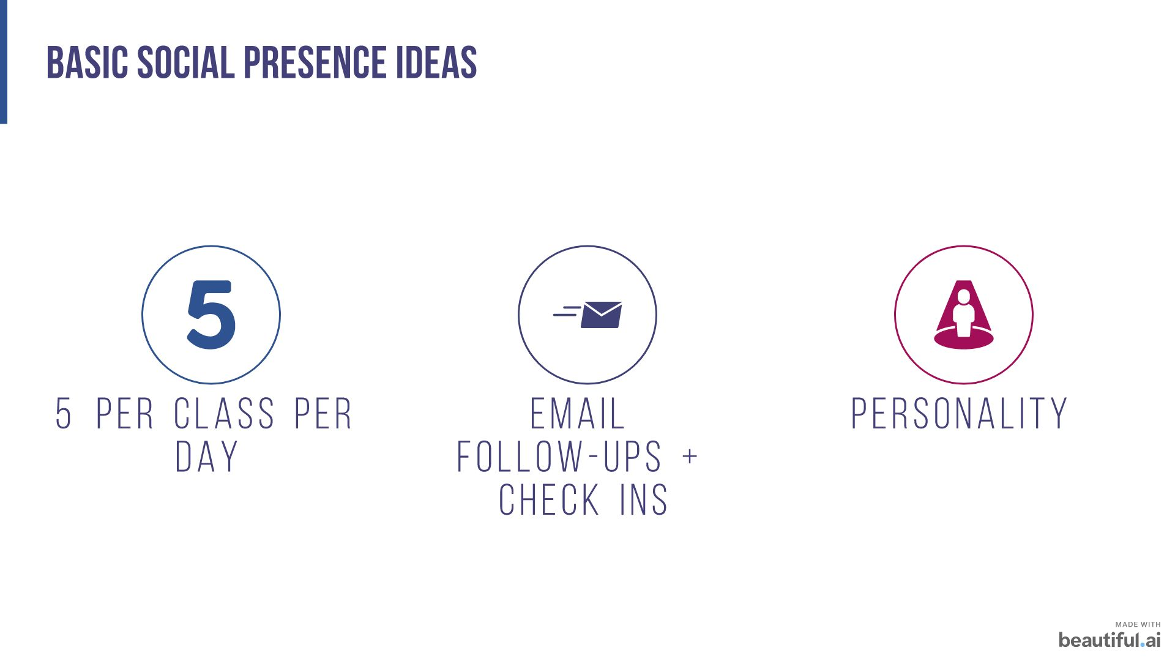

Slide 22
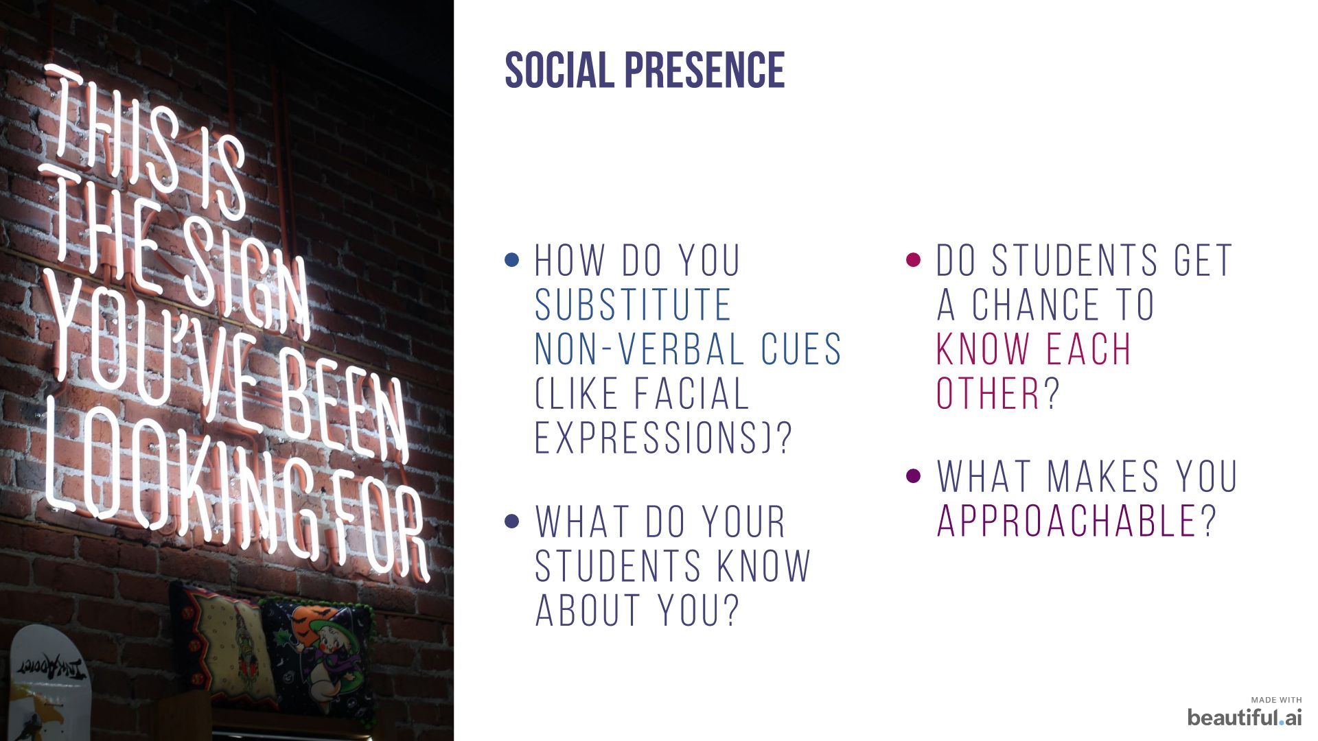

Slide 23


Slide 24
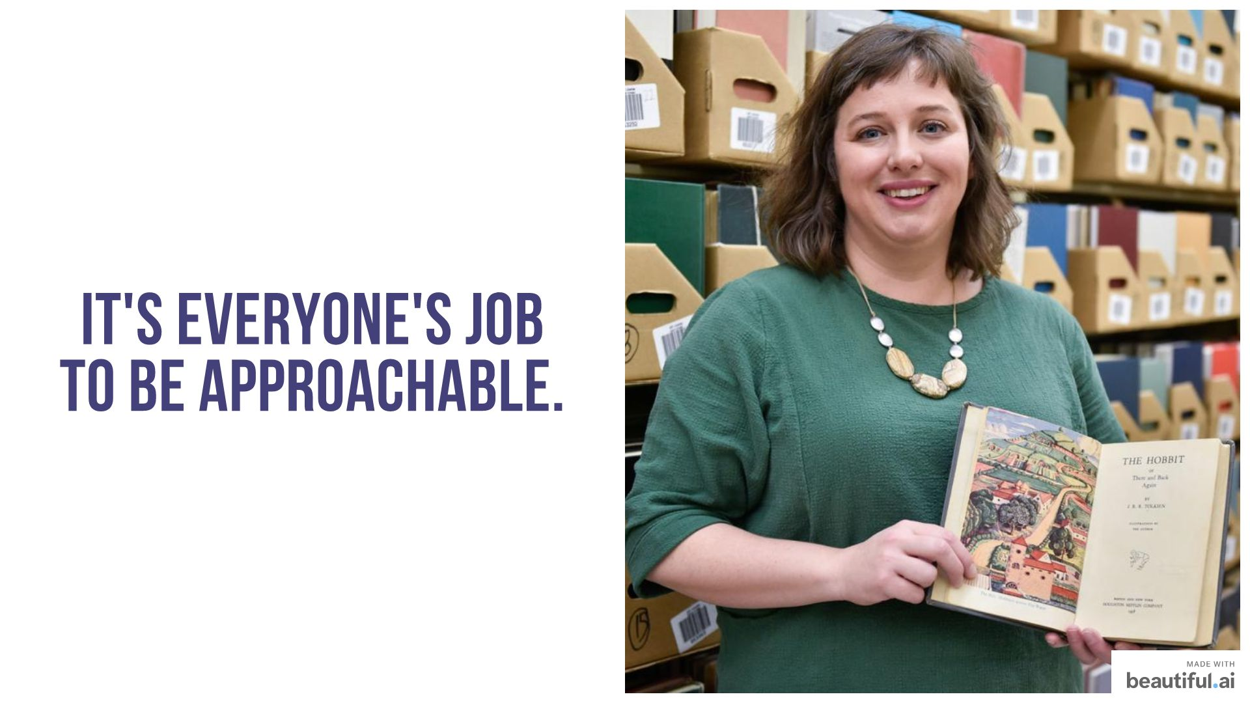

Slide 25
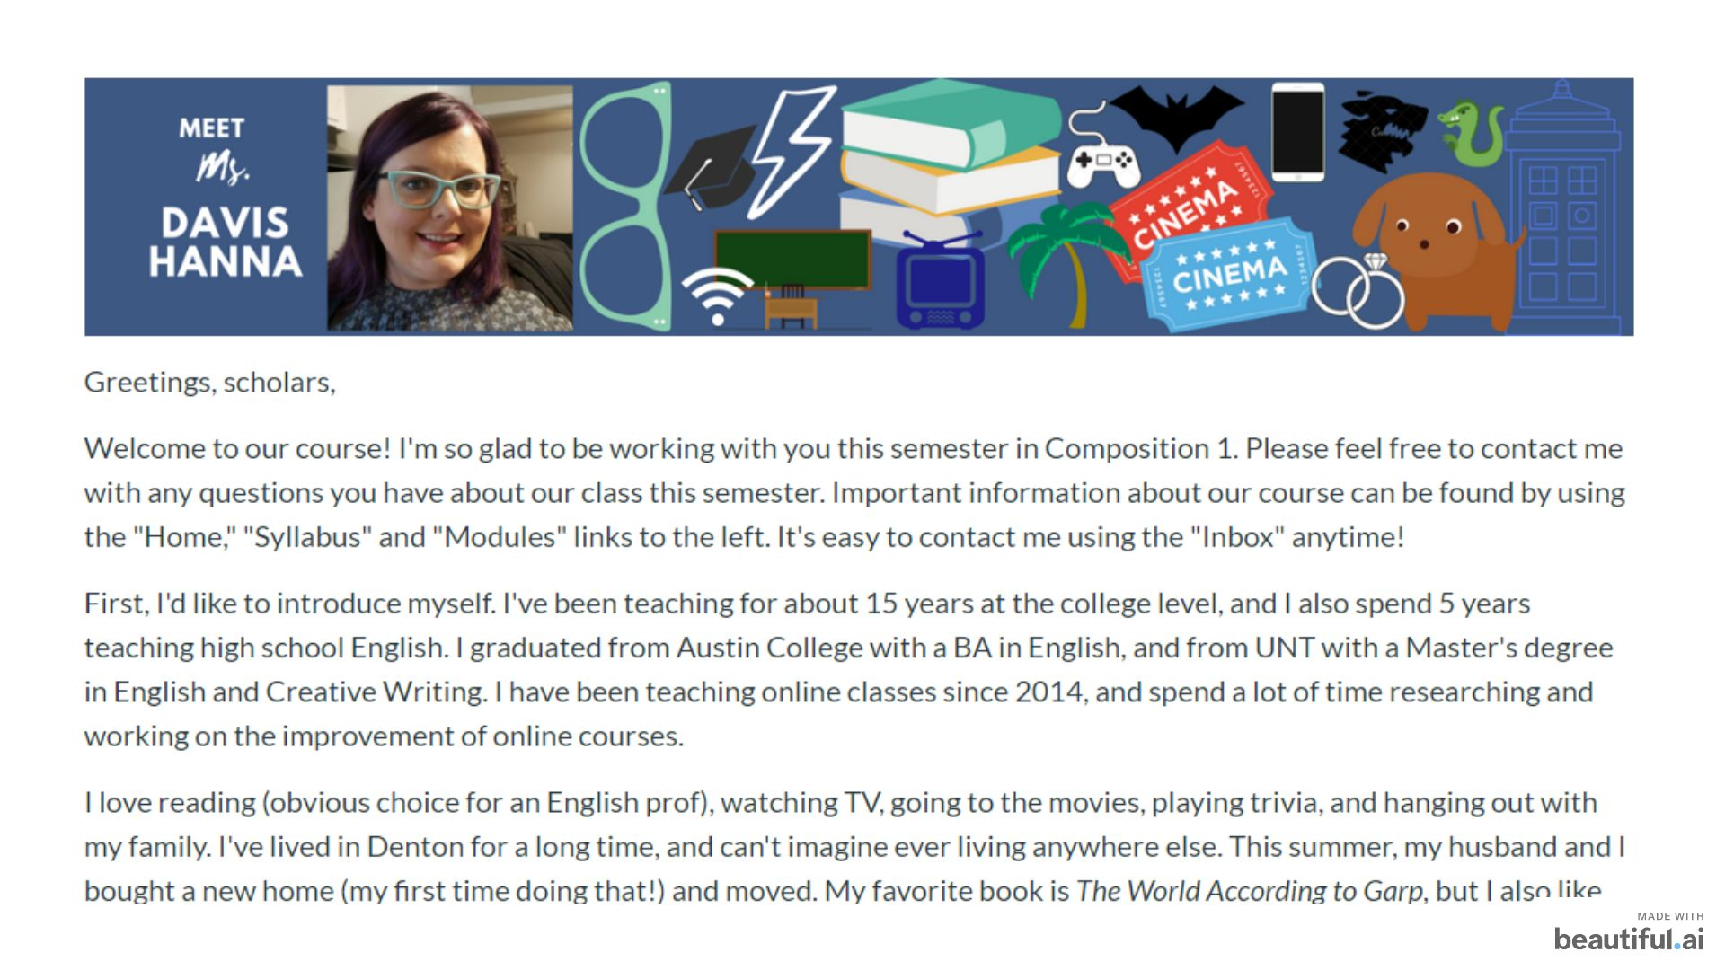

Slide 26
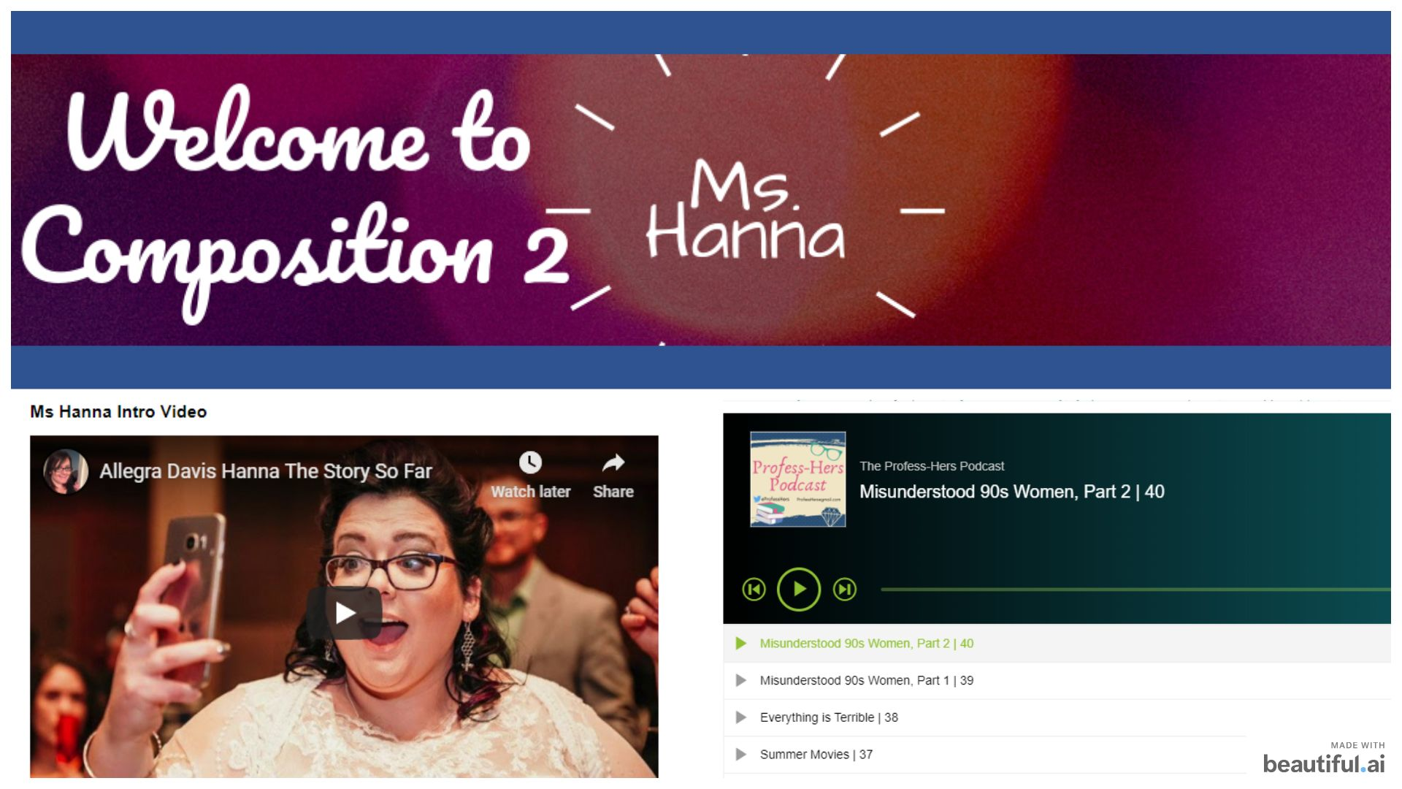

Slide 27
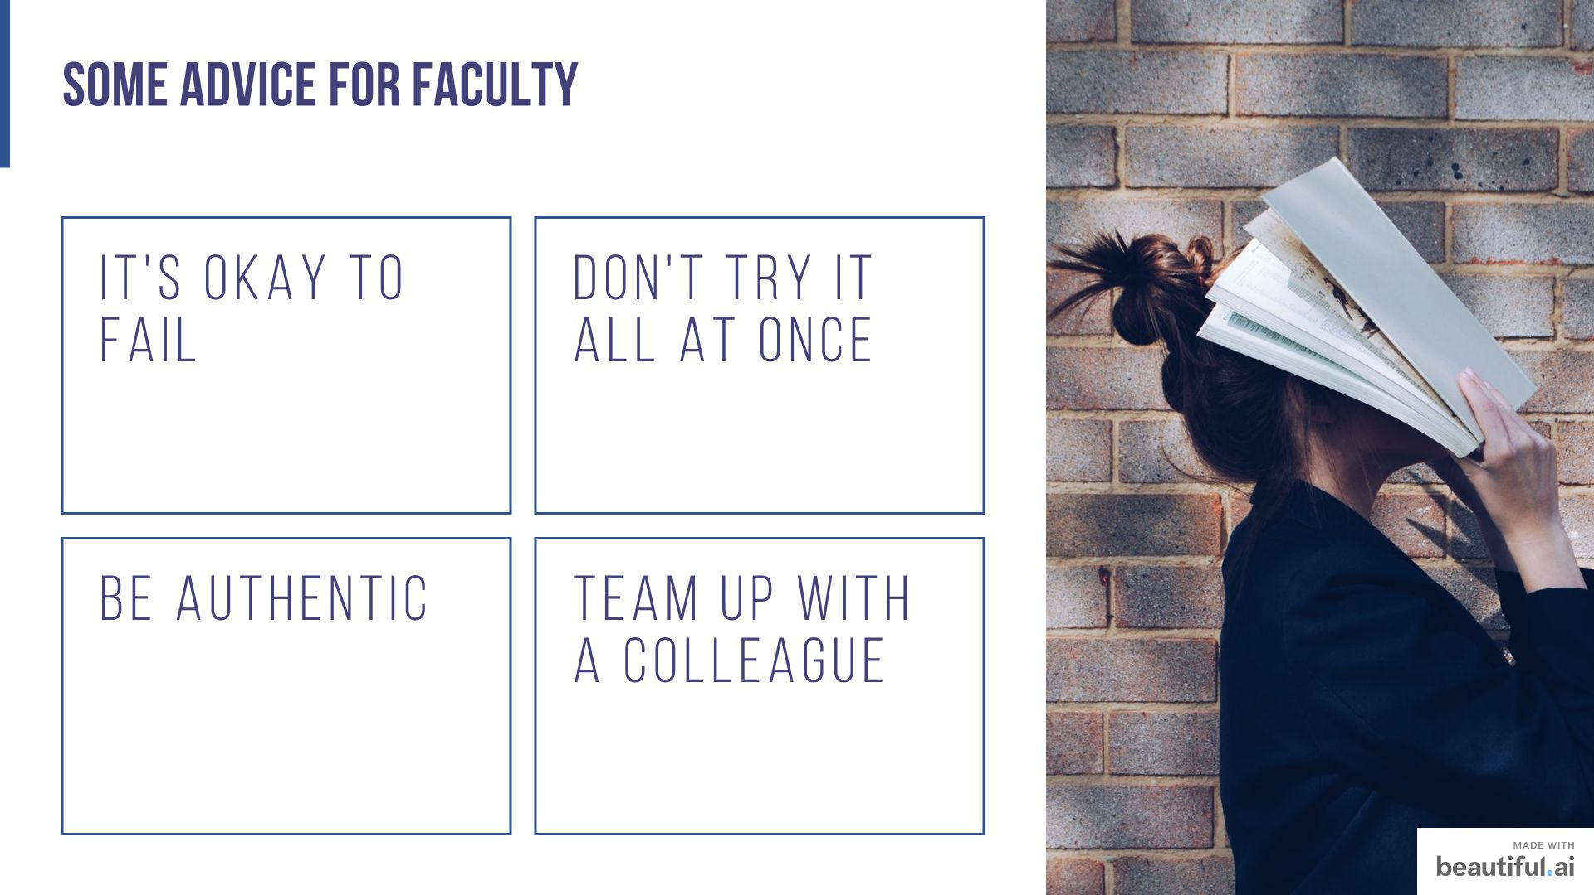

Slide 28


Slide 29
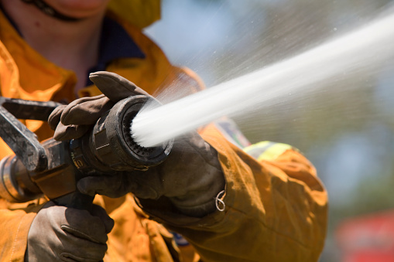
Resources
Banners and Graphics: www.canva.com
Free / Creative Commons images: www.pixabay.com
Bitmoji (Chrome plug-in): Click here
Rubrics in Blackboard Learn: Click here
OER Commons: www.oercommons.org
OpenStax: www.openstax.org
Email our Instructional Design team: elearning.instructionalservices@tccd.edu
Allegra Davis Hanna: allegra.davis@tccd.edu
Use the TEAM: Click here

Slide 30
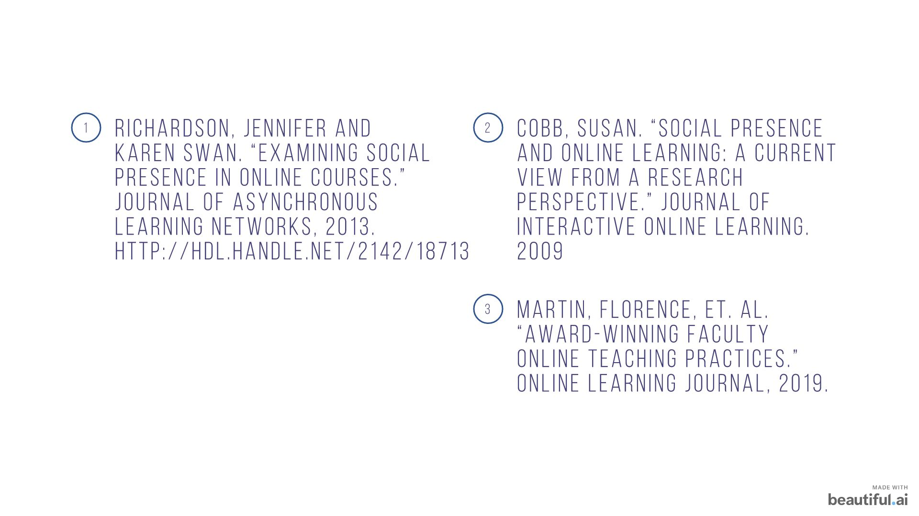

Slide 31
